Slide 1
DOE Office of Science
Early Career Research Program
Linda G. Blevins, Ph.D.
Senior Technical Advisor
Office of the Deputy Director for Science Programs
August 19, 2014
2014 Grants Resource Center
Funding Competitiveness Conference
American Association of State Colleges and Universities
Washington, DC
These slides will be posted for access by the public at:
http://science.energy.gov/sc-2/presentations-and-testimony/

Slide 2
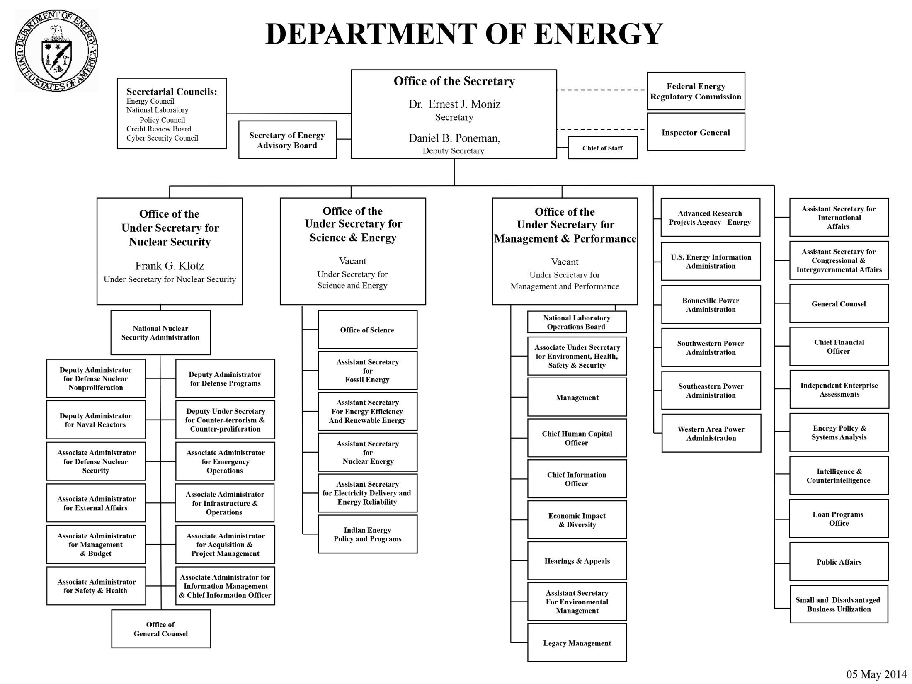

Slide 3
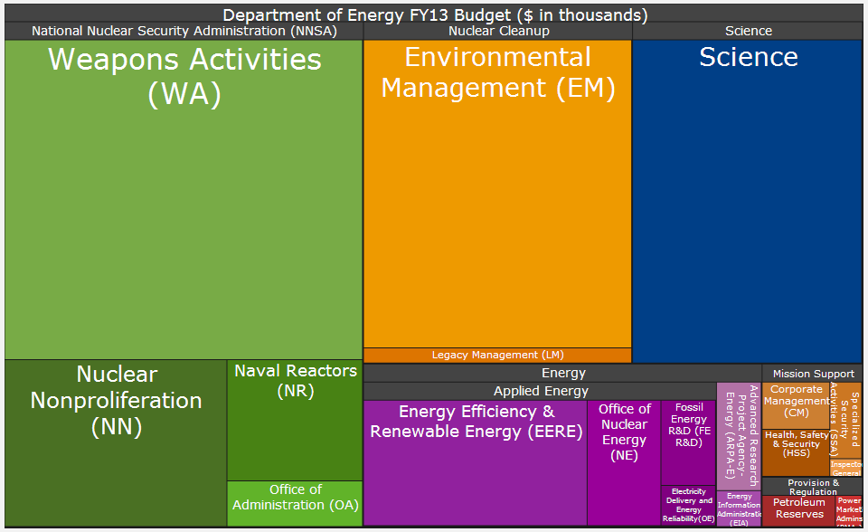
The DOE Portfolio (~$28B Total)
Credit: DOE Office of the Chief Financial Officer
Notes:
Begin with a short intro to DOE

Slide 4
Our Corner of the DOE: The Office of Science
The mission of the DOE Office of Science is to deliver the scientific discoveries and major scientific tools that transform our understanding of nature and advance the energy, economic, and national security of the United States.
The mission is accomplished by funding
  The Frontiers of Science
  The 21st Century Tools of Science
  Science for Energy and the Environment
The Office of Science is the Nation’s largest Federal sponsor of basic research in the physical sciences.
FY14 Budget is ~$5B
Six program offices
  Advanced Scientific Computing Research (ASCR)
  Biological and Environmental Research (BER)
  Basic Energy Sciences (BES)
  Fusion Energy Sciences (FES)
  High Energy Physics (HEP)
  Nuclear Physics (NP)
http://science.energy.gov/

Slide 5
The DOE Office of Science Research Portfolio
Basic Energy Sciences
Understanding, predicting, and ultimately controlling matter and energy flow at the electronic, atomic, and molecular levels
Advanced Scientific Computing Research
Delivering world leading computational and networking capabilities to extend the frontiers of science and technology
Biological and Environmental Research
Understanding complex biological, climatic, and environmental systems
Fusion Energy Sciences
High Energy Physics
Nuclear Physics
Building the scientific foundations for a fusion energy source
Understanding how the universe works at its most fundamental level
Discovering, exploring, and understanding all forms of nuclear matter
http://science.energy.gov/

Slide 6
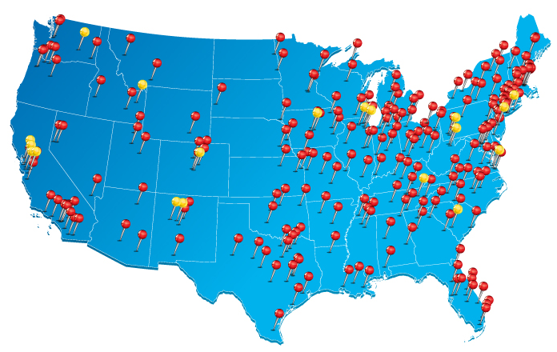
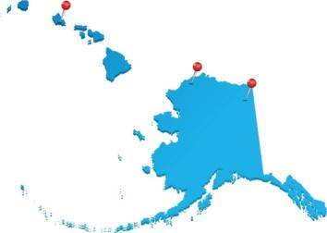
The Office of Science Supports Research
at More than 300 Institutions Across the U.S.
Universities
DOE laboratories

Slide 7
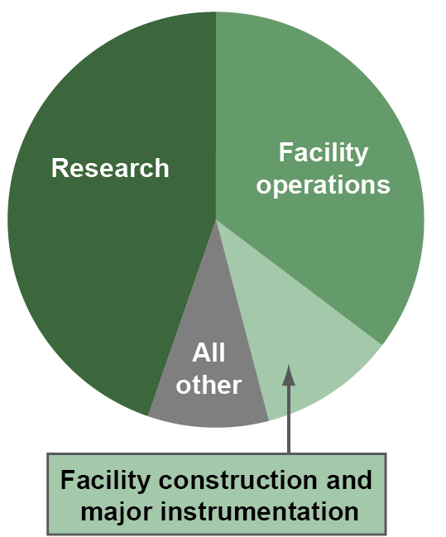
Office of Science Numbers
The Office of Science is a steward for 10 of 17 DOE national labs and operates more than 29 major scientific user facilities.
Approximately 1/2 of the budget supports operations of the scientific user facilities and construction of new facilities; the other 1/2 supports research at the national laboratories and universities.
About 1/3 of SC research funding goes to support grants at more than 300 colleges and universities nationwide.
In FY 2014, SC is supporting ~25,000 Ph.D.s, postdoctoral researchers, graduate students, and undergraduates.
~29,000 users of scientific facilities a year
  ~1/2 of the annual 29,000 facility users come from universities;
  ~1/3 of the users come from DOE national laboratories;
  the remaining come from industry, other agencies, and international entities.
http://science.energy.gov/

Slide 8
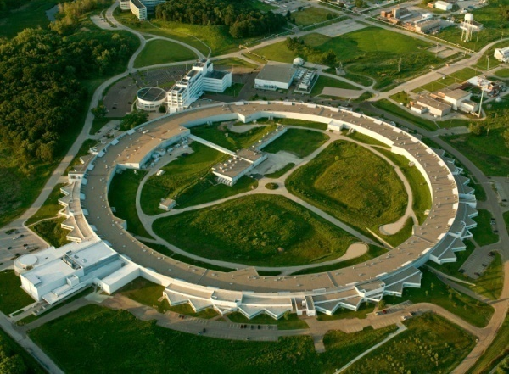
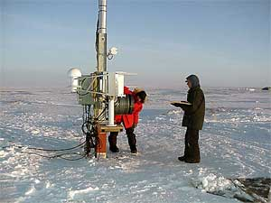
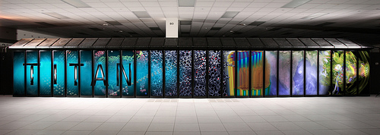
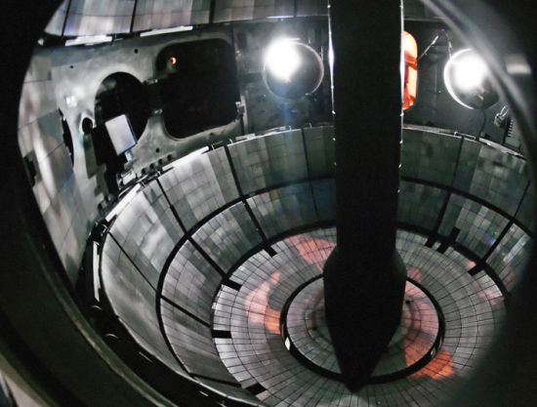
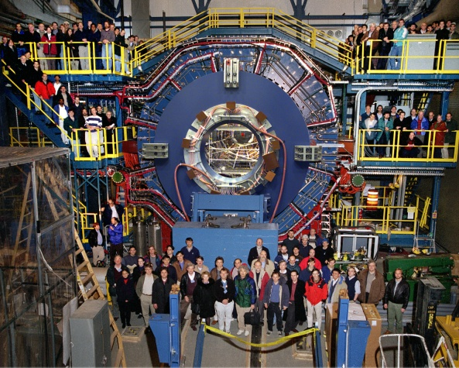
Office of Science User Facilities
> 30 world-leading facilities serving
over 29,000 researchers annually
supercomputers,
high intensity x-ray, neutron, and electron sources,
nanoscience facilities,
genomic sequencing facilities,
particle accelerators,
fusion/plasma physics facilities, and
atmospheric monitoring capabilities.
Open access; allocation determined through peer review of proposals
Free for non-proprietary work published in the open literature
Full cost recovery for proprietary work
http://science.energy.gov/user-facilities/

Slide 9
Early Career Research Program: Purpose
To support the development of individual research programs of outstanding scientists early in their careers and to stimulate research careers in the disciplines supported by the DOE Office of Science.
Proposals are invited in the following program areas:
  Advanced Scientific Computing Research (ASCR)
  Biological and Environmental Research (BER)
  Basic Energy Sciences (BES)
  Fusion Energy Sciences (FES)
  High Energy Physics (HEP)
  Nuclear Physics (NP)
http://science.energy.gov/early-career/

Slide 10
Early Career Research Program: Overview
Universities and national labs eligible
  University grants at least $150,000 per year for 5 years for summer salary & expenses.
  Lab awards at least $500,000 per year for 5 years for full annual salary & expenses
Plan is for about 300 active awards in steady state
  200 university awards & 100 lab awards
Roughly $80M in funding for new and ongoing awards each year
  About 60 new awards (40 university & 20 lab) per year in steady state
Management Principles
  One common solicitation for Office of Science
  Decisions based on peer review with common review criteria
  Reviewed, awarded, and managed locally in the programs
  Program rules governed by the Office of the Deputy Director for Science Programs with advice from a six-member (ASCR, BER, BES, FES, HEP, and NP) coordinating committee
http://science.energy.gov/early-career/

Slide 11
Early Career Research Program: Eligibility
No more than ten (10) years can have passed between the year the Principal Investigator's Ph.D. was awarded and the year of the deadline for the proposal.
DOE National Laboratories
  full-time, permanent, non-postdoctoral employee.
U.S. Academic Institutions
  untenured Assistant Professor or Associate Professor on the tenure track.
An employee with a joint appointment between a university and a DOE national laboratory must apply through the institution that pays his or her salary and provides his or her benefits; the eligibility criteria above must also be met.
http://science.energy.gov/early-career/

Slide 12
Early Career Research Program: Merit Review Criteria
Scientific and/or technical merit of the project.
Appropriateness of the proposed method or approach.
Competency of applicant's personnel and adequacy of proposed resources.
Reasonableness and appropriateness of the proposed budget.
Relevance to the mission of the specific program (e.g., ASCR, BER, BES, FES, HEP, or NP) to which the proposal is submitted.
Potential for leadership within the scientific community.
Strongly Encourage Funding (5-6); Encourage Funding (3-4); or Discourage Funding (1-2).
http://science.energy.gov/early-career/

Slide 13
Early Career Research Program: Special Rules
General Rules:
Preproposals are required.
A full proposal is not allowed if the work proposed in the preproposal is not responsive to the research topics identified in the solicitation.
No co-PIs.
A PI can submit one proposal per competition.
A PI cannot participate more than three times.
No letters of recommendation.
Optional letters of collaboration, if included, must use a template.
For DOE National Laboratories
  A letter from the lab director confirming that the proposed research idea fits within the scope of Office of Science-funded programs at the lab is required.
  Lab scientists must charge at least 50% of their time to the award.
  Execution of funding is at the PI’s discretion according to the approved budget.
  Employing lab addresses funding transition issues when the award ends.
http://science.energy.gov/early-career/

Slide 14
Early Career Research Program: This Year’s Solicitations
DE-FOA-0001170 and LAB 14-1170
Step | Date | Time | Notes
Issue Solicitation: | Jul 30, 2014 |  | mid-summer
Due date for Preproposals: | Sep 11, 2014 | 5 PM Eastern | 6 weeks for PIs to write preproposals
Encourage / Discourage Decisions*: | Oct 9, 2014 | 5 PM Eastern | 4 weeks for DOE to decide
Due date for Proposals**: | Nov 20, 2014 | 5 PM Eastern | 8 weeks for PIs to write proposals
Target Award Start Date: | Jul 15, 2014
*In the past, we have encouraged ~90% of preproposals.
**In the past, we have received proposals for ~80% of the encouraged preproposals.
http://science.energy.gov/early-career/

Slide 15
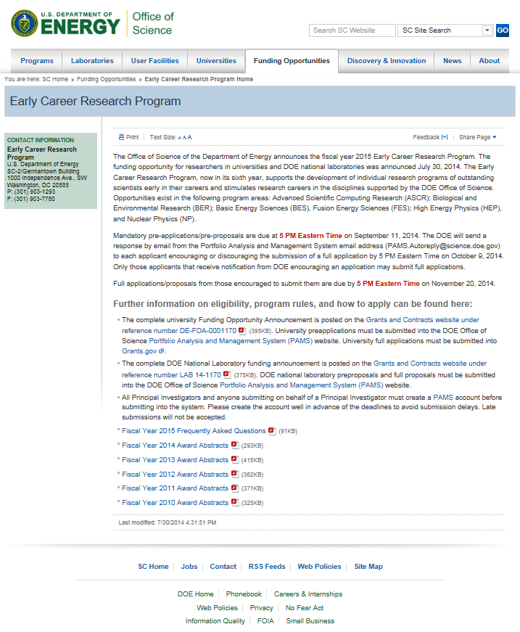
Early Career Research
Program Website
Deadlines
Direct links to announcements
Links to PAMS for submitting preproposal
Frequently Asked Questions (FAQ)
Award abstracts from first five years of the program office
http://science.energy.gov/early-career/

Slide 16
Early Career Research Program: Results
306 awards made over five years.
  204 university awards
  102 DOE National Laboratory awards
Awards made at 14 labs and 92 universities in 37 states.
Percentage women awardees 28%, 26%, 20%, 25%, and 33% in FY14, FY13, FY12, FY11, and FY10, respectively.
Fiscal Year | Number of Proposals Received | Number of Awards Made | Success Rate
FY10 | 1744 | 69 | 4 %
FY11 | 1149 | 69 | 6 %
FY12 | 838 | 68 | 8 %
FY13 | 770 | 65 | 8 %
FY14 | 755 | 38 | 5 %
http://science.energy.gov/early-career/

Slide 17
Early Career Research Program:
Awards by Program Office and Institution Type
Office | Number of University Awards |  |  |  |  | Number of Laboratory Awards
 | FY10 | FY11 | FY12 | FY13 | FY14 | FY10 | FY11 | FY12 | FY13 | FY14
ASCR | 5 | 3 | 3 | 3 | 3 | 2 | 2 | 3 | 2 | 2
BER | 3 | 4 | 6 | 4 | 1 | 3 | 3 | 3 | 3 | 3
BES | 18 | 24 | 21 | 26 | 8 | 8 | 7 | 8 | 5 | 6
FES | 4 | 4 | 1 | 2 | 1 | 2 | 2 | 3 | 2 | 2
HEP | 10 | 8 | 8 | 7 | 3 | 4 | 5 | 4 | 2 | 3
NP | 5 | 4 | 5 | 6 | 2 | 3 | 3 | 3 | 3 | 1
SC | 47 | 47 | 44 | 48 | 18 | 22 | 22 | 24 | 17 | 17
http://science.energy.gov/early-career/

Slide 18
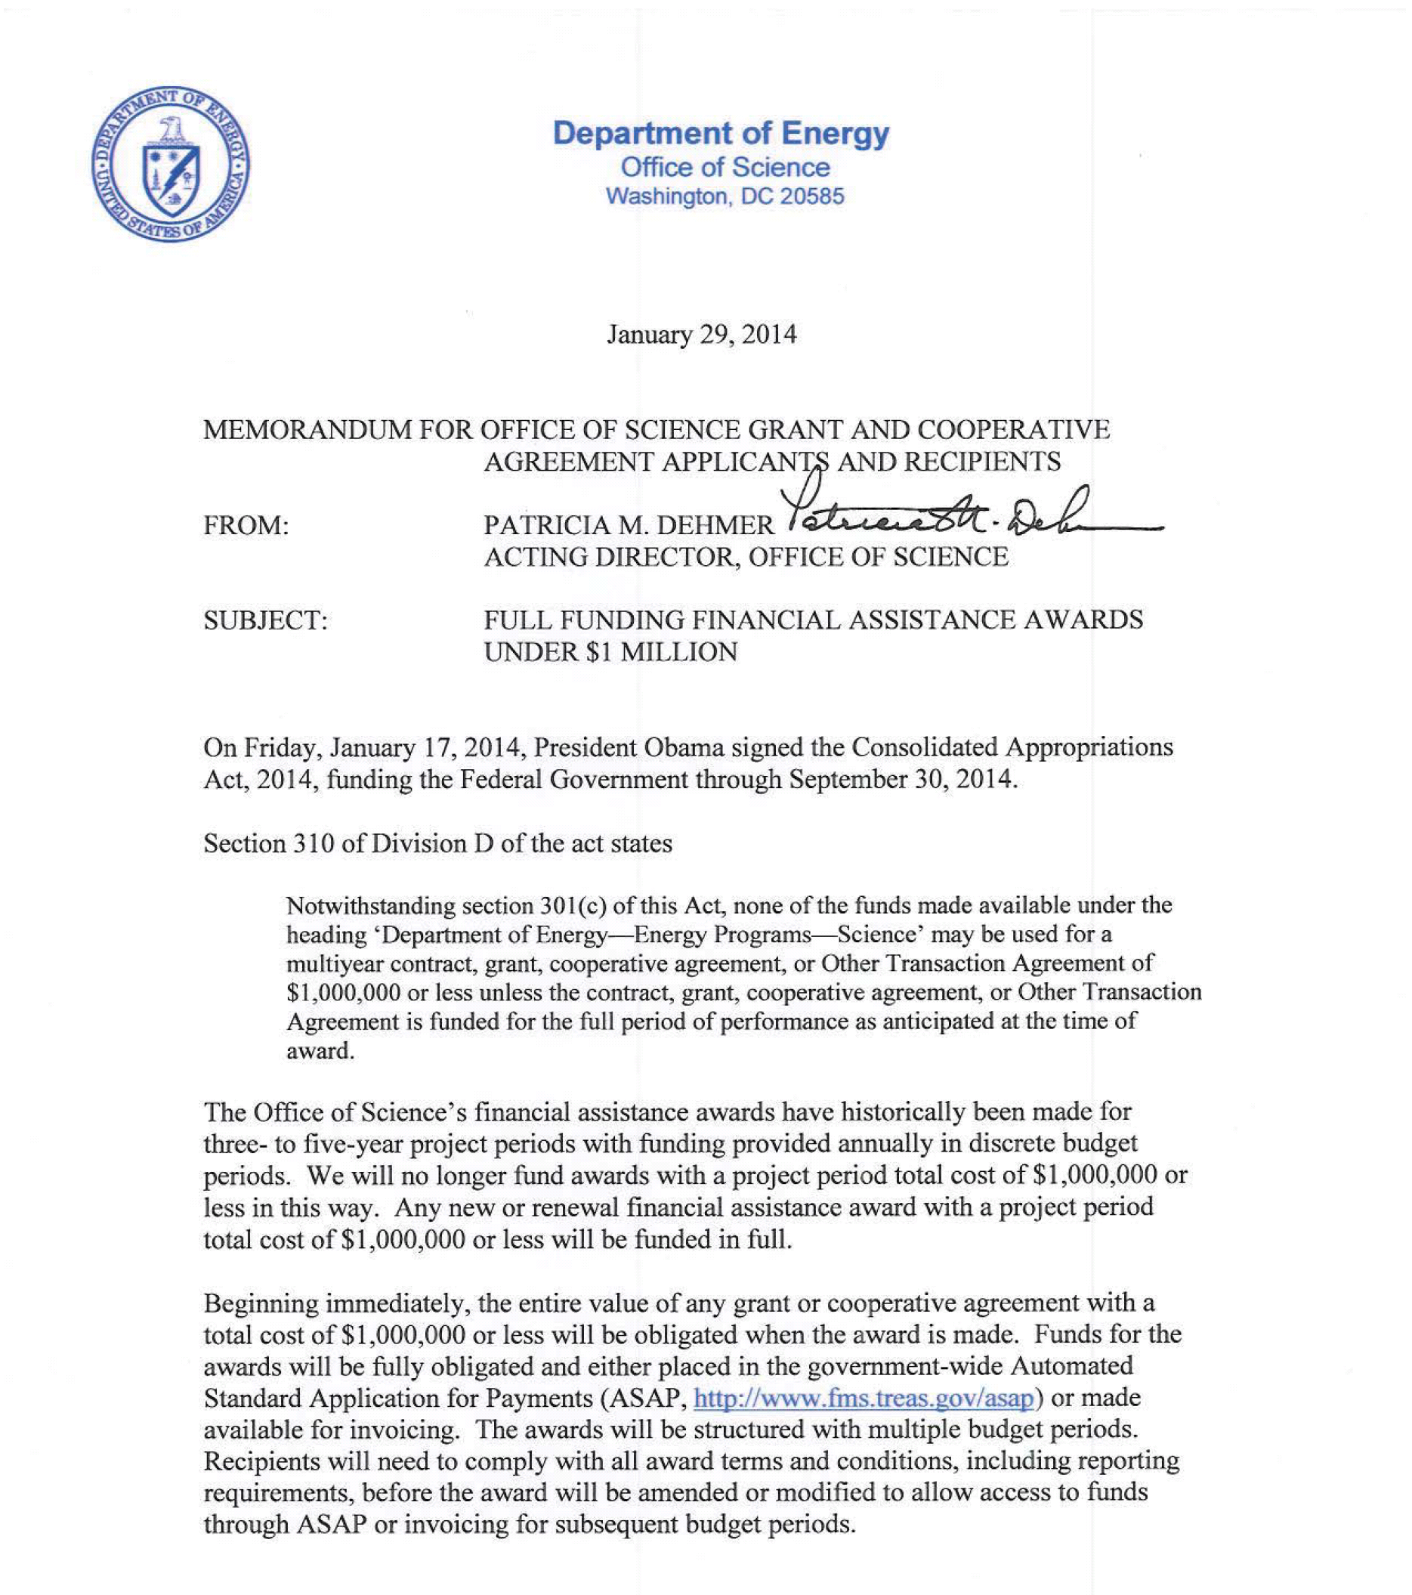
http://science.energy.gov/~/media/grants/pdf/FullFundingMemo.pdf

Slide 19
Office of Science PECASE Process
PECASE = Presidential Early Career Award for Scientists and Engineers
Candidate pool is that of the eligible winners of the Early Career Research Program
External peer review is performed by a cross-disciplinary panel based on two broad criteria defined by the White House
  Innovative research at the frontiers of science and technology that is relevant to the mission of the sponsoring organization or agency.
  Community service demonstrated through scientific leadership, education or community outreach.
Evaluated based on research proposal, expert reviews, and updated C.V.
DOE selects nominees and advances them to the White House, which makes its selections and announces the awards.
No additional financial award is provided beyond already lucrative five years of early career funding.
http://science.energy.gov/about/honors-and-awards/pecase/

Slide 20
Questions about the Early Career Research Program?
Linda Blevins, Ph.D.
301-903-1293
linda.blevins@science.doe.gov
http://science.energy.gov/early-career/

Slide 21
Other Funding Opportunities in the DOE Office of Science
Linda G. Blevins, Ph.D.
Senior Technical Advisor
Office of the Deputy Director for Science Programs
Office of Science
Department of Energy
http://science.energy.gov/

Slide 22
Reminder: Office of Science Portfolio

Slide 23
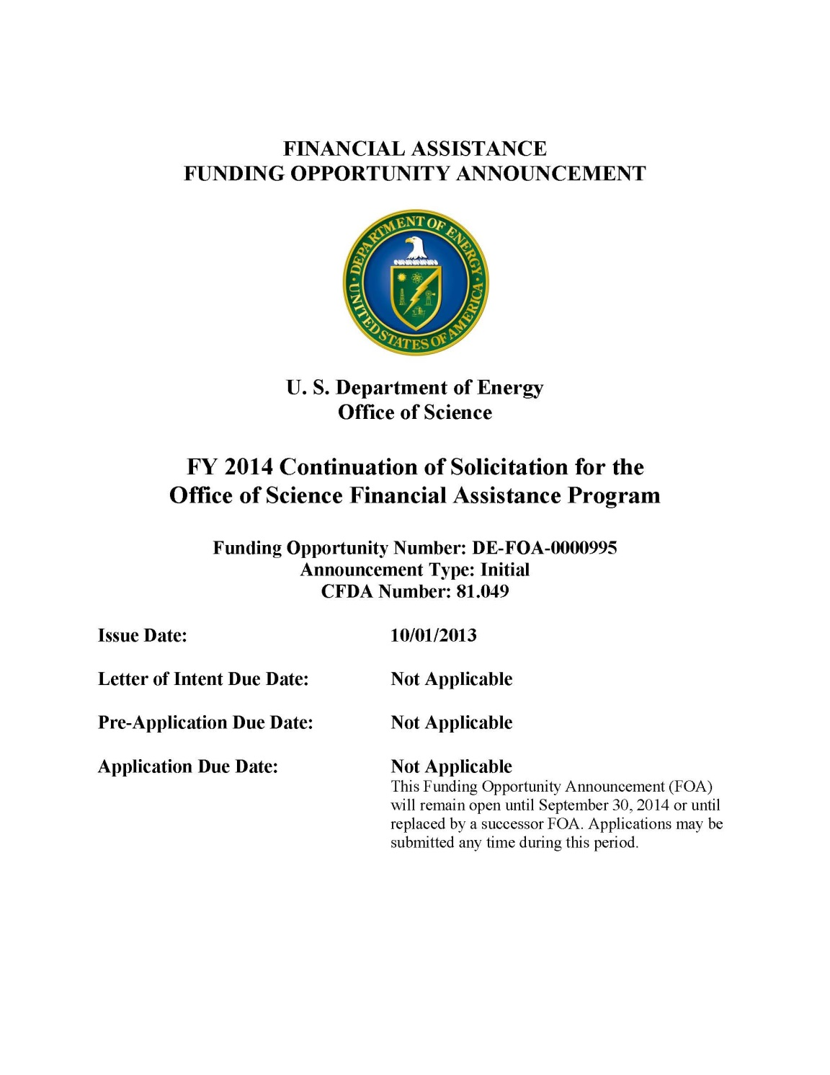
Annual Open Solicitation http://science.energy.gov/grants/foas/open/
Open throughout the year.
Funding Opportunity Announcements can be more specific, too. (The Office of Science issues about 40 FOAs per year.)
Submission is through
Grants.gov.

Slide 24
Recent Examples of Topical Solicitations: Watch science.energy.gov/grants/foas/open/ for future opportunities
Org | Solicitation Name | Solicitation Number | Estimated Funding Available | Issue Date | Closing Date
NP | Research and Development for Next Generation Nuclear Physics Accelerator Facilities | DE-FOA-0001082 | $ 1,870,000 | 2/11/2014 | 4/8/2014 05:00 PM ET
BES | Experimental Program to Stimulate Competitive Research (DOE EPSCoR) Implementation Grants | DE-FOA-0001087 | $ 3,800,000 | 2/14/2014 | 4/15/2014 11:59 PM ET
BES | Scientific Discovery through Ultrafast Materials and Chemical Sciences | DE-FOA-0001089 | $ 4,000,000 | 2/21/2014 | 4/21/2014 05:00 PM ET
FES | SciDAC: Multiscale Integrated Modeling for Fusion Energy Science | DE-FOA-0001096 | $ 1,250,000 | 3/6/2014 | 5/2/2014 05:00 PM ET
ASCR | Analytical Modeling for Extreme-Scale Computing Environments | DE-FOA-0001088 | $ 4,500,000 | 3/10/2014 | 4/18/2014 11:59 PM ET
FES | Theoretical Research in Magnetic Fusion Energy Science | DE-FOA-0001102 | $ 3,200,000 | 3/18/2014 | 6/19/2014 11:59 PM ET
NP | Research, Development and Training in Isotope Production | DE-FOA-0001099 | $ 2,600,000 | 3/28/2014 | 5/23/2014 05:00 PM ET
BER | Atmospheric System Research-New Site Science Opportunities | DE-FOA-0001139 | $ 1,000,000 | 5/23/2014 | 7/31/2014 05:00 PM ET
HEP | FY2015 Research Opportunities in Accelerator Stewardship | DE-FOA-0001142 | $ 10,000,000 | 6/13/2014 | 9/4/2014 05:00 PM ET
NP | Leveraging Isotope Program Resources and Enhancing Facilities for Isotope Production and Research | DE-FOA-0001136 | $ 1,000,000 | 6/13/2014 | 8/1/2014 05:00 PM ET
FES | High-Energy-Density Laboratory Plasma Science | DE-FOA-0001153 | $ 1,000,000 | 7/3/2014 | 10/1/2014 11:59 AM ET
FES | Collaborative Research in Magnetic Fusion Energy Sciences on Long-Pulse International Stellarator... | DE-FOA-0001156 | $ 500,000 | 7/7/2014 | 9/22/2014 11:59 PM ET
HEP | FY 2015 Research Opportunities in High Energy Physics | DE-FOA-0001140 | $ 40,000,000 | 7/22/2014 | 9/23/2014 11:59 PM ET
ASCR | Resilience for Extreme Scale Supercomputing Systems | DE-FOA-0001059 | $ 4,000,000 | 7/28/2014 | 11/3/2014 05:00 PM ET

Slide 25
All research funded at laboratories and universities is awarded through a peer-reviewed, merit-based process.
10 CFR 600:
It is the policy of DOE that discretionary financial assistance be awarded through a merit-based selection process.
Merit review means a thorough, consistent, and objective examination of applications based on pre-established criteria by persons who are independent of those submitting the applications and who are knowledgeable in the field of endeavor for which support is requested.
Each program office must establish a merit review system covering the financial assistance programs it administers.
10 CFR 605:
Program managers perform an initial evaluation of all applications to ensure that the required information is provided; the proposed effort is technically sound and feasible; and the effort is consistent with program funding priorities.
For applications that pass the initial evaluation, program managers use peer review to evaluate them based on criteria specified in 10 CFR 605.

Slide 26
The Office of Science selects reviewers on the basis of professional qualifications and expertise. (10 CFR 605)
The Office of Science obtains about 10,000-12,000 reviews per year.
Reviewers may be selected based on (a few examples):
  Authors of papers references in the proposal
  Cross-references from journal publication databases
  Program manager professional contacts and personal knowledge of the field
  Reviewer publication record and reputation
  Pool of volunteers
  No apparent conflict of interest
Reviewers are volunteers and can come from around the world, from universities, national laboratories, government agencies, industries, nonprofits, etc.
Diversity (of topic, type of institution, demographics, etc.) among reviewers selected for a given proposal or set of proposals is important.

Slide 27
Peer review is the cornerstone of our work.
Funding decisions in the Office of Science are made based on peer review.
  Also used by our user scientific facility directors to allocate time.
Proposals and programs are typically reviewed triennially.
Each proposal receives three or more reviews.
Reviewers must agree that they do not have a conflict of interest before completing the review.
Reviewer identity and review contents are confidential; anonymous reviews are returned to the Principal Investigator.
Proposals are reviewed generally within 6 months and no longer than 12 months from the date of receipt.

Slide 28
Common review criteria are used. (10 CFR 605)
Scientific and/or technical merit of the project;
Appropriateness of the proposed method or approach;
Competency of applicant's personnel and adequacy of proposed resources;
Reasonableness and appropriateness of the proposed budget; and
Other appropriate factors, established and set forth in a notice of availability or in a specific solicitation.
For renewals and continuations, program managers also consider performance under current award.

Slide 29
The review method varies according to need.
Mail Review
  Generally used for the open solicitation, when proposals arrive throughout the year.
  Reviews trickle in over time.
  Reviewers are generally given six weeks to return the review.
  Reviewer identity kept confidential.
Panel Review
  Used for targeted solicitations when many proposals arrive simultaneously.
  Multiple panels of 5-15 people apiece convene and submit reviews; the total number of panelists at a given time can be in the hundreds.
  Each panelist provides his/her own input.
  Reviewer identity kept confidential.
Site Visit or “Reverse Site Visit”
  Generally used for large, group programs such as national laboratory efforts, large facility competitions, etc.
  Researchers make presentations to site visit reviewers.
  The site visit team may interact with and ask questions of the investigators.
  The site visit team members submit independent reviews to DOE.

Slide 30
Expert federal program managers recommend proposals for funding.
Our federal program managers generally hold science doctorates and are experienced researchers.
The Office of Science employs about 150 federal program managers, all stationed in Germantown, Maryland.
Program managers stay current and connected in science.
  Have access to the Web of Science and full text articles of important journals
  Host and attend workshops
  Host regular meetings of Principal Investigators with invited speakers and attendees
  Attend conferences (within travel budget allowance)
  Converse with the leaders in the field frequently
  Organize and attend peer review panels and site visits, where they listen to debate
External experts from national laboratories and universities rotate and bring fresh perspectives.
Merit review is advisory and does not replace the authority of the program manager or contracting officer.
Program managers consider peer review, funding availability, and programmatic fit to recommend awards to the contracting officers, who make the final decisions.
Program manager decisions are reviewed by committees of visitors at regular intervals.

Slide 31
Committees of Visitors evaluate how well we execute peer review.
The quality of the peer review process as well as the standing of each research portfolio is evaluated every three years by external experts from the scientific community who come together to form Committees of Visitors (COV).
Every three years, a COV is asked to
  Assess the efficacy and quality of the process used to solicit, review, recommend, and document proposal actions and to monitor active awards, projects, and programs.
  Comment on the breadth and depth of portfolio elements and the national and international standing of the portfolio.
Guidance documents, COV reports, and program responses are archived:
http://science.energy.gov/sc-2/committees-of-visitors/

Slide 32
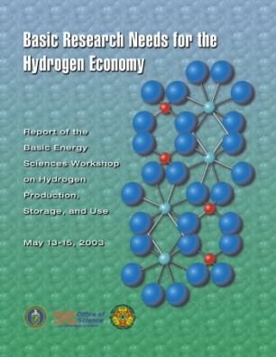

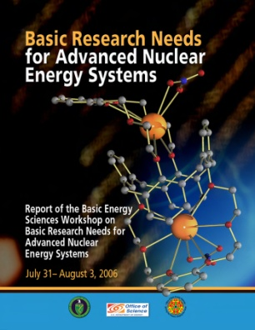
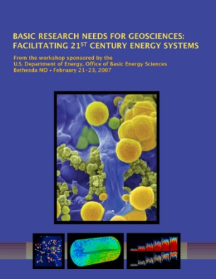

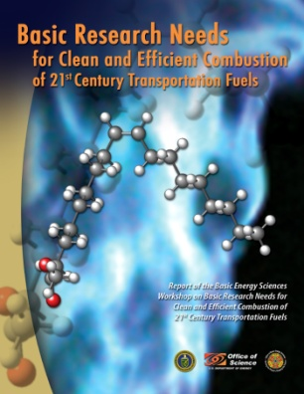




The Office of Science develops programs and plans within the context of the DOE mission and in concert with the science community.
Research areas are identified using federal advisory committees, program and topical workshops, interagency groups, National Academies’ studies, and open and targeted solicitations.

Slide 33
University researchers can become involved in many ways.
Read about the core research areas on our websites and contact program managers to discuss whether your ideas fit within their programs.
Volunteer to become a reviewer or participate in a workshop.
Incorporate our large scientific user facilities into your research. Apply to compete for time at one of them.
Follow federal advisory committee meetings.
Respond to open and topical solicitations.

Slide 34
Office of Science Statement on Digital Data Management
All proposals submitted to SC for research funding
will be required to include a Data Management Plan
Requirements will be included in all solicitations for research funding starting Oct. 1st, 2014. This includes the Annual FOA.
Detailed requirements and further information on:
  Suggestions for what to include in a Data Management Plan
  Supplemental guidance and requirements from SC Program Offices
  Links to information about data management resources at SC user facilities
  Definitions of key terms
  FAQs
http://science.energy.gov/funding-opportunities/digital-data-management/
Now
Live!

Slide 35
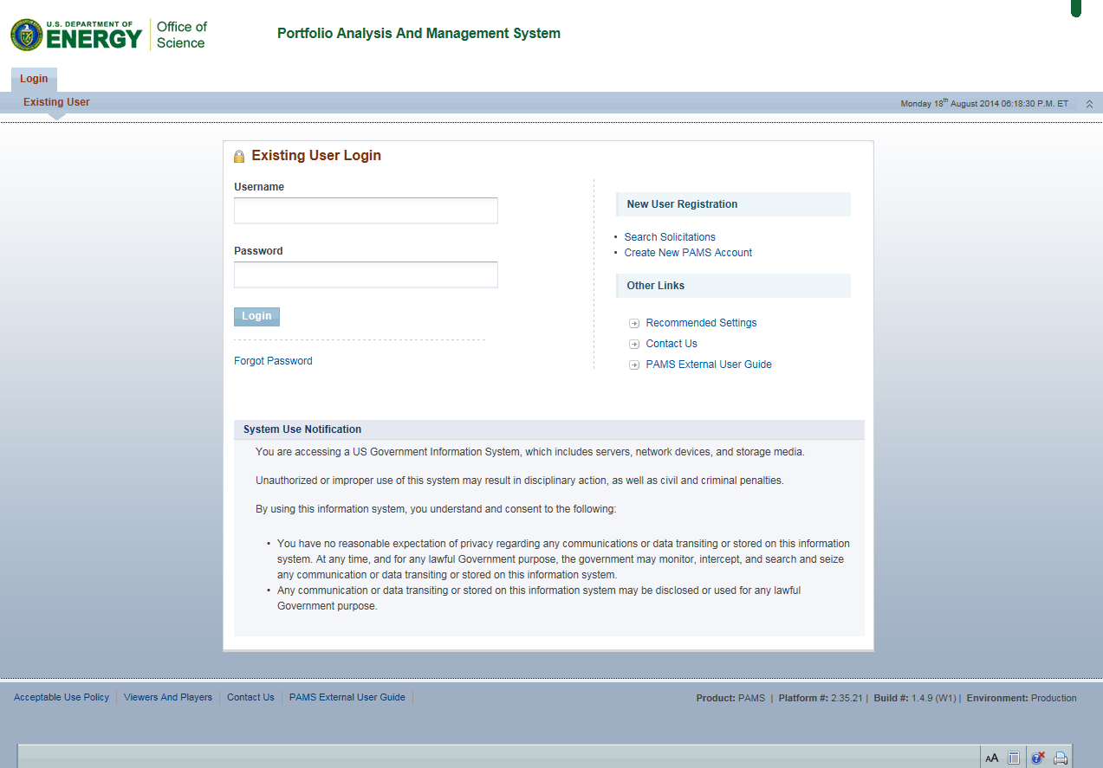
Portfolio Analysis and Management System (PAMS)
https://pamspublic.science.energy.gov/

Slide 36
Questions about Other Office of Science funding opportunities?
Linda Blevins, Ph.D.
301-903-1293
linda.blevins@science.doe.gov
http://science.energy.gov/

