Slide 1
DOE Office of Science Graduate Fellows Meeting
30 July 2012
A Few Facts about DOE and Energy
And, featuring, “How to Buy a Light Bulb”
Dr. Patricia M. Dehmer
Deputy Director for Science Programs
Office of Science, U.S. Department of Energy
http://www.science.energy.gov/sc-2/presentations-and-testimony/

Slide 2
The Department of Energy

Slide 3

DOE and its predecessors—and the formation of major labs
1942-1946 Manhattan Project, War Department Army Corps of Engineers
  Wartime weapons development
  Foundations of first DOE multi-purpose national labs
1946-1974 Atomic Energy Commission created by the 1946 Atomic Energy Act (P.L. 79-585)
  Research in basic nuclear processes, nuclear reactor technologies, use of nuclear materials for variety of purposes
  Establishment of 9 of the 10 DOE/SC national labs
1974-1977 Energy Research and Development Administration, a new energy R&D agency motivated by Arab oil embargo and created by (P.L. 93-438)
  Research expands to include solar, fossil, geothermal, synthetic fuels, transmission, conservation, etc.
1977-present Department of Energy (P.L. 95-91)
  Separation of management oversight of weapons and non-weapons labs and separation of basic and applied research
  DOE/SC labs undergo transition to “open” labs with 1000s of visitors/users annually

Slide 4
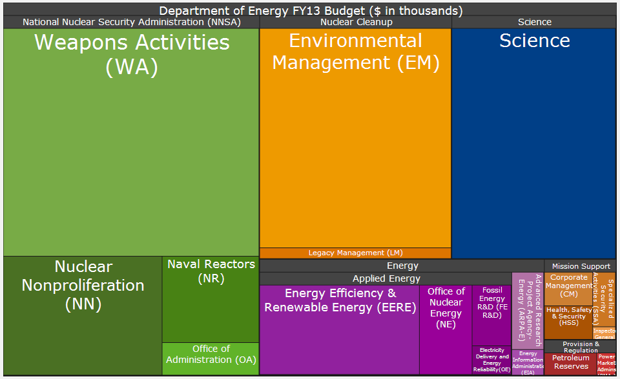
The DOE Portfolio Today
Area map of the FY 2013 budget request to Congress ($27.2B)
Notes:
Begin with a short intro to DOE

Slide 5
DOE’s Office of Science

Slide 6
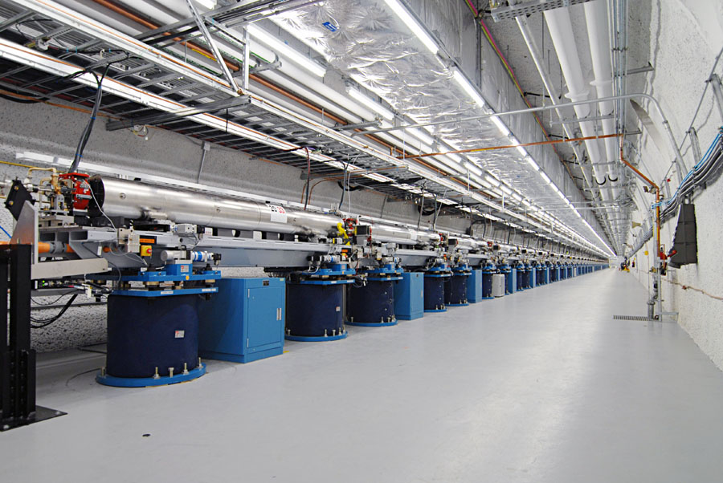
DOE’s Office of Science, by the Numbers
  $5B budget, supporting:
  25,000 Ph.D. scientists, graduate students, under-graduates, engineers, and technical staff at more than 300 institutions in all 50 States and DC through competitive awards
  26,000 users at 32 national scientific user facilities
  100 Nobel Prizes during the past 6 decades—more than 20 in the past 10 years
The undulator hall at the Linac Coherent Light Source, SLAC, 2011.

Slide 7
The Budget for Research and Facilities in the Office of Science
All Other
Funding = $5B
Major Items of Equipment
  Support for 25,000 Ph.D.s, grad students, undergrads, engineers, and support staff
Facility Construction
Research
  The world’s largest collection of scientific user facilities with over 26,000 users /yr
Facility Operations

Slide 8
Facilities and the evolution of DOE/SC labs

Slide 9
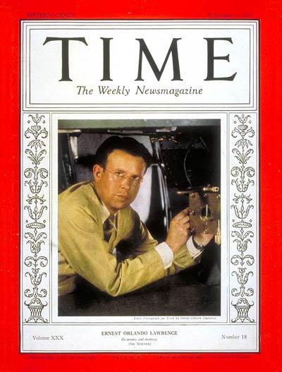
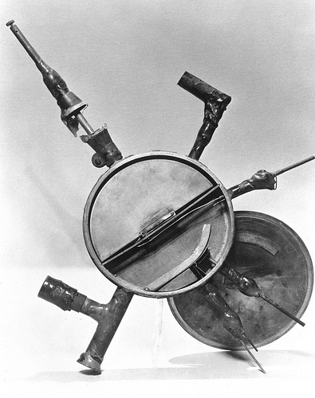
Origins of Accelerator Science in
(the Earliest Predecessor of) the Office of Science
Ernest O. Lawrence
November 1, 1937
Lawrence’s original
5-inch cyclotron, 80 keV, 1931

Slide 10
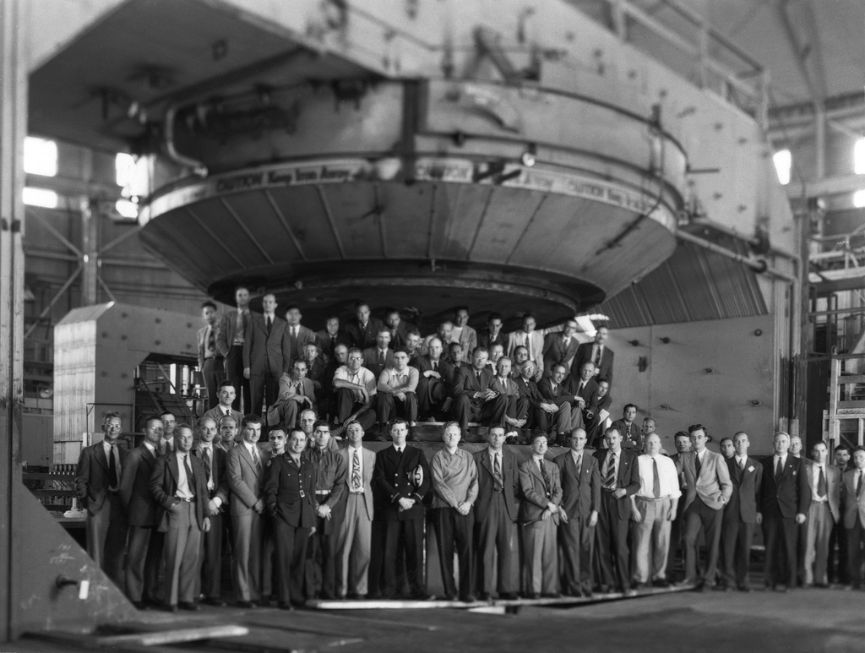
After several intermediate sizes came the 184-inch cyclotron …
184-inch cyclotron, > 100 MeV, 1946

Slide 11
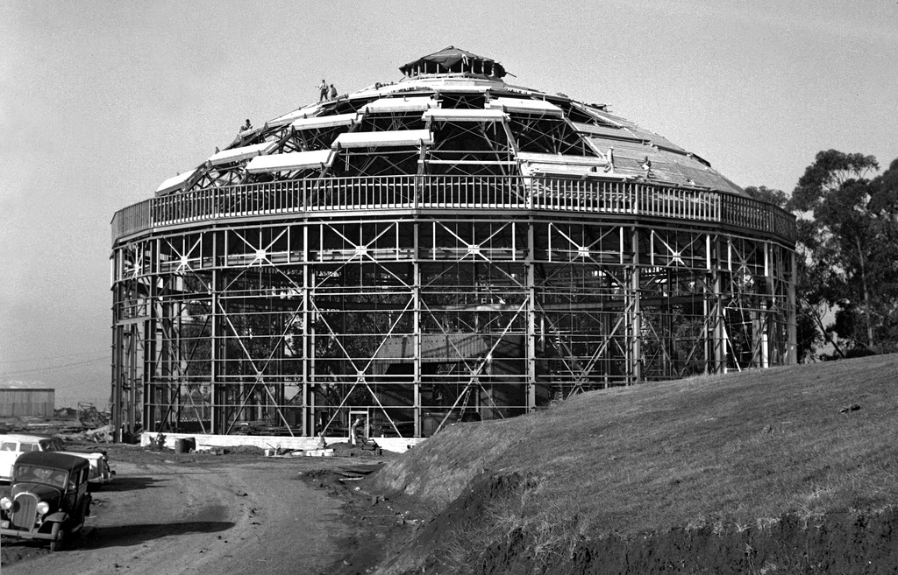
... housed in its own designer building at LBNL , c 1941.
The building to house the 184-inch cyclotron was designed by Arthur Brown, whose works included San Francisco’s City Hall, Opera House, and Coit Tower. (1941)

Slide 12
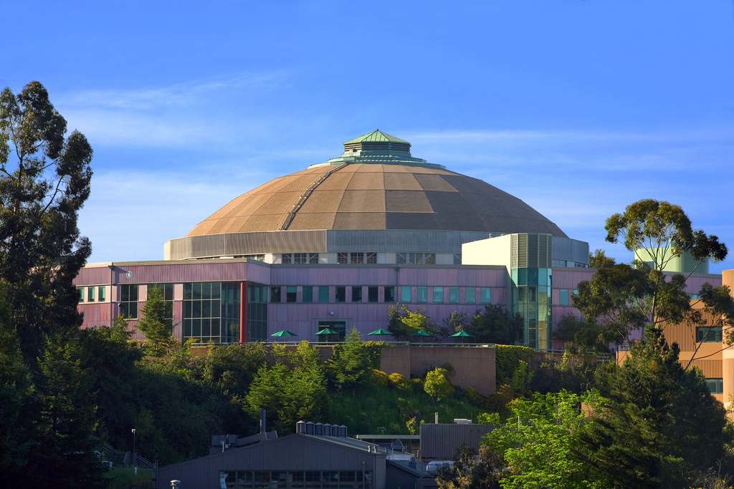
This building now houses the Advanced Light Source, commissioned 1993.

Slide 13
Big Science at the 10 DOE/SC labs in their Earliest Days
1931 LBNL E.O. Lawrence and the cyclotron at the “Rad Lab”
1943 ORNL Nuclear reactor technology
1946 ANL Nuclear reactor technology
1947 AMES High-purity uranium production; heavy-element chemistry
1947 BNL Construction/operation of large facilities for NE universities
1951 PPPL Magnetic fusion research
1962 SLAC (Electron) accelerator technology; particle physics research
1965 PNNL Independent R&D associated with the Hanford site
1967 FNAL (Proton) accelerator technology; particle physics research
1984 TJNAF (Electron) accelerator technology; nuclear physics research

Slide 14
The formation of Brookhaven National Lab
BNL Construction/operation of large facilities for NE universities
  In 1946, Columbia, Cornell, Harvard, Johns Hopkins, MIT, Princeton, U. Pennsylvania, U. Rochester, and Yale formed a nonprofit corporation to establish a new nuclear-science facility.
  They chose a surplus army base “way out on Long Island” as the site.
  BNL was conceived
      to design, construct and operate large scientific machines that individual institutions could not afford to develop on their own and
      to promote basic research in the physical, chemical, biological and engineering aspects of the atomic sciences.

Slide 15
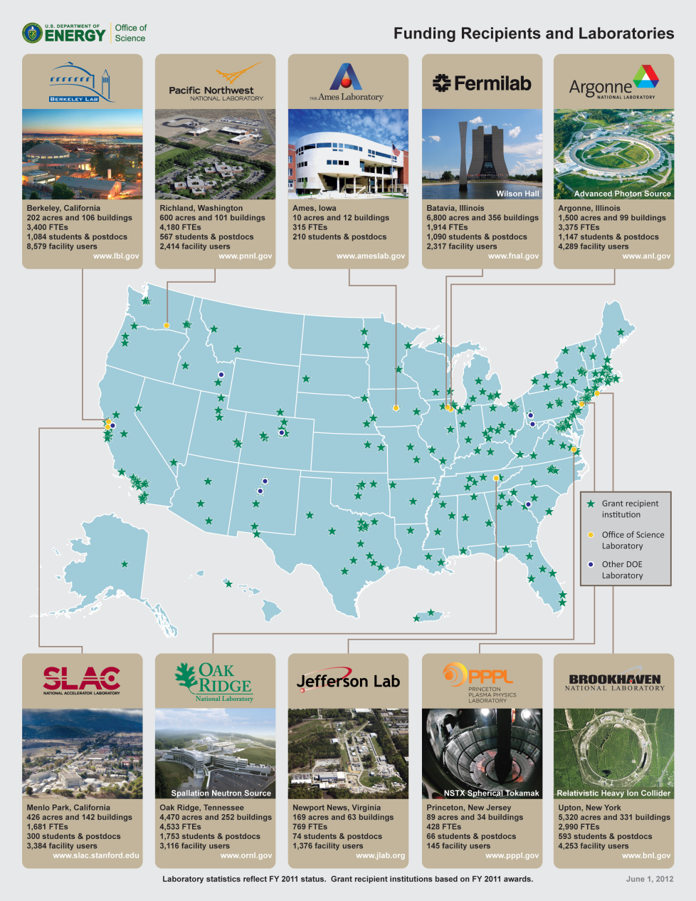
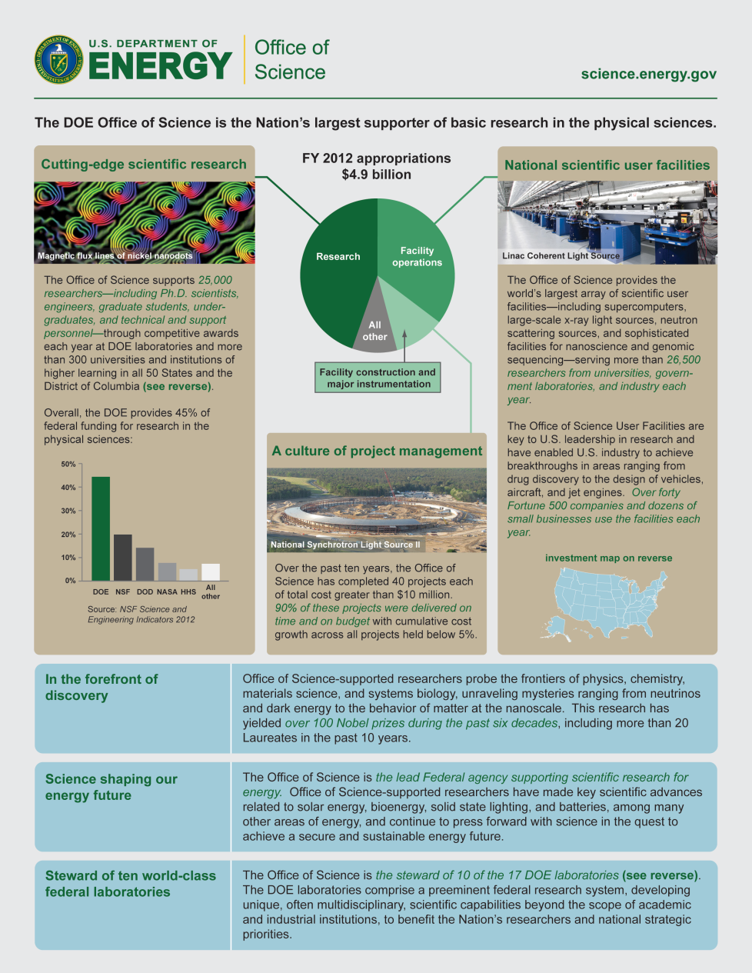
Our SC Quick-Facts Handout, 2012

Slide 16

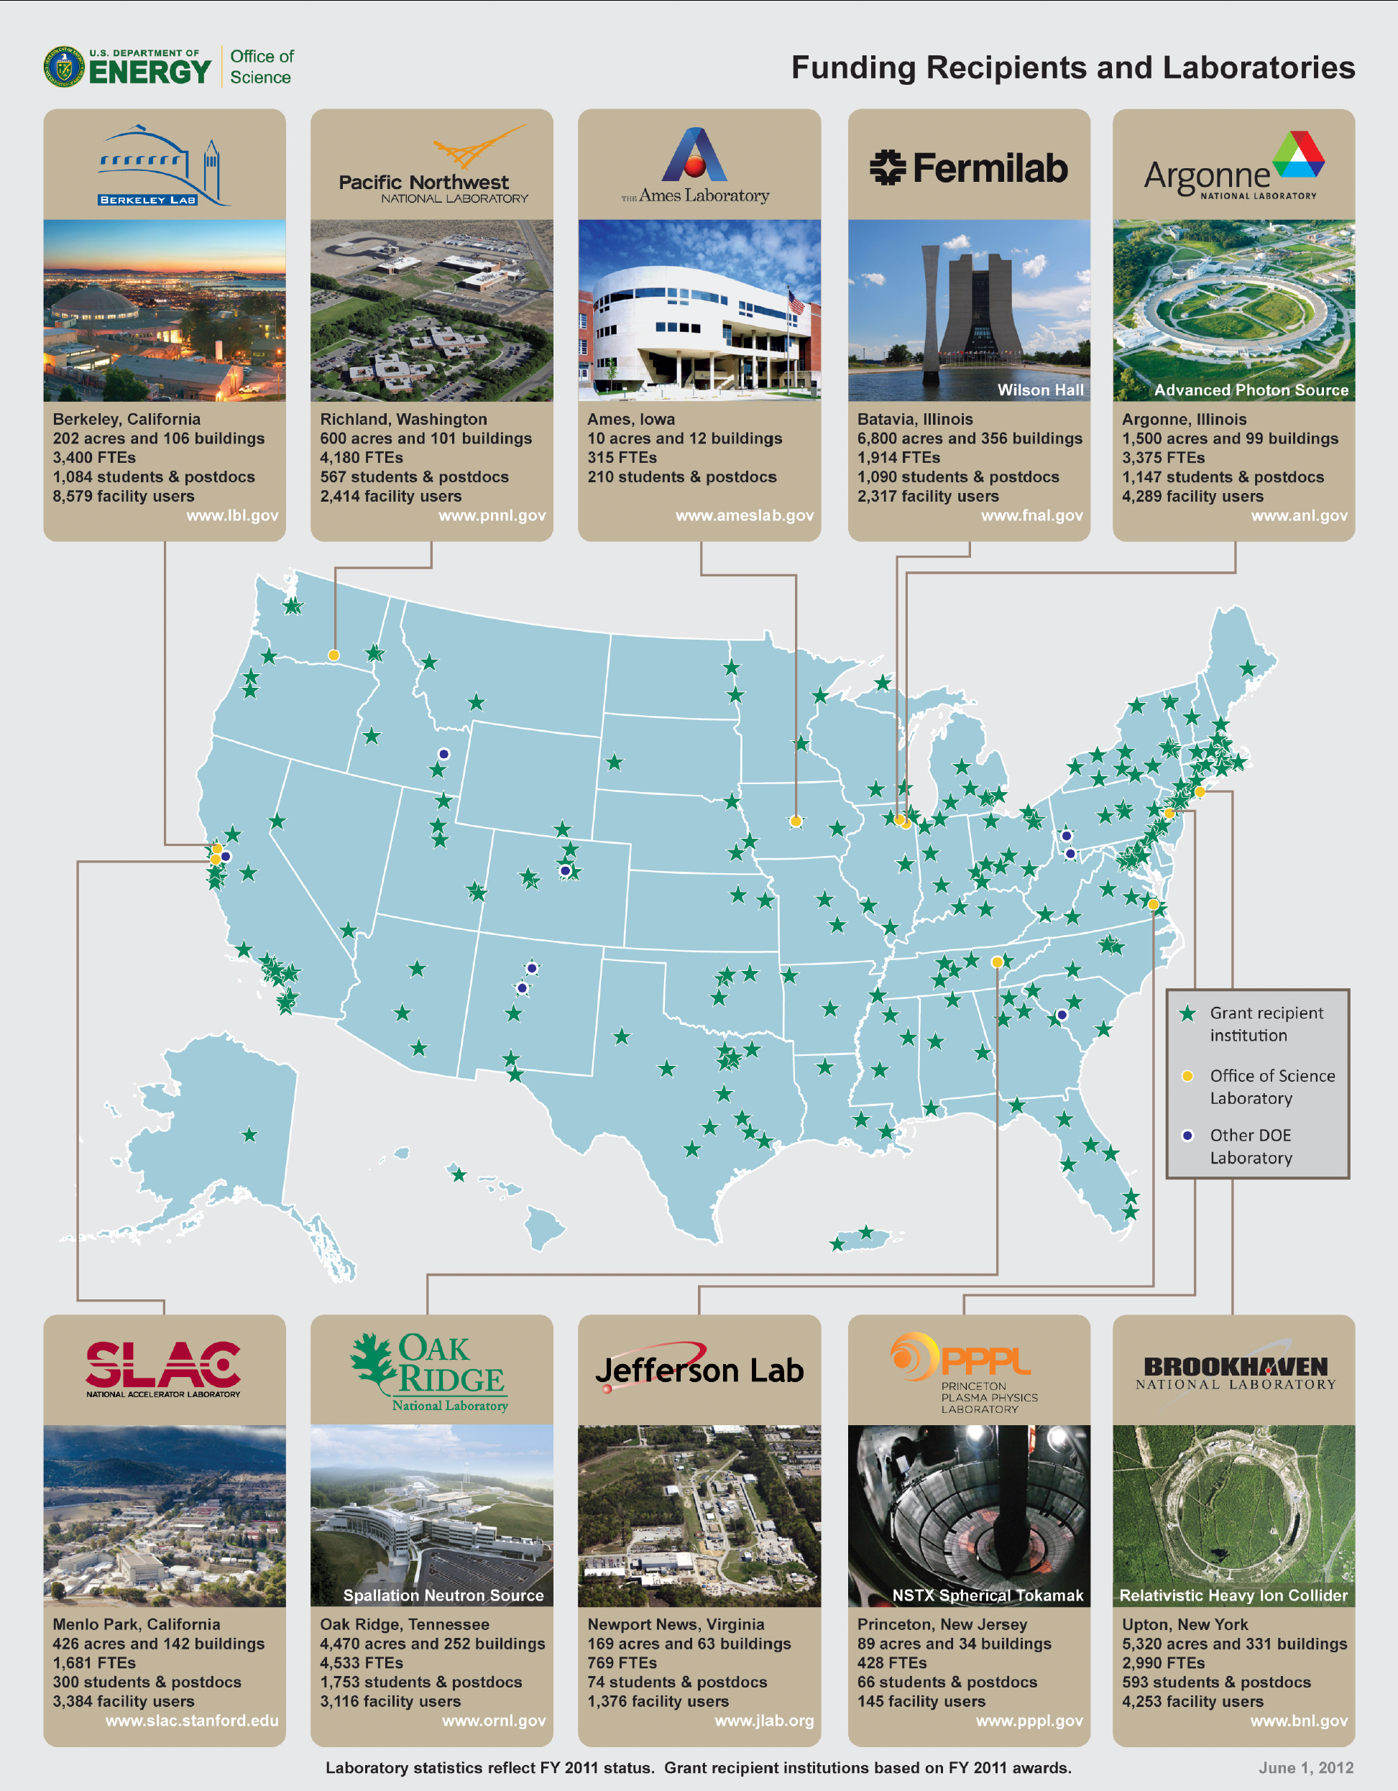
The DOE/SC Labs Today – User Facilities Us

Slide 17
A Review: “Big Science” and the SC Labs
“Big science,” born at the Labs during and after WWII, begat the suite of Office of Science national user facilities.
These facilities transformed the nature of the labs, opening them to thousands of external users, many of whom are nonspecialists or novice users.
Today, stewardship of the facilities and their users is a defining characteristic of the Office of Science.
According to Wiki, big science = big budgets, big staffs, big machines, and/or big laboratories

Slide 18
Users Come from all 50 States and D.C.
Alcator
DIII-D
NSTX
ARM
SSRL
JGI
EMSL
FES
ALS
ATLAS
Bio & Enviro
Facilities
HRIBF
TJNAF
Nuclear physics
facilities
APS
RHIC
Light Sources
B-Factory
High energy physics facilities
Tevatron
ALCF
Computing
Facilities
Neutron Sources
NSLS
OLCF
Nano
Centers
LCLS
HFIR
Lujan
NERSC
SNS
NSRCs

Slide 19
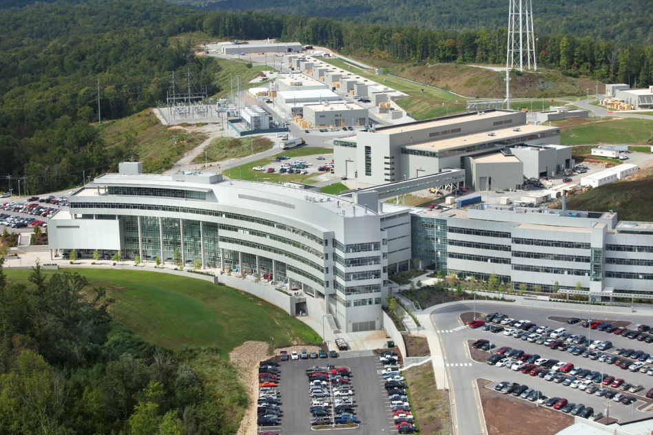
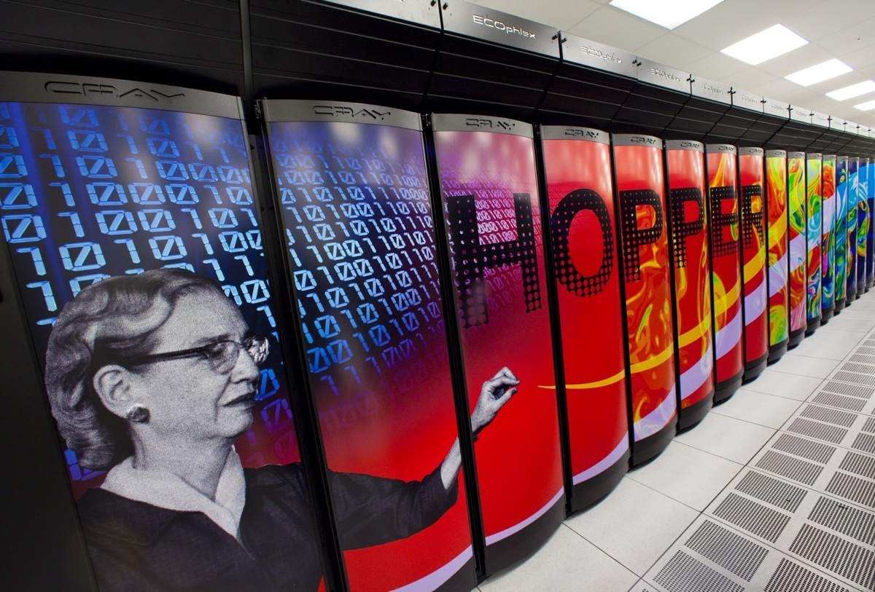
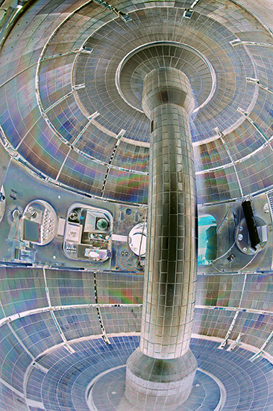
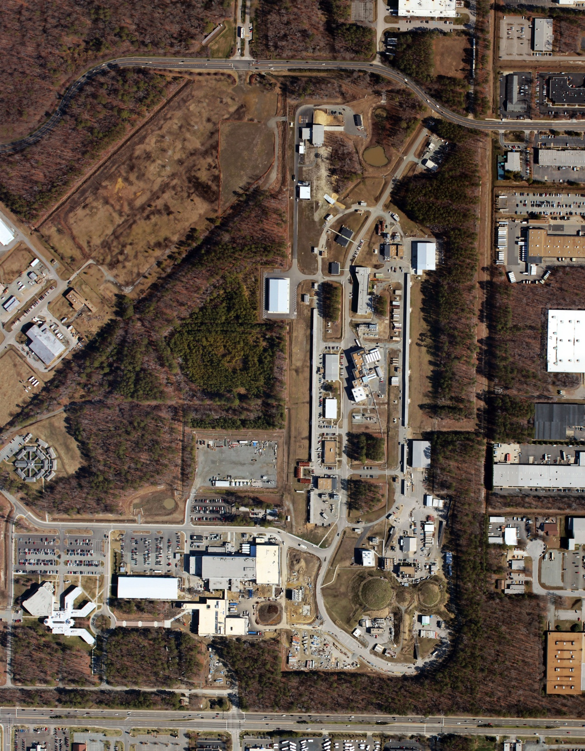
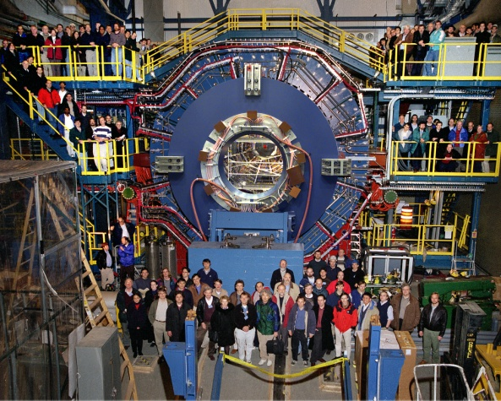
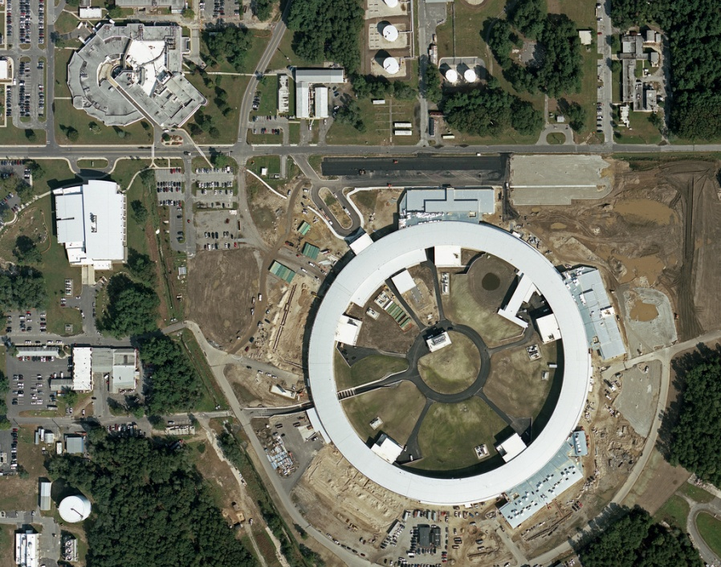
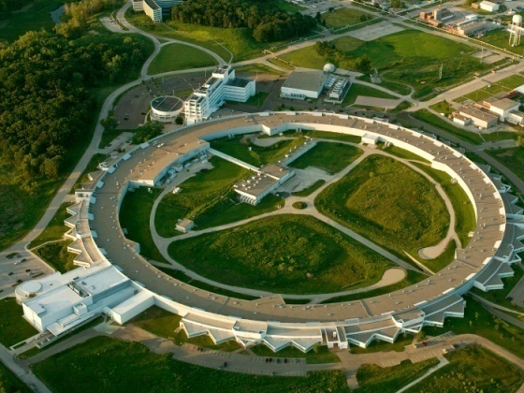
Some of the 32 Office of Science User Facilities
NSLS
NSLS-II
SNS ORNL; NERSC Computing Center, LBNL; NSTX, PPPL; STAR Detector, RHIC, BNL; APS, ANL; CEBAF, TJNAF; NSLS-II, BNL,

Slide 20
The Energy Challenge

Slide 21
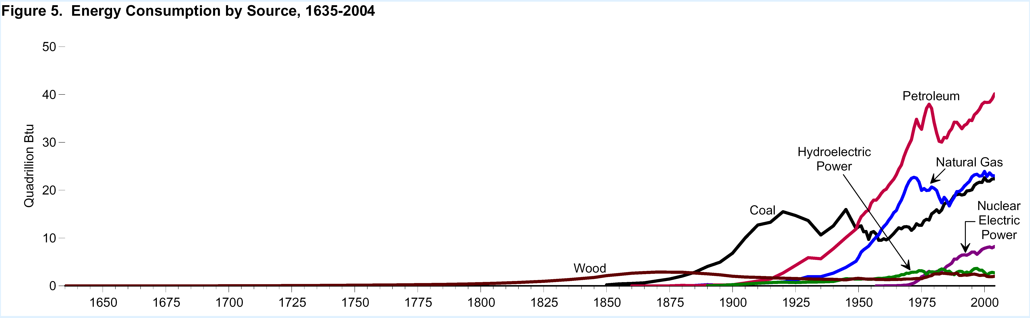
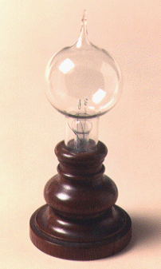
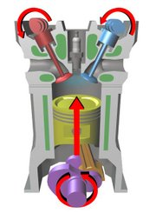
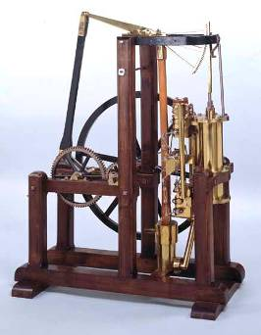
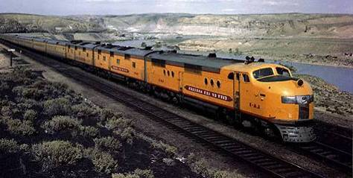
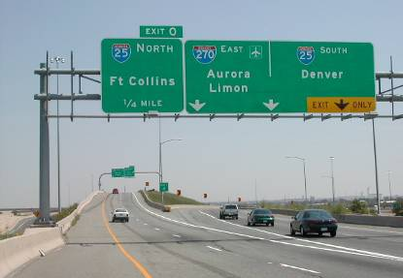
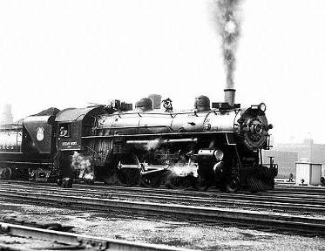
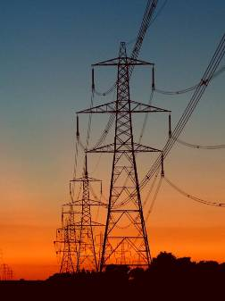
400 Years of Energy Use in the U.S.
19th C discoveries and 20th C technologies are very much part of today’s infrastructure
Still ~85% reliant on fossil fuels
40
Petroleum
40
U.S. Energy Consumption by Source
30
30
Hydroelectric
Power
Natural Gas
Quadrillion Btu
Quadrillion Btu
20
20
Coal
Nuclear Electric Power
Incandescent lamp,
1870s
Four-stroke combustion engine, 1870s
10
10
Wood
Watt Steam Engine, 1782
0
0
1650
1700
1750
1800
1850
1900
1950
2000
Rural Electrification Act,
1935
Intercontinental Rail System, mid 1800s
Eisenhower Highway System, 1956

Slide 22
Sustainable Energy = High Tech Materials
Materials, Chemical Transformations, & Biology by (Computer-Aided) Design
Today
Gas CH₄
Oil CH₂
Coal CH_{0.8}
useful work
combustion
heat
Disposable fuels
Commodity materials
Future
direct conversion
Sunlight
Wind
Water
Geothermal
Biomass
+
Storage
Transmission
CCS
Efficiency
Electricity
and
fuels
useful work
High-tech materials, chemistry, biology, e.g., for photovoltaics, electrodes and electrolytes, smart membranes, separators, superconductors, catalysts, fuels, sensors, and novel piezoelectrics
22

Slide 23
Banishing fear of
energy discussions

Slide 24
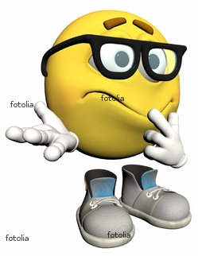
Fear of Too Many Energy Units
BTU .. quad .. boe .. bboe .. toe .. tce .. Joule .. therm .. thermie .. calorie ..
“quads”
“toe”

Slide 25
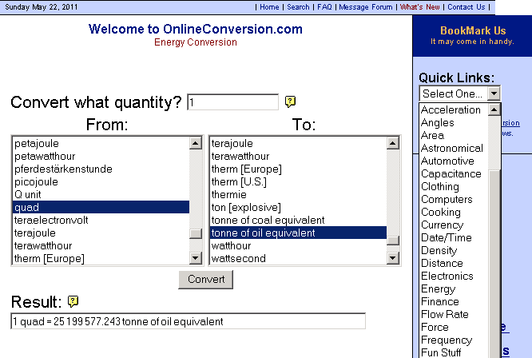
On-Line Energy Conversion Calculators Banish Fear of Units

Slide 26

Fear of Too Many Facts

Slide 27
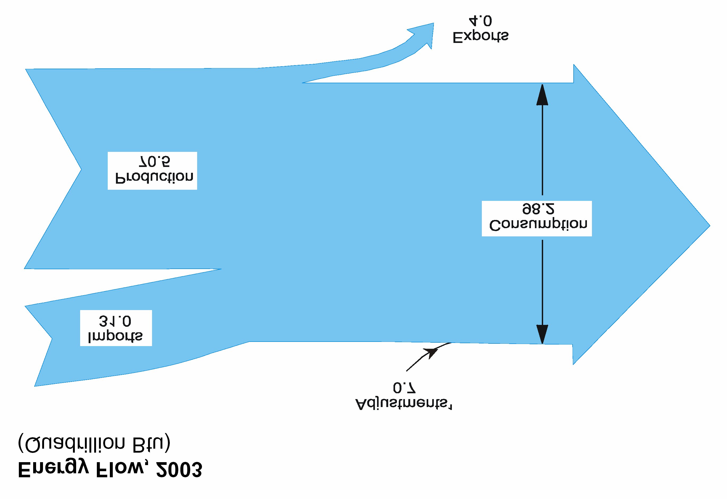

Energy sources and consumption sectors in the U.S.

Slide 28
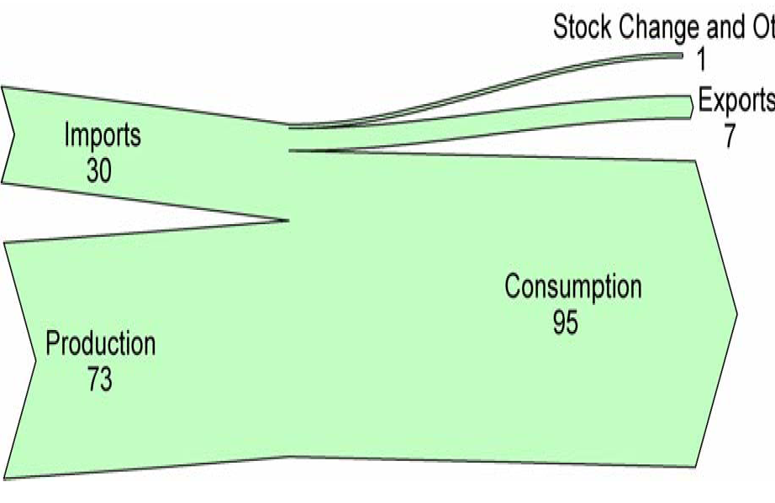
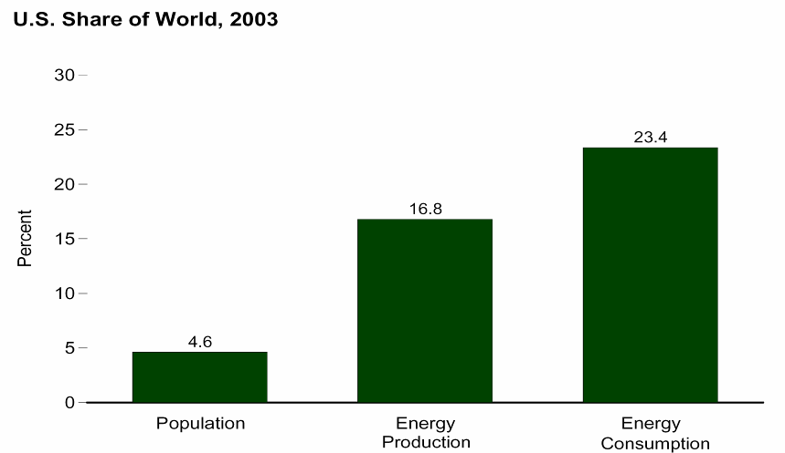
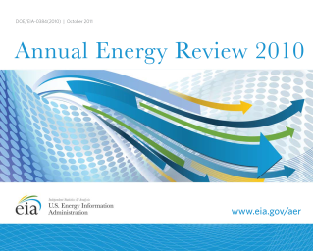
U.S. Energy Flow, 2010
About 1/3 of U.S. primary energy is imported
Adjustments: -1
Exports:
8 Quads
Imports:
30 Quads
Consumption:
98 Quads
Energy Supply (Quads)
Energy Consumption
Domestic
Production:
75 Quads
U.S. Share of World, 2007
21.0%
15.0%
4.6%
Population
Energy
Production
Energy
Consumption

Slide 29
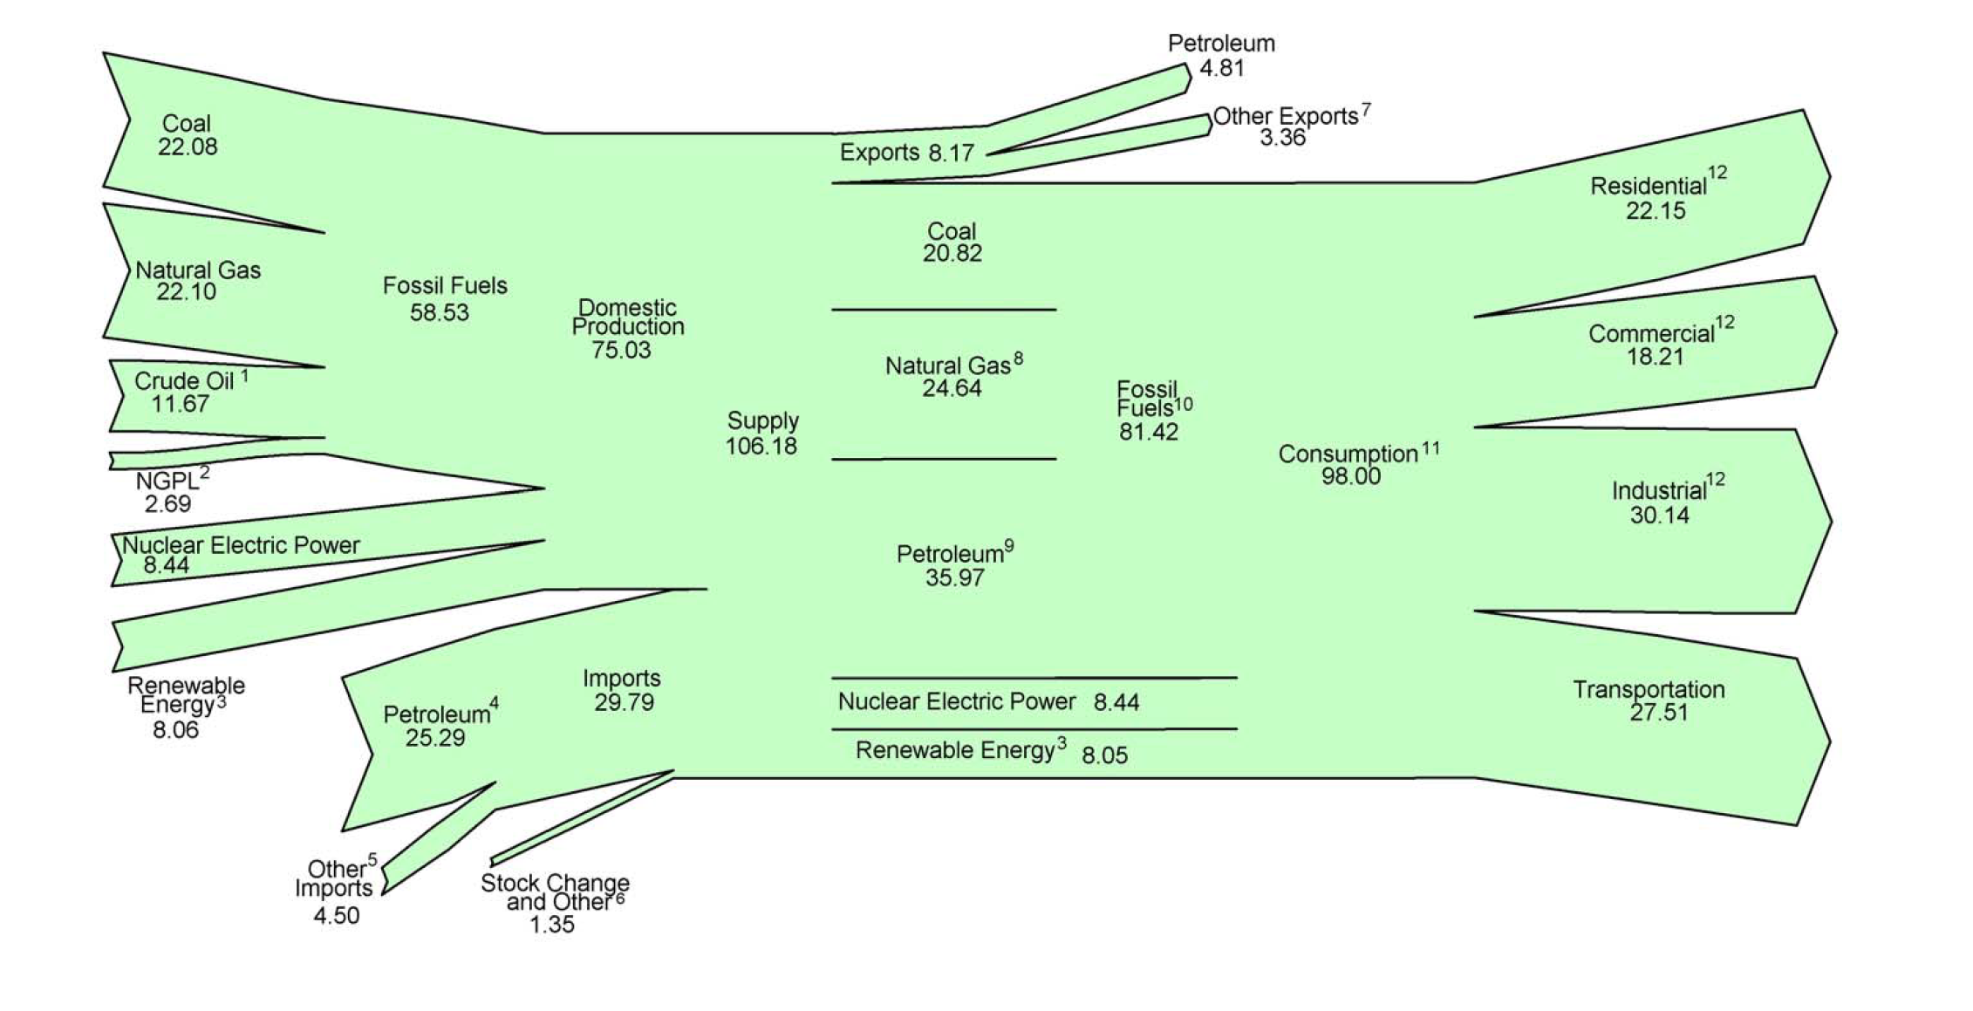
U.S. Energy Flow, 2010 (Quads)
>80% of primary energy is from fossil fuels
Residential
Domestic
72%
Commercial
Supply
106
Quads
Fossil
83%
Consume
98
Quads
Industrial
Imports
28%
Nuclear 9%
Transportation
Renewable 8%

Slide 30
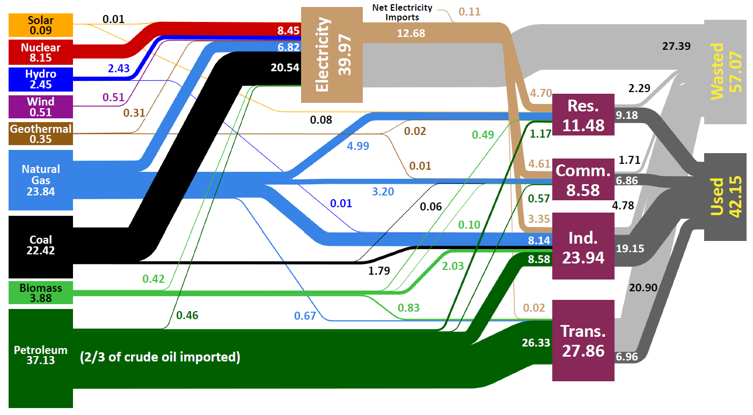
U.S. Energy Production and Usage in 2008
Units in Quadrillion BTUs (Quads)
Today compared to 1950:
U.S. population ~2x that in 1950
Total primary energy ~3x that in 1950
Primary energy (petroleum) for transportation ~4x that in 1950
Primary energy for electricity generation ~10x that in 1950
Little or no imported petroleum in 1950
“Used” and “Wasted” energy were about equal in 1950
Source: Lawrence Livermore National Laboratory and the Department of Energy, Energy Information Administration, 2009 (based on data from DOE/EIA-0384(2008), June 2009).
Notes:
Delete yellow things

Slide 31
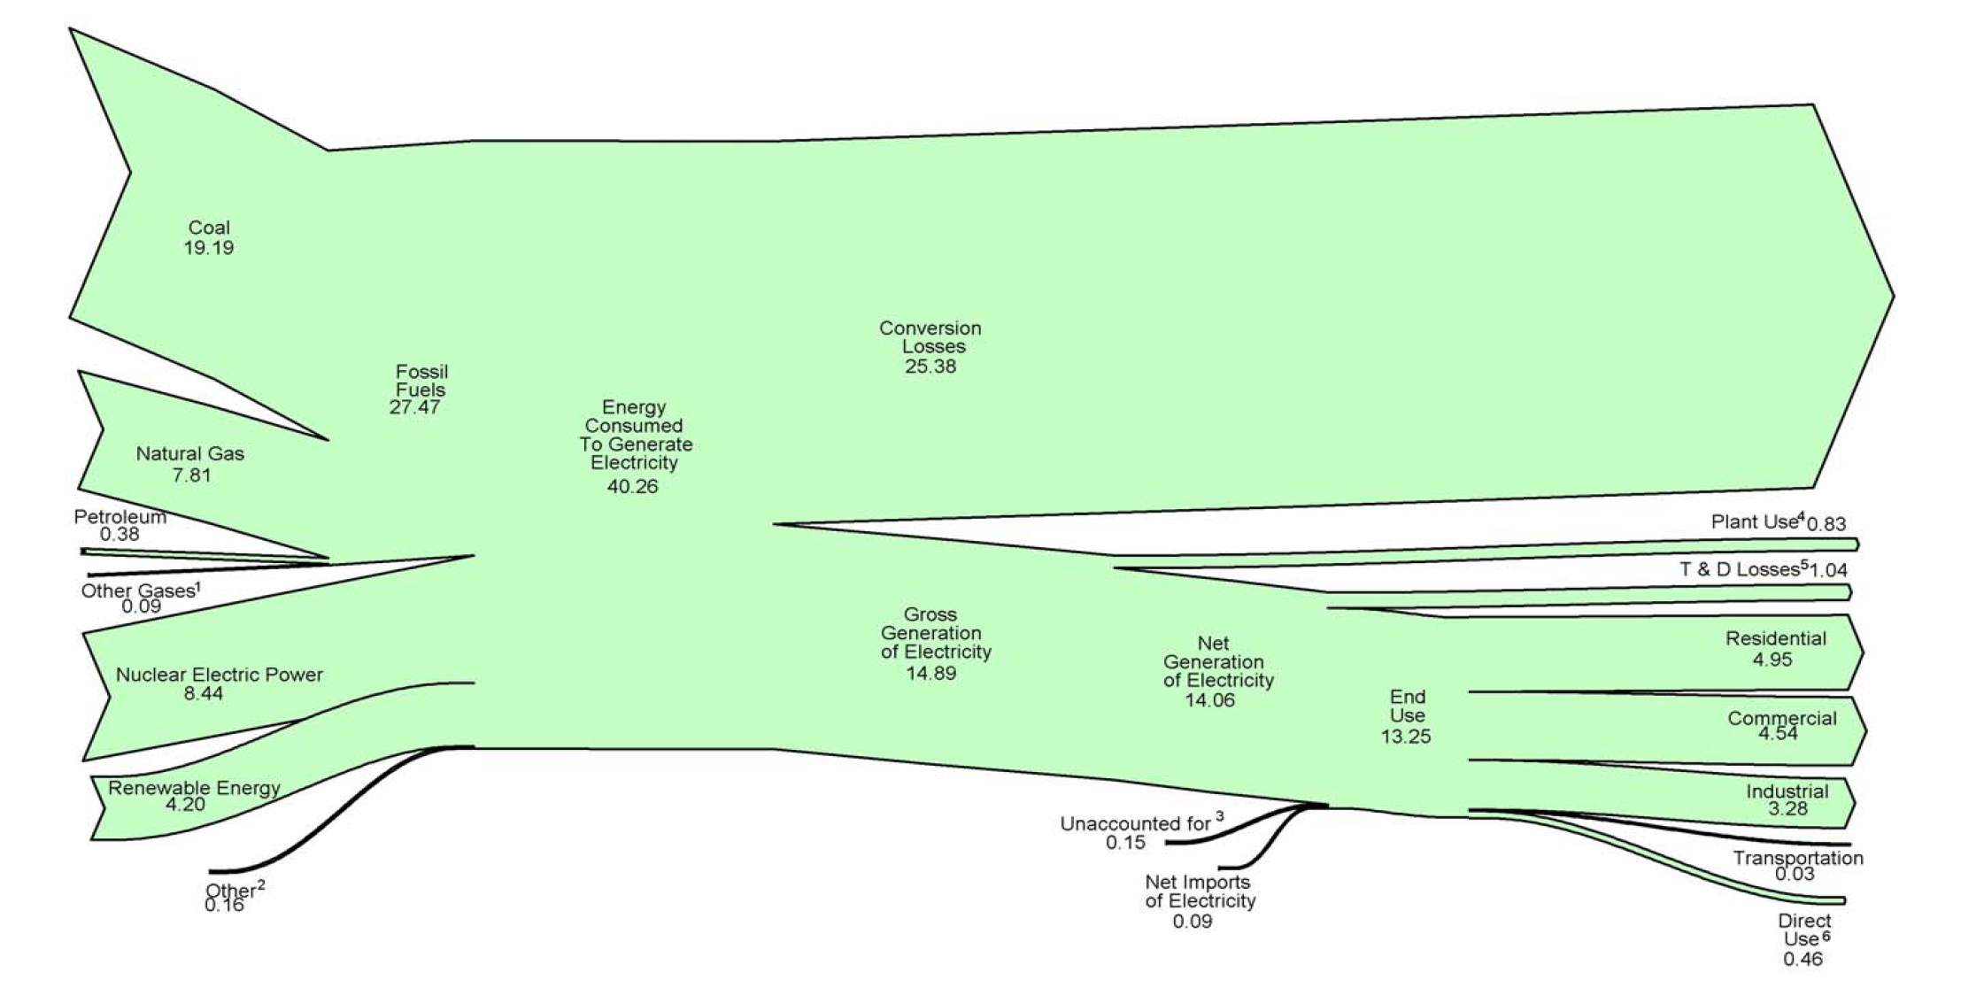
Electricity Sources and End Uses (Trillion Btu)
Conversion Losses
25 Quads
Energy Consumed to
Generate Electricity
40 Quads
Gross Generation
15 Quads
Residential
Commercial
Industrial

Slide 32
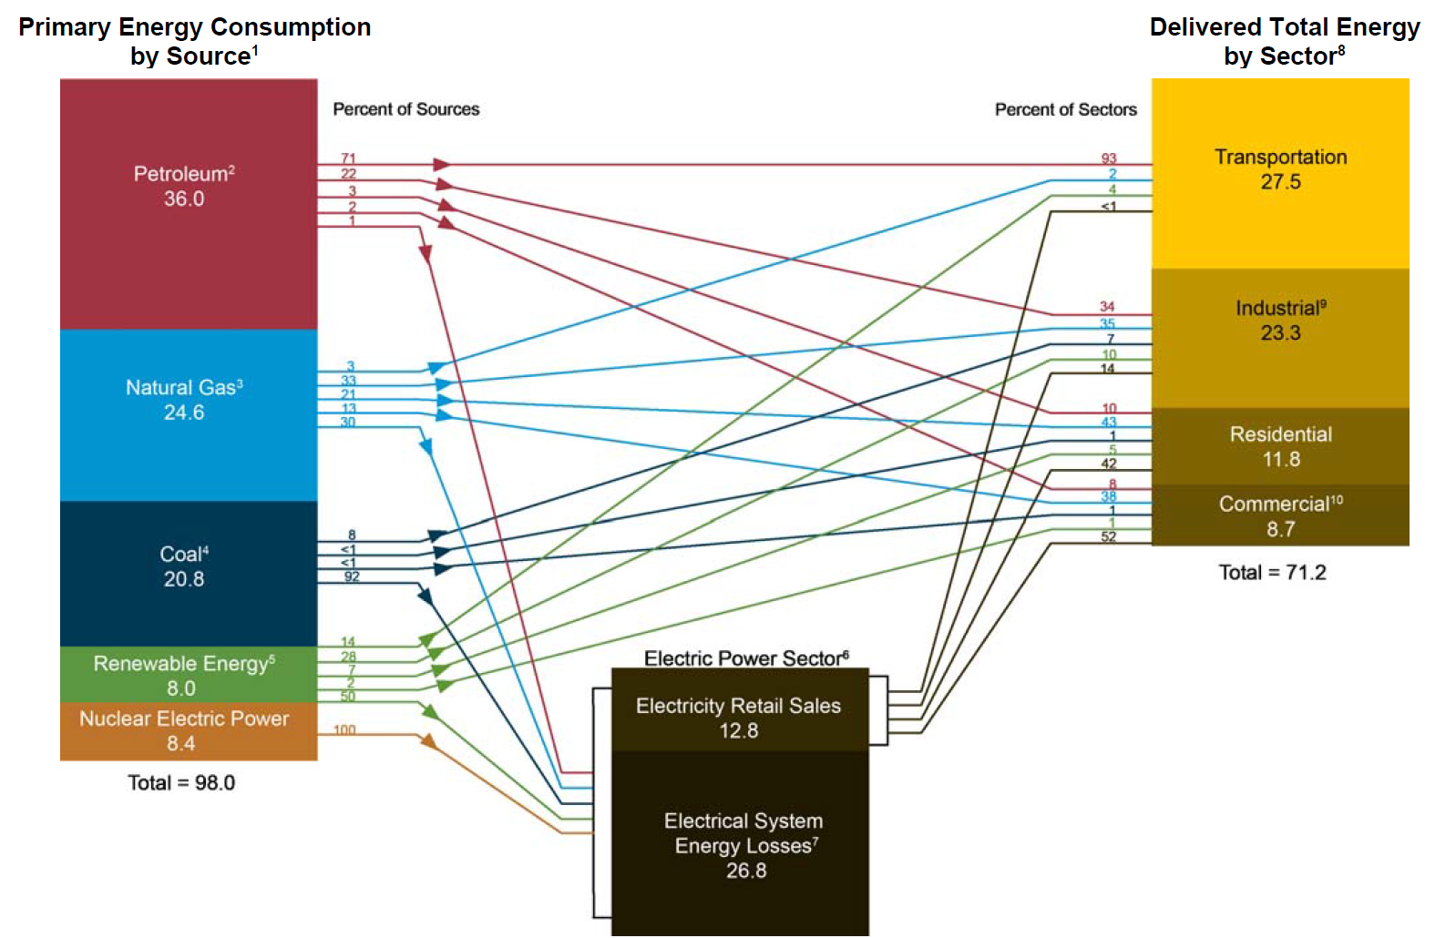
Summary of Sources and Consumption Sectors (Quads)

Slide 33
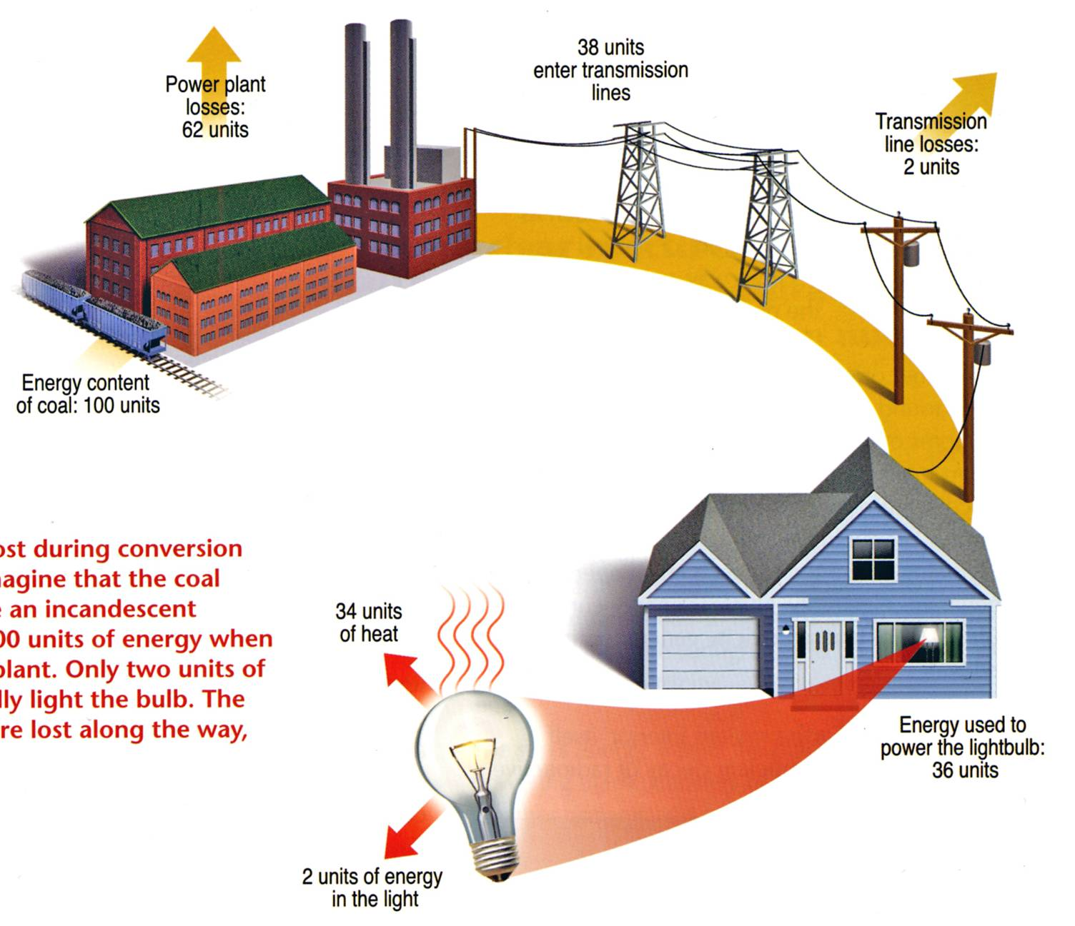
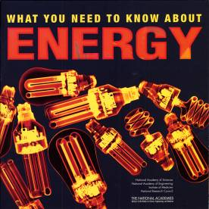
Overall Efficiency of an Incandescent Bulb ≅ 2%
Lighting accounts for 22% of all electricity usage in the U.S.
Energy content of coal: 100 units
The Energy Independence and Security Act of 2007 requires light bulbs be 30% more energy efficient (similar to current halogen lamps) than current incandescent bulbs by 2012 to 2014. The efficiency standards start with 100-watt bulbs in January 2012 and end with 40-watt bulbs in January 2014. By 2020, all general-purpose bulbs must produce at least 45 lumens per watt (similar to current CFLs).
Example of energy lost during conversion and transmission. Imagine that the coal needed to illuminate an incandescent light bulb contains 100 units of energy when it enters the power plant. Only two units of energy eventually light the bulb. The remaining 98 units are lost along the way, primarily as heat.
2 units of energy
in light output

Slide 34
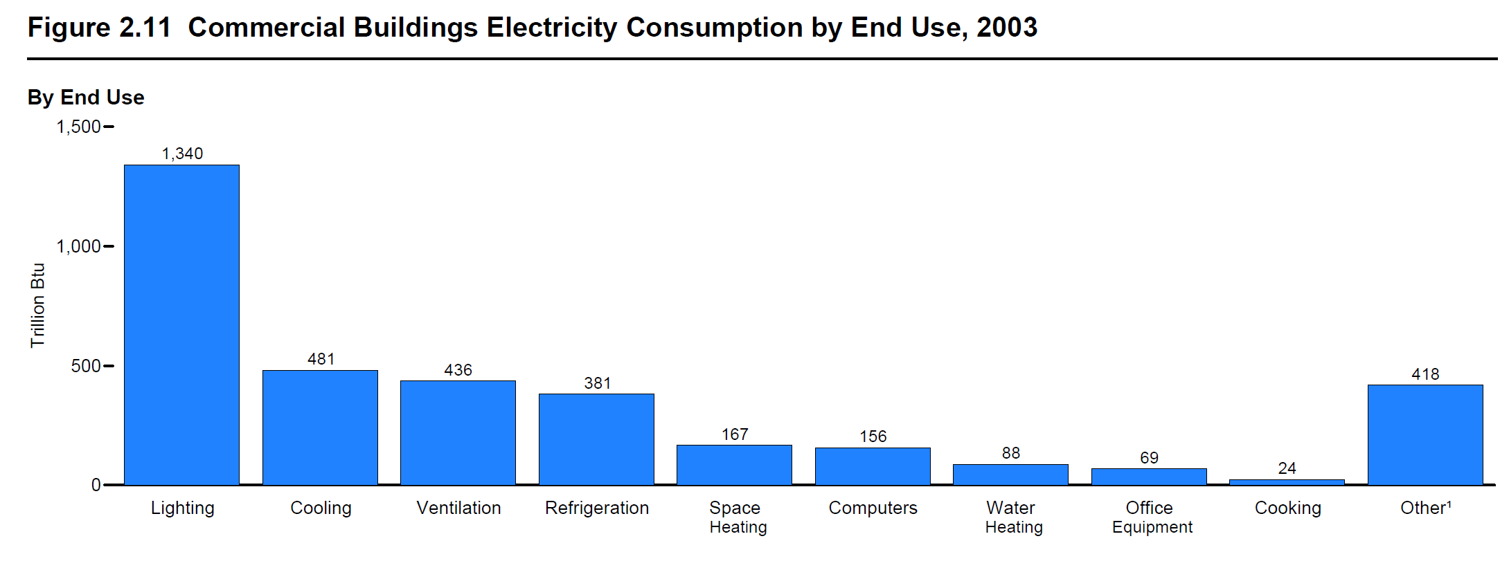
Commercial Buildings Electricity Consumption by End Use, 2003
(Trillion Btu)
Lighting
Cooling
Ventilation
Cooking
All Other
Refrigeration
Computers
Space Heating
Water Heating
Office Equipment

Slide 35
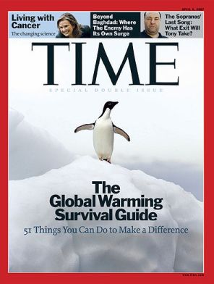

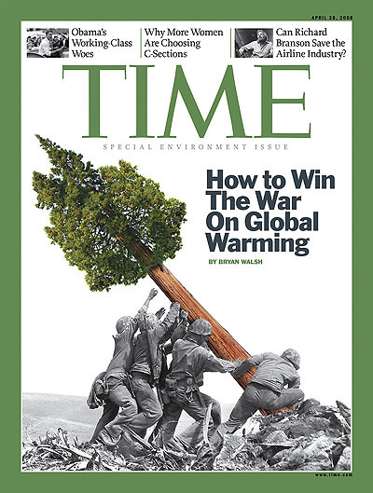
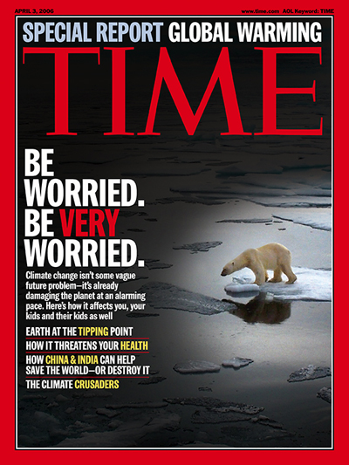
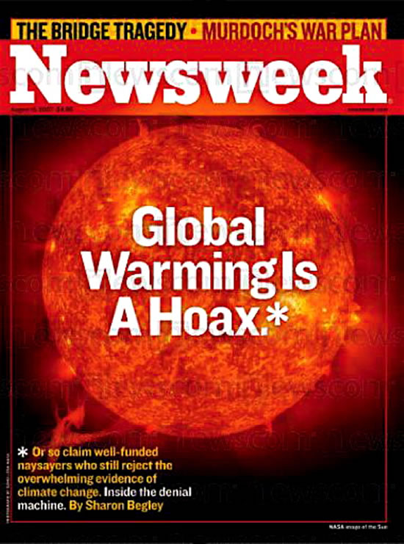
Energy and the environment

Slide 36
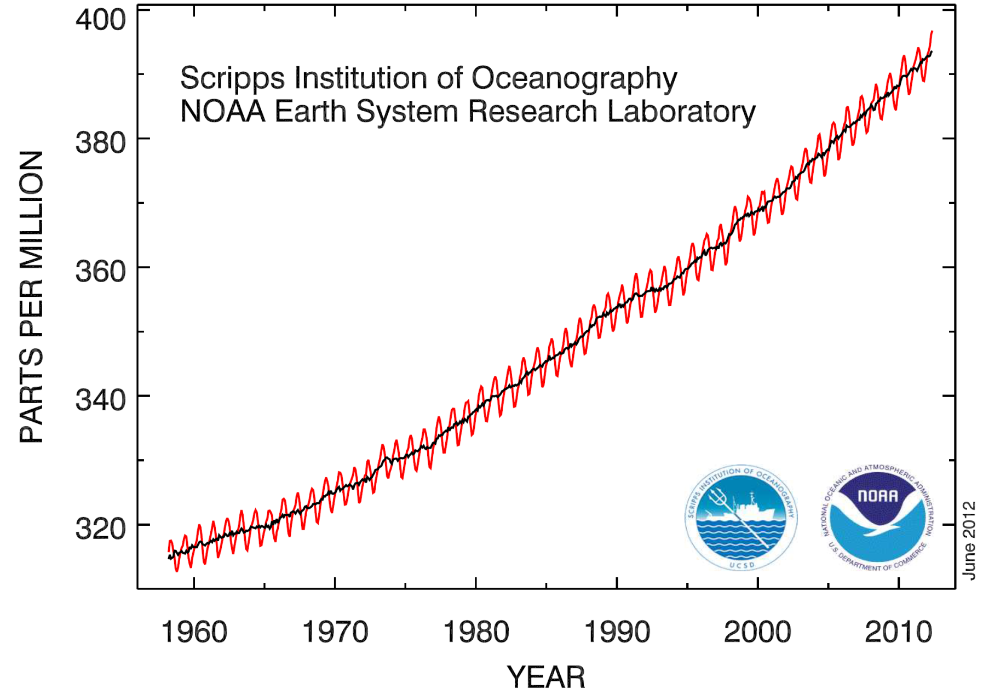
Modern CO₂ Concentrations are Increasing
The current concentration is the highest in 800,000 years, as determined by ice core data
Concentration now ~395 ppm. Under a “business-as-usual” scenario, concentration could rise to 1,000 ppm
Concentration prior to 1800 was ~280 ppm

Slide 37
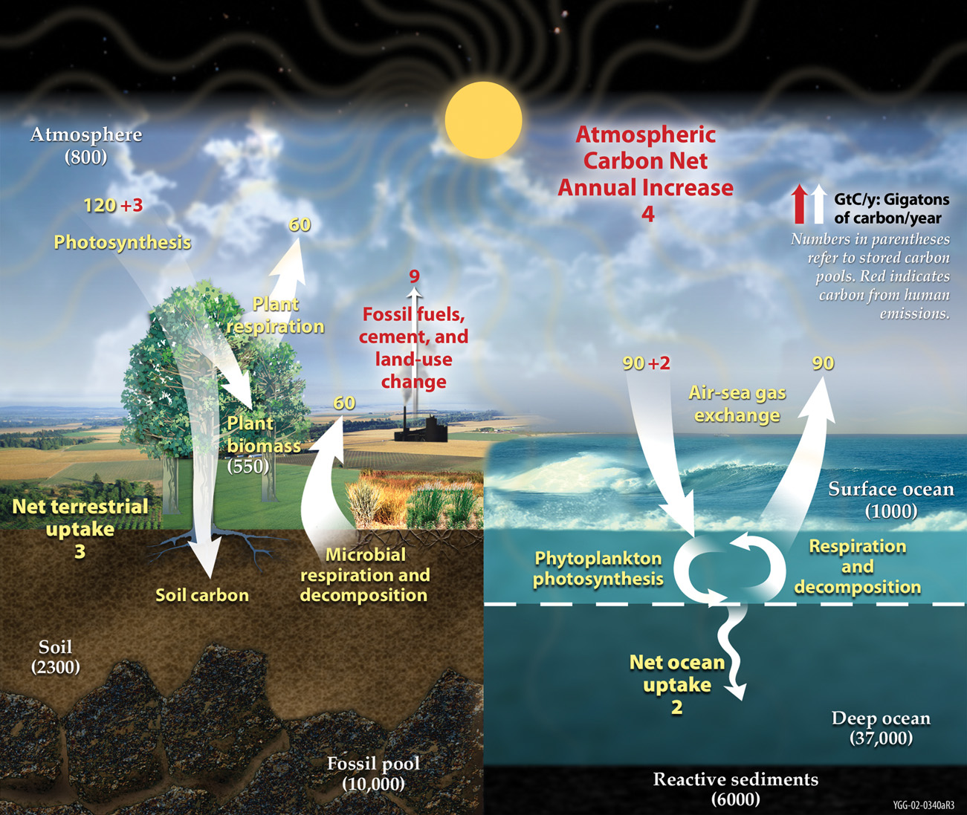
Carbon Cycle
Atmosphere = 800 GtC

Slide 38

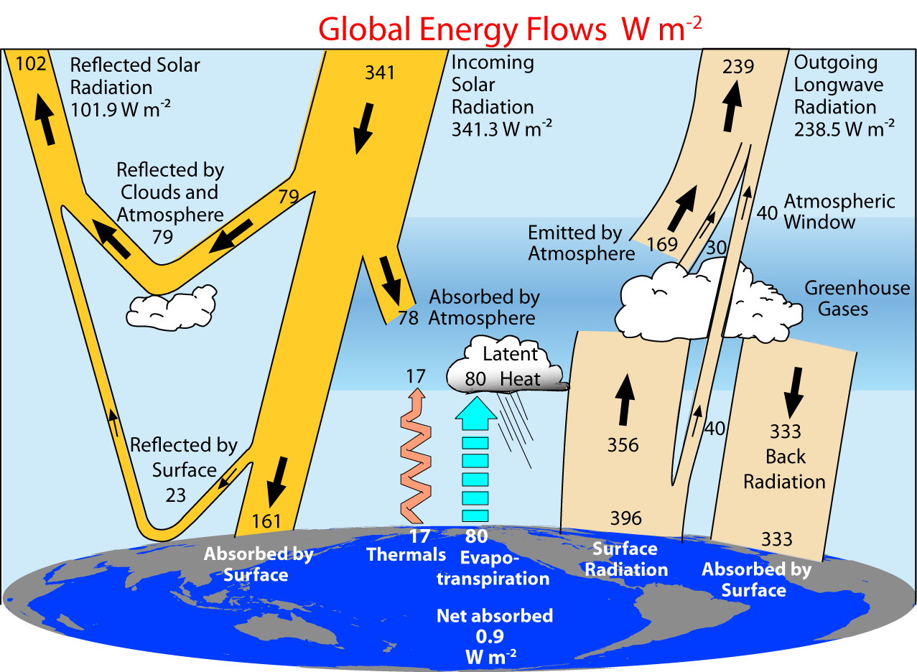
Solar Energy Cycle
And the Greenhouse Effect
Notes:
THE FLOW OF ENERGY THROUGH THE CLIMATE SYSTEM
A suite of papers has provided updated estimates of trends, variability, mean and annual cycle of energy flowing through the climate system, and energy storage, release, and transport in the atmosphere, ocean, and land surface. The estimates are obtained from recent observations using the latest datasets ([1]-[5]). The results indicate that the global energy budget can now be estimated reasonably well, with the largest continuing sources of uncertainty being the ocean heat budget south of about 35°S. The current imbalance in radiation at the top-of-atmosphere owing to human-induced increases in greenhouse gases means that the atmosphere, land and ocean are warming up, and ice is melting, leading to a rise in sea level. A holistic integrated approach that brings all information to bear provides constraints on what is happening and where the main weaknesses are in the current observing system. These analyses also provide insights into both top-of-atmosphere and surface balances and model problems. For instance, the results indicate that climate models typically have too much downward longwave radiation, which is compensated by too much evaporation and precipitation.
Figure: From Trenberth et al (2008) shows the estimated global mean energy flows for the 2000 to 2004 time frame.
Fasullo, J. T., and K. E. Trenberth, 2008: The annual cycle of the energy budget. Part I: Global mean and land-ocean exchanges. J. Climate, 21, 2297-2312.
Fasullo, J. T., and K. E. Trenberth, 2008: The annual cycle of the energy budget. Part II: Meridional structures and poleward transports. J. Climate, 21, 2313-2325.
Trenberth, K. E., and L. Smith, 2008: The three dimensional structure of the atmospheric energy budget: methodology and evaluation. Climate Dynamics, in press. doi:10.1007/s00382-008-0389-3.
Trenberth, K. E., and L. Smith, 2008: Atmospheric energy budgets in the Japanese Reanalysis: Evaluation and variability. J. Meteor. Soc. Japan, in press.
Trenberth, K. E., J. T. Fasullo, and J. Kiehl, 2008: Earth's global energy budget. Bull. Amer. Meteor. Soc., in press.
Several recent presentations by Trenberth may be found at http://www.cgd.ucar.edu/cas/Trenberth/trenberth_presentations.html

Slide 39
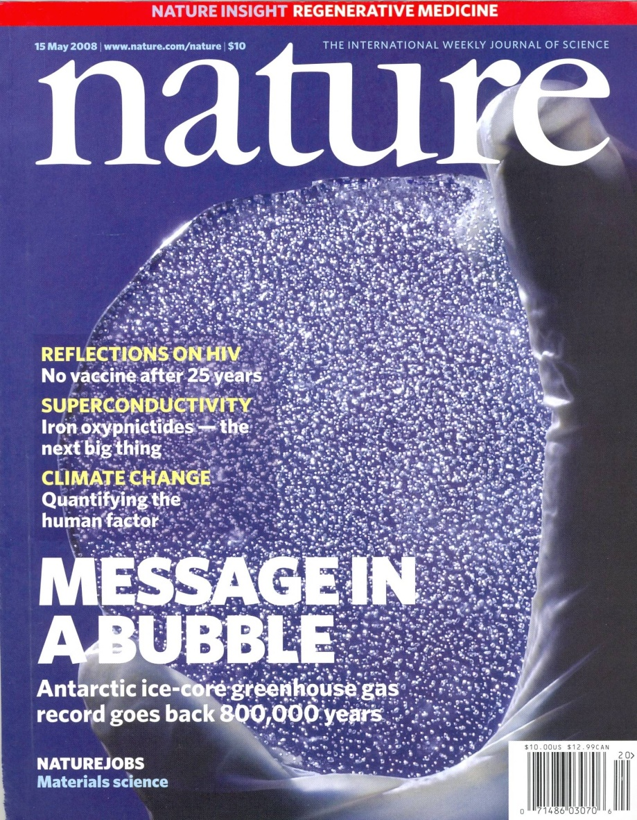
Bubbles – 800,000 Years of CO₂ Concentrations
Nature, 15 May 2008 The air bubbles trapped in the Antarctic Vostok and EPICA Dome C ice cores provide composite records of levels of atmospheric carbon dioxide and methane for the past 800,000 years.
The conclusion: today's concentrations of these greenhouse gases have no past analogue in the ice-core record. Concentrations do not rise above pre-industrial revolution values.

Slide 40
CO₂ Concentrations and Temperature
The correlation extends throughout the 800,000-year time span of the ice core data
a The 800,000-year records of atmospheric carbon dioxide (red; parts per million, p.p.m.) and methane (green; parts per billion, p.p.b.) from the EPICA Dome C ice core together with a temperature reconstruction (relative to the average of the past millennium) based on the deuterium–hydrogen ratio of the ice, reinforce the tight coupling between greenhouse-gas concentrations and climate observed in previous, shorter records. Concentrations of greenhouse gases in the modern atmosphere are highly anomalous with respect to natural greenhouse-gas variations (present-day concentrations are around 380 p.p.m. for carbon dioxide and 1,800 p.p.b. for methane).
b The carbon dioxide and methane trends from the past 2,000 years.
E.J. Brook, Nature 453, 291 (2008).

Slide 41
One small step:
Let’s buy some new light bulbs.

Slide 42
Overall Efficiency of an Incandescent Bulb ≅ 2%
Lighting accounts for 22% of all electricity usage in the U.S.
Energy content of coal: 100 units
2 units of energy
in light output
Question: Do you know how many light bulbs are in your house?

Slide 43
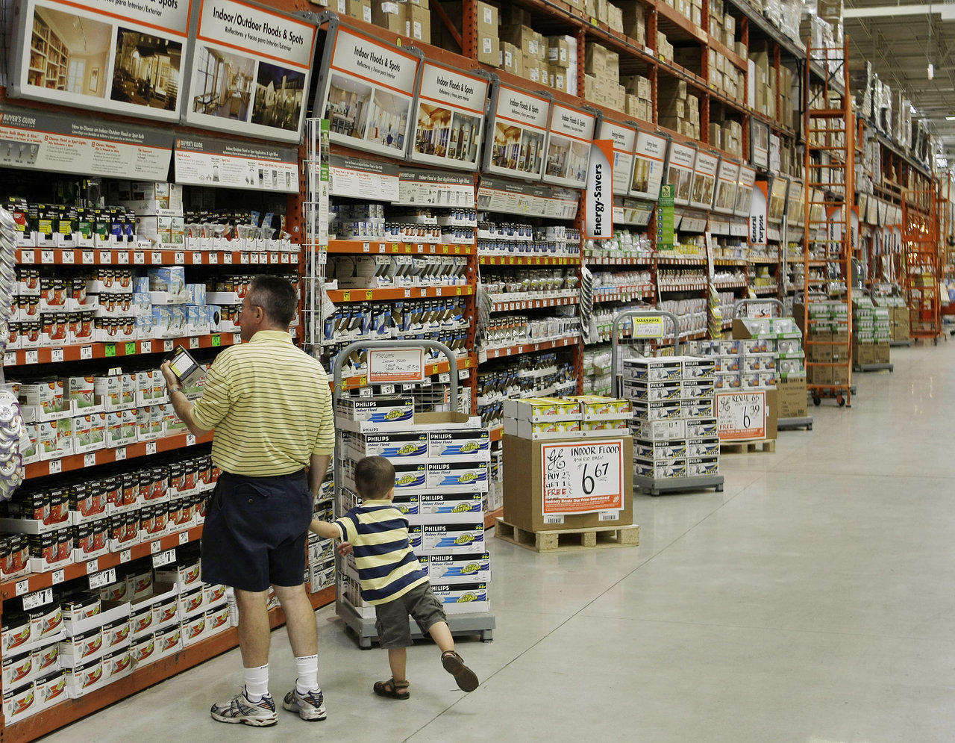
Lighting Tutorial

Slide 44
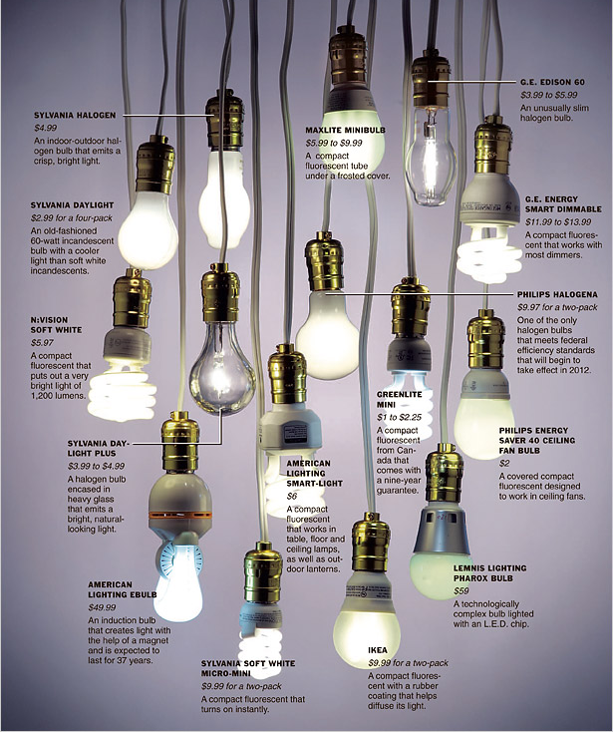
Today consumers have many decisions
to make when purchasing light bulbs
Shape of glass bulb/size of base
Type: Incandescent, halogen, fluorescent, LED
Brightness (lumens)
Color (K)
Color rendition index
Energy (watts)
Efficacy (lumens/watt) … and …
Efficiency (%)
Cost
Life expectancy (hours or years, sometimes assuming 1,000 hours/year)
Life cycle cost: Initial purchase price and price of energy to operate
Health/Safety
Instant on/Buzz/Dimmable/3-Way

Slide 45
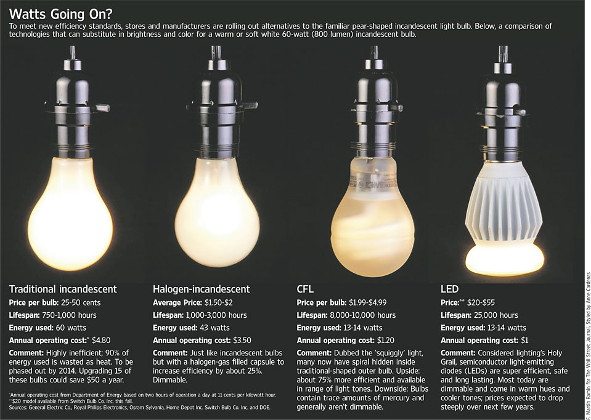

Slide 46
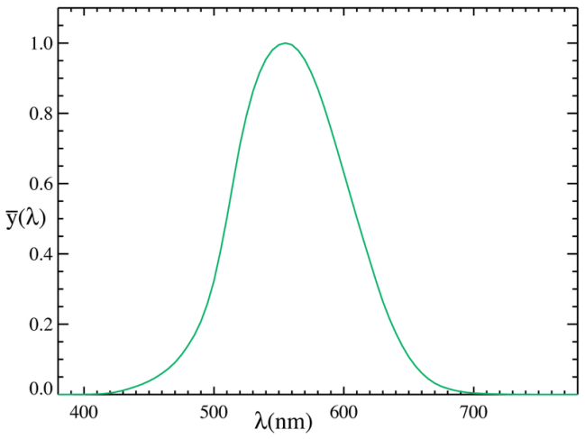
Brightness (lumens)
The lumen (symbol: lm) is the SI derived unit of luminous flux, a measure of the total "amount" of visible light emitted by a source. Luminous flux depends on nominal response of the human eye to different wavelengths as represented by the luminosity function.
The lumen is defined in relation
to the candela as
  1 lm = 1 cd · sr
The candela is the luminous intensity, in a given direction, of a source that emits monochromatic radiation of frequency 540 x 10¹² hertz (555 nm) and that has a radiant intensity in that direction of 1/683 watt per steradian.

Slide 47


Slide 48


Slide 49

100 watt
soft white incandescent
2700K CFL
3500K CFL
4100K CFL
5500K CFL
6500K CFL
All CFLs are 100 watt replacements, ranging from 23 to 26 watt

Slide 50
Color Rendering Index (CRI)
The CRI measures the ability of a light source to reproduce the colors of objects faithfully in comparison with an ideal (blackbody) light source or natural light source.
Blackbody radiation has a CRI of 100; incandescent lamps have that rating, because they are almost blackbody radiators.
An ideal light source for color rendering will have both a color temperature similar to daylight and a high CRI value.
Notes:
Lighting technologies are substitutes for sunlight in the 425-675 nm spectral region where sunlight is most concentrated and to which the human eye has evolved to be most sensitive. The history of lighting can be viewed as the development of increasingly efficient technologies for creating visible light inside, but not wasted light outside, of that spectral region.
A 200-year perspective on that history is shown in the figure. The left axis indicates luminous efficacy, in units of lumens (a measure of light which factors in the human visual response to various wavelengths) per watt. The right axis indicates the corresponding power-conversion efficiency for a tri-LED tri-color white light source with moderate color rendering (CRI=80) and relatively warm color temperature (CCT=3900K). For such a source, 400lm/W would correspond to 100% power-conversion efficiency.
The three traditional technologies are fire; incandescence; and fluorescence and high-intensity discharges (HID). These three traditional technologies have all made significant progress over the past 200 years, but appear to be saturating at efficiencies in the 1-25% range.
A new, fourth technology is solid-state lighting. In principle, the technology is simple: electrons and holes are injected into a forward-biased semiconductor p-n junction; they recombine creating photons; the resulting photons are extracted from the chip; then the photons are either mixed with different-color photons from other LEDs, or are energy down-converted into a distribution of colors using phosphors or other down-conversion materials, with the colors chosen so as to create the appearance of white.
In practice, there are losses at every step of the way, and efficiently creating white light from semiconductor materials with band-gaps that span the visible spectrum is extremely challenging. Nevertheless, great strides are being made, and SSL-LED technology is currently on a very rapid improvement curve, particularly the red, green and blue monochrome lamps necessary for white light.

Slide 51
Color Rendering Index (CRI) made easier
Two different light spectra that have the same effect on the three color receptors in the human eye will be perceived as the same color.
Daylight, which has a continuous spectrum
White light emitted by fluorescent lamps, which has a spectrum of a few bands
The human eye cannot tell the difference between such light spectra by looking into the light source, but reflected colors from objects can look different.
This can be exploited to make things look better, e.g., to make tomatoes look more intensely red.
Notes:
Lighting technologies are substitutes for sunlight in the 425-675 nm spectral region where sunlight is most concentrated and to which the human eye has evolved to be most sensitive. The history of lighting can be viewed as the development of increasingly efficient technologies for creating visible light inside, but not wasted light outside, of that spectral region.
A 200-year perspective on that history is shown in the figure. The left axis indicates luminous efficacy, in units of lumens (a measure of light which factors in the human visual response to various wavelengths) per watt. The right axis indicates the corresponding power-conversion efficiency for a tri-LED tri-color white light source with moderate color rendering (CRI=80) and relatively warm color temperature (CCT=3900K). For such a source, 400lm/W would correspond to 100% power-conversion efficiency.
The three traditional technologies are fire; incandescence; and fluorescence and high-intensity discharges (HID). These three traditional technologies have all made significant progress over the past 200 years, but appear to be saturating at efficiencies in the 1-25% range.
A new, fourth technology is solid-state lighting. In principle, the technology is simple: electrons and holes are injected into a forward-biased semiconductor p-n junction; they recombine creating photons; the resulting photons are extracted from the chip; then the photons are either mixed with different-color photons from other LEDs, or are energy down-converted into a distribution of colors using phosphors or other down-conversion materials, with the colors chosen so as to create the appearance of white.
In practice, there are losses at every step of the way, and efficiently creating white light from semiconductor materials with band-gaps that span the visible spectrum is extremely challenging. Nevertheless, great strides are being made, and SSL-LED technology is currently on a very rapid improvement curve, particularly the red, green and blue monochrome lamps necessary for white light.

Slide 52

Color Rendering Index
Notes:
Lighting technologies are substitutes for sunlight in the 425-675 nm spectral region where sunlight is most concentrated and to which the human eye has evolved to be most sensitive. The history of lighting can be viewed as the development of increasingly efficient technologies for creating visible light inside, but not wasted light outside, of that spectral region.
A 200-year perspective on that history is shown in the figure. The left axis indicates luminous efficacy, in units of lumens (a measure of light which factors in the human visual response to various wavelengths) per watt. The right axis indicates the corresponding power-conversion efficiency for a tri-LED tri-color white light source with moderate color rendering (CRI=80) and relatively warm color temperature (CCT=3900K). For such a source, 400lm/W would correspond to 100% power-conversion efficiency.
The three traditional technologies are fire; incandescence; and fluorescence and high-intensity discharges (HID). These three traditional technologies have all made significant progress over the past 200 years, but appear to be saturating at efficiencies in the 1-25% range.
A new, fourth technology is solid-state lighting. In principle, the technology is simple: electrons and holes are injected into a forward-biased semiconductor p-n junction; they recombine creating photons; the resulting photons are extracted from the chip; then the photons are either mixed with different-color photons from other LEDs, or are energy down-converted into a distribution of colors using phosphors or other down-conversion materials, with the colors chosen so as to create the appearance of white.
In practice, there are losses at every step of the way, and efficiently creating white light from semiconductor materials with band-gaps that span the visible spectrum is extremely challenging. Nevertheless, great strides are being made, and SSL-LED technology is currently on a very rapid improvement curve, particularly the red, green and blue monochrome lamps necessary for white light.

Slide 53

Luminous efficacy (lumens/watt) for various light sources

Slide 54








Luminous efficacy (lumens/watt) for various light sources
3
Jeff Y. Tsao, “Solid-State Lighting: Lamps, Chips and Materials for Tomorrow,” IEEE Circuits & Devices 20(3), 28-37 (2004).
Notes:
Lighting technologies are substitutes for sunlight in the 425-675 nm spectral region where sunlight is most concentrated and to which the human eye has evolved to be most sensitive. The history of lighting can be viewed as the development of increasingly efficient technologies for creating visible light inside, but not wasted light outside, of that spectral region.
A 200-year perspective on that history is shown in the figure. The left axis indicates luminous efficacy, in units of lumens (a measure of light which factors in the human visual response to various wavelengths) per watt. The right axis indicates the corresponding power-conversion efficiency for a tri-LED tri-color white light source with moderate color rendering (CRI=80) and relatively warm color temperature (CCT=3900K). For such a source, 400lm/W would correspond to 100% power-conversion efficiency.
The three traditional technologies are fire; incandescence; and fluorescence and high-intensity discharges (HID). These three traditional technologies have all made significant progress over the past 200 years, but appear to be saturating at efficiencies in the 1-25% range.
A new, fourth technology is solid-state lighting. In principle, the technology is simple: electrons and holes are injected into a forward-biased semiconductor p-n junction; they recombine creating photons; the resulting photons are extracted from the chip; then the photons are either mixed with different-color photons from other LEDs, or are energy down-converted into a distribution of colors using phosphors or other down-conversion materials, with the colors chosen so as to create the appearance of white.
In practice, there are losses at every step of the way, and efficiently creating white light from semiconductor materials with band-gaps that span the visible spectrum is extremely challenging. Nevertheless, great strides are being made, and SSL-LED technology is currently on a very rapid improvement curve, particularly the red, green and blue monochrome lamps necessary for white light.

Slide 55
Luminous efficacy vs. efficiency for a light source
Luminous efficacy is the ratio of the luminous flux emitted (lumens) to the input power (watts).
But, remember, luminous flux depends on response of the human eye to different wavelengths as represented by the luminosity function.
When expressed as a fraction of the maximum possible luminous efficacy (i.e., uncorrected for the response of the eye), this is called lighting efficiency.

Slide 56

Luminous efficacy vs. efficiency for light sources

Slide 57

Traditional
incandescent
Halogen
incandescent
Compact
fluorescent (CFL)
Light-emitting
diode (LED)
Approximate wattage to produce 1,600 lumens
100
watts
77
watts
23
watts
20
watts
1,600
lumens
1,600
lumens
1,600
lumens
1,600
lumens

Slide 58


Slide 59


Slide 60


Slide 61
Lighting Tutorial
So we return to the light bulb aisle now understanding the package labels.

Slide 62


Slide 63


Slide 64

View looking down through the shade of a lamp on an end table in our hotel, showing the use of two different CFLs. The use of dissimilar, independently operable lamps seems clever until one inspects the identical lamp on the other side of the room …..

Slide 65


Slide 66

END

