Slide 1
The DOE Webinar will begin shortly . . .
Why is there no sound?
  Once you logged into the webinar, you were provided two options to listen to this broadcast. The first option is through your computer speakers, the second option is via dialing the phone number provided to you upon login to the webinar. If you chose to listen through your computer speakers, you may need to turn your speaker volume on or up.
Will DOE provide access to the recorded webinar after the meeting?
  Yes, all those who registered will receive a link to the slides and to the recorded webinar soon after the meeting. It will also be available on the DOE SBIR/STTR web site.
Where can I find the Topics being discussed today?
  This link will take you to the Funding Opportunity Announcement (FOA) page that lists the FY 2020 Phase I Release 2 Topics: https://science.osti.gov/sbir/Funding-Opportunities
What if my question was not answered at today’s webinar?
  Please contact the point of contact that follows each subtopic in the document listed above for further clarification.
  If you have a question about the grant application process, please send us an email at: sbir-sttr@science.doe.gov or call us at (301) 903-5707.

Slide 2

DOE SBIR/STTR
Phase I Release 2 Topics Webinar
Topics associated with the
FY 2020 Phase I Release 2
Funding Opportunity Announcement
Topics 1-5, 18 & 19-25
DOE SBIR/STTR Programs Office
November 18, 2019

Slide 3
TODAY’S AGENDA
Topics Introduction | DOE SBIR/STTR Programs Office
Topic 1 | Office of Cybersecurity, Energy Security, and Emergency Response
Topics 2-3 | Office of Defense Nuclear Nonproliferation
Topics 4-5 | Office of Electricity
Topic 18 | Office of Environmental Management
Topics 19-25 | Office of Fossil Energy

Slide 4
FY 2020 Phase I Schedule
 | Release 1 | Release 2
Topics Issued | Monday, July 15, 2019 | Tuesday, November 12, 2019
Webinar(s) | Week of July 22, 2019 | Week of November 18, 2019
FOA Issued | Monday, August 12, 2019 | Monday, December 16, 2019
Webinar(s) | Friday, August 19, 2019 | Thursday, December 19, 2019
Letters of Intent (LOI) Due | Tuesday, September 3, 2019 | Monday, 6 January, 2020
Non-responsive LOI Feedback Provided | Tuesday, September 24, 2019 | Tuesday, January 27, 2020
Applications Due | Tuesday, October 15, 2019 | Monday, February 24, 2020
Award Notification | Monday, January 6, 2020 | Monday, May 18, 2020

Slide 5

Phase I Funding Opportunity Announcements
Participating DOE Programs (FY 2020)
Office of Advanced Scientific Computing Research
Office of Basic Energy Sciences
Office of Biological and Environmental Research
Office of Nuclear Physics
Office of Science
Phase I
Release 1
Office of Cybersecurity, Energy Security, and Emergency Response
Office of Defense Nuclear Nonproliferation
Office of Electricity
Office of Energy Efficiency and Renewable Energy
Office of Environmental Management
Office of Fossil Energy
Office of Fusion Energy Sciences
Office of High Energy Physics
Office of Nuclear Energy
Phase I
Release 2

Slide 6
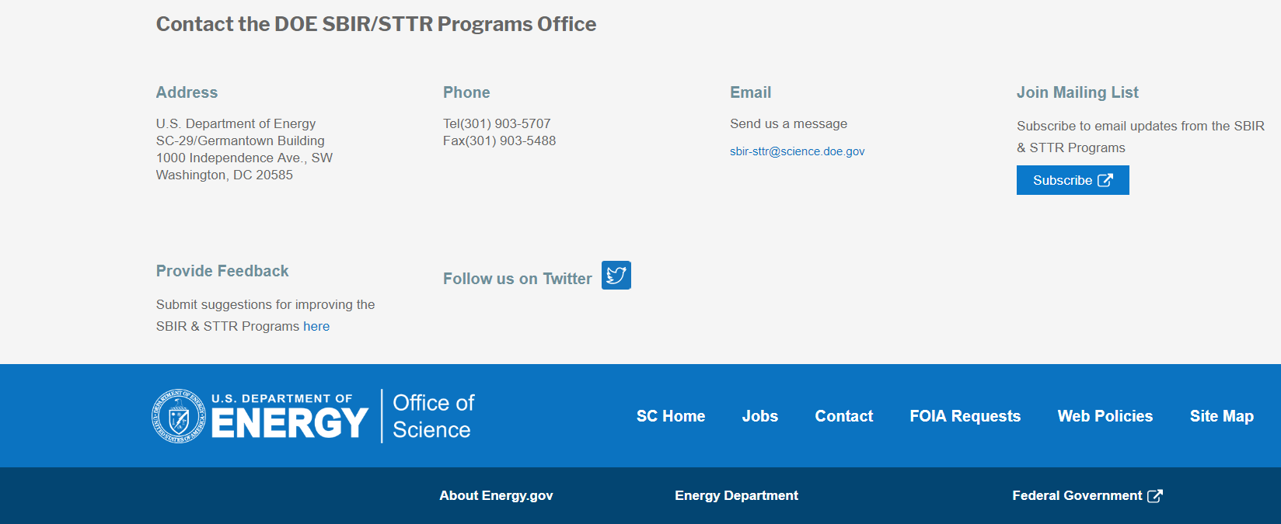
Funding Opportunity Announcement (FOA) Webinar
FY20 Phase I Release 2 FOA will be issued on December 16th
Join our Mailing List – this field is on every DOE SBIR/STTR web page
  Following the issuance of the FOA, look for an email with a link to the FOA
Webinar with Q&A for this FOA on December 19th
  Overview of the FY 2020 DOE SBIR/STTR Programs
    Following the issuance of the FOA, look for an email announcing this webinar

Slide 7
Topic Basics
Topics are created by DOE program managers and define important technology breakthroughs needed in R&D areas that support the DOE mission
Topics are organized by DOE Program Office, e.g., EERE, BES, etc.
DOE program managers are listed with each subtopic
  Questions to DOE program managers are limited to clarification of the topic and subtopic (including references)
  Clarification is provided to help you determine whether your technology fits within the topic and subtopic
  You may communicate with these topic managers from the release of topics until the grant application due date
  The decision to apply is yours

Slide 8
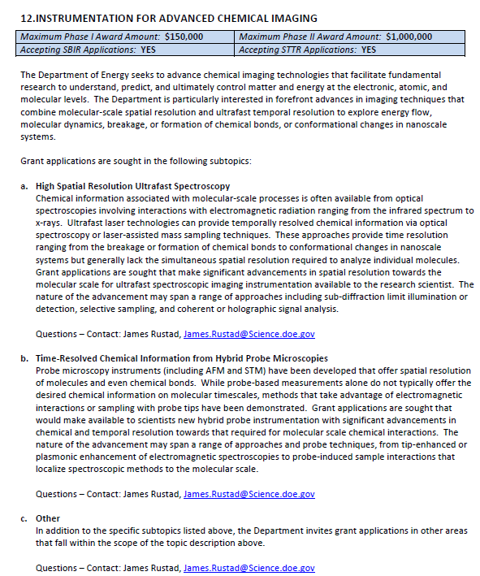
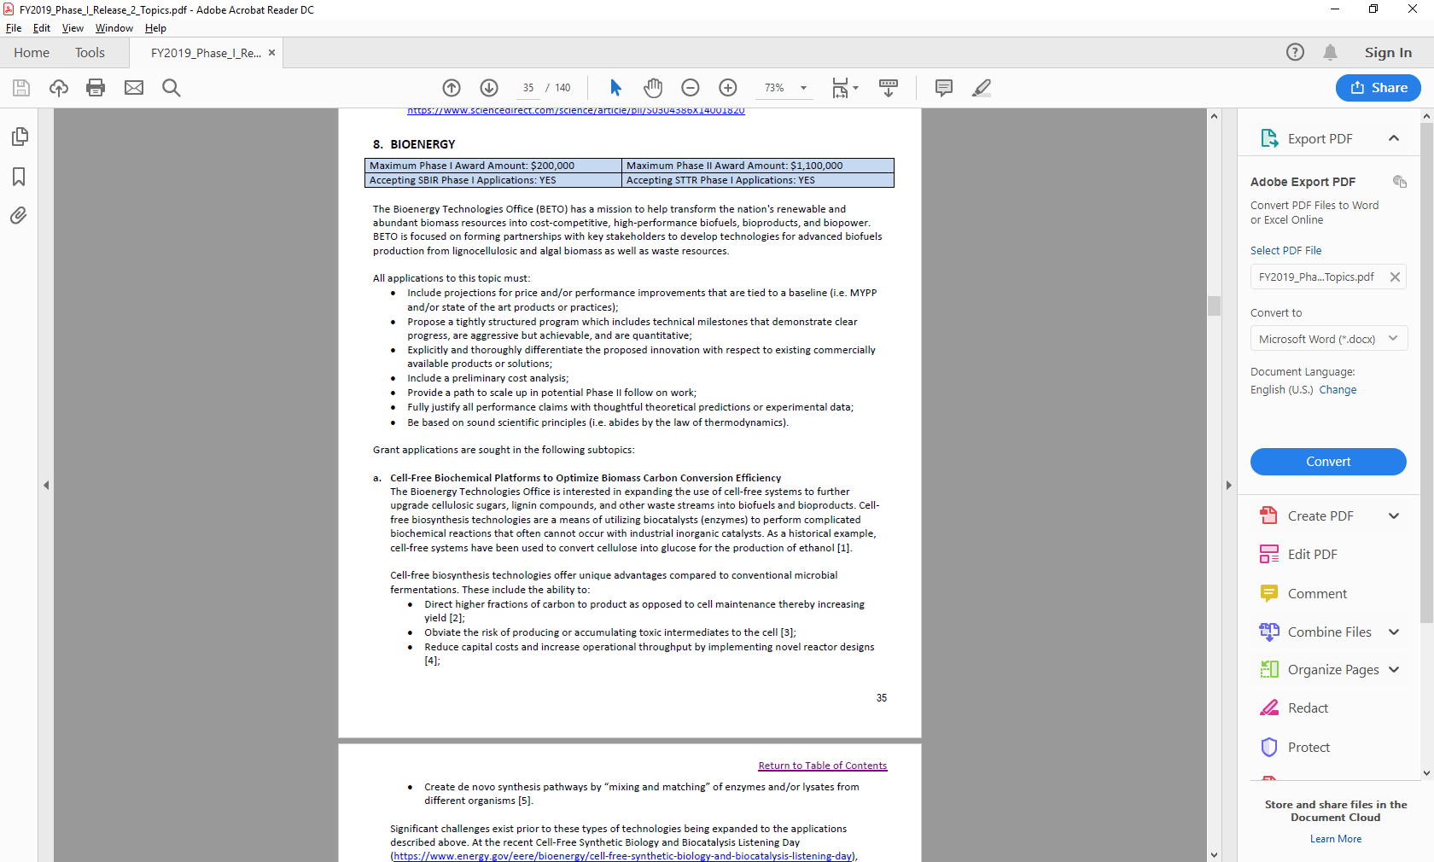
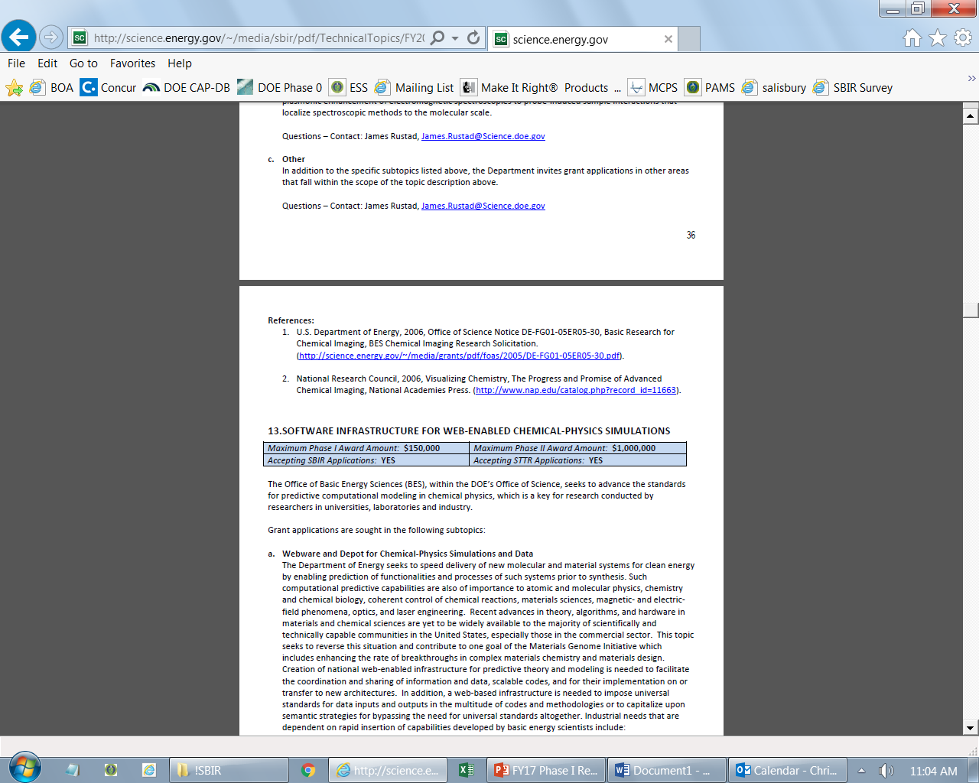
Example Topic
Topic & Subtopic
  You must specify the same topic and subtopic in your Letter of Intent and grant application
Topic Header
  Lists the maximum award amounts for Phase I & Phase II and the types of application accepted (SBIR and/or STTR)
Program Manager
  Each subtopic lists the responsible DOE program manager
“Other” Subtopic
References
Notes:
Here is an example topic from our current announcement. Note that every SBIR or STTR application must include the topic and subtopic to which you are applying. The general topic description describes the general field of technology that is of interest. The subtopics describe specific opportunities in which proposals are requested. Each topic at DOE will also have an “other” subtopic. Under this subtopic you can submit proposals that fall within the general topic description, but do not fit with any of the other subtopics. We have found that when we write the subtopics too narrow sometimes we miss good opportunities, and this “other” subtopic is a means collecting disruptive solutions.

Slide 9
Topic 01: ENERGY SYSTEMS CYBERSECURITY
Maximum Phase I Award Amount: $200,000 | Maximum Phase II Award Amount: $1,100,000
Accepting SBIR Phase I Applications: YES | Accepting STTR Phase I Applications: NO
a. Cybersecurity during Contingency Operations
b. Power Systems Settings Security
Questions: Walter Yamben, Walter.Yamben@netl.doe.gov

Slide 10
Topic 02: RADIATION DETECTION
Maximum Phase I Award Amount: $200,000 | Maximum Phase II Award Amount: $1,100,000
Accepting SBIR Phase I Applications: YES | Accepting STTR Phase I Applications: NO
Radiation Detection Material Advancement
Portable Neutron, X-ray, and Multi-Modal Radiography
Other
Questions: Donald Hornback, Donald.Hornback@nnsa.doe.gov

Slide 11
Topic 03: DESIGN AND MANUFACTURING ADVANCES FOR SPACE-BASED SENSORS
Maximum Phase I Award Amount: $200,000 | Maximum Phase II Award Amount: $1,100,000
Accepting SBIR Phase I Applications: YES | Accepting STTR Phase I Applications: No
Next-Generation Miniaturized Ionizing Radiation Sensors
Manufacturing Developments for Silicon Photodiodes
Space Qualified Printed Circuit Boards Produced Via Additive Manufacturing
Other
Questions: Lt Col Robert Heyward, Robert.heyward@nnsa.doe.gov

Slide 12
Topic 04: ADVANCED GRID TECHNOLOGIES
Maximum Phase I Award Amount: $200,000 | Maximum Phase II Award Amount: $1,100,000
Accepting SBIR Phase I Applications: YES | Accepting STTR Phase I Applications: No
Power System Operator Human Factors Innovation
Advanced Power Transmission Tools and Technologies
Questions: Subtopics a – Sandra Jenkins, sandra.jenkins@hq.doe.gov
Subtopics b – Kerry Cheung, kerry.cheung@hq.doe.gov

Slide 13
Topic 05: SAFETY TECHNOLOGIES FOR GRID SCALE BATTERY ENERGY STORAGE SYSTEMS
Maximum Phase I Award Amount: $200,000 | Maximum Phase II Award Amount: $1,100,000
Accepting SBIR Phase I Applications: YES | Accepting STTR Phase I Applications: No
Thermal Runaway Prevention Technologies for Lithium-Ion Batteries
Battery Energy Storage Systems Emergency Response Technologies
Questions: Andre Pereira, andre.pereira@hq.doe.gov

Slide 14
Topic 18: NOVEL MONITORING CONCEPTS IN THE SUBSURFACE
Maximum Phase I Award Amount: $200,000 | Maximum Phase II Award Amount: $1,100,000
Accepting SBIR Phase I Applications: YES | Accepting STTR Phase I Applications: No
Onsite and Field Monitoring Tools and Sensors
Other
Questions: Latrincy Bates, Latrincy.Bates@em.doe.gov

Slide 15
Topic 19: ADVANCED TURBINES TECHNOLOGIES
Maximum Phase I Award Amount: $250,000 | Maximum Phase II Award Amount: $1,600,000
Accepting SBIR Phase I Applications: YES | Accepting STTR Phase I Applications: YES
Low Cost, High-Yield Advanced Manufacturing (AM) Techniques for Ceramic Matrix Composite Applicable to Combustion Turbine Hot Gas Path Components
Sensors for Turbine Applications
Low Flow, High Pressure Ratio Compressors Providing Ancillary Support to Supercritical Carbon Dioxide Power Cycles
Expansion Joint Technology for High Temperature and Pressure Conditions in sCO2 Power Cycles
Other
Questions: Subtopics a & e – Patcharin Burke, Patcharin.Burke@netl.doe.gov Subtopic b – Mark Freeman, Mark.Freeman@netl.doe.gov
Subtopics c & d – Matt Adams, Matthew.F.Adams@netl.doe.gov

Slide 16
Topic 20: CARBON CAPTURE TECHNOLOGIES
Maximum Phase I Award Amount: $250,000 | Maximum Phase II Award Amount: $1,600,000
Accepting SBIR Phase I Applications: YES | Accepting STTR Phase I Applications: YES
Novel Materials or Processes to Support Transformational Carbon Capture Technologies
Direct Air Capture
Process Intensification for Carbon Capture Systems
Other
Questions: Katharina Daniels, Katharina.Daniels@netl.doe.gov

Slide 17
Topic 21: CARBON STORAGE TECHNOLOGIES
Maximum Phase I Award Amount: $250,000 | Maximum Phase II Award Amount: $1,600,000
Accepting SBIR Phase I Applications: YES | Accepting STTR Phase I Applications: YES
Integrating Technologies to Lower Uncertainties in Carbon Storage Complexes
Developing Graphical User Interface and Software Distribution Platform for an Integrated Model for Geologic Carbon Storage Containment and Leakage Risk Assessment
Other
Questions: Kyle Smith, Kyle.Smith@netl.doe.gov

Slide 18
Topic 22: CARBON UTILIZATION PROGRAM
Maximum Phase I Award Amount: $250,000 | Maximum Phase II Award Amount: $1,600,000
Accepting SBIR Phase I Applications: YES | Accepting STTR Phase I Applications: YES
Plasma Technologies
Carbon Utilization - Production of Solid Carbon Materials
Other
Questions: Naomi O’Neil, Naomi.Oneil@netl.doe.gov

Slide 19
Topic 23: CROSSCUTTING TECHNOLOGIES
Maximum Phase I Award Amount: $250,000 | Maximum Phase II Award Amount: $1,600,000
Accepting SBIR Phase I Applications: YES | Accepting STTR Phase I Applications: YES
Supply Chain Enhancements for Fossil Energy Alloy Production
Automated Plant Component Inspection, Analysis, and Repair Enabled by Robotics
Real-time Monitoring of Selenium, Mercury, and Arsenic in Coal Power Plant Effluent Streams
Other
Questions: Subtopics a – Richard Dunst, Richard.Dunst@netl.doe.gov
Subtopics b & c – Jessica Mullen, Jessica.Mullen@netl.doe.gov
Subtopics d – Maria Reidpath, Maria.Reidpath@netl.doe.gov

Slide 20
Topic 24: FUEL CELLS
Maximum Phase I Award Amount: $250,000 | Maximum Phase II Award Amount: $1,600,000
Accepting SBIR Phase I Applications: YES | Accepting STTR Phase I Applications: YES
Sensors for Solid Oxide Fuel Cell (SOFC) Applications
Additive Manufacturing for Solid Oxide Fuel Cell (SOFC) Cell, Stack, or Balance of Plant (BOP) Components
Other
Questions: Subtopics a & c – Steven Markovich, Steven.Markovich@netl.doe.gov
Subtopics b – Debalina Dasgupta, Debalina.Dasgupta@netl.doe.gov

Slide 21
Topic 25: TRANSFORMATIVE POWER GENERATION
Maximum Phase I Award Amount: $250,000 | Maximum Phase II Award Amount: $1,600,000
Accepting SBIR Phase I Applications: YES | Accepting STTR Phase I Applications: YES
Advanced Hybrid Fossil Energy Systems with Energy Storage
Improving the Performance of the Existing Coal Fleet
Modeling and Validation of Heat Transfer for Indirect SCO2 Coal-Fired Boilers
Other
Questions: Subtopics a – Matt Adams, Matthew.F.Adams@netl.doe.gov Subtopics b – Steven Markovich, Steven.Markovich@netl.doe.gov
Subtopics c & e – Mark Freeman, Mark.Freeman@netl.doe.gov

Slide 22


DOE SBIR/STTR Programs Office
Contact Information
SBIR/STTR Web: https://science.osti.gov/sbir
Email: sbir-sttr@science.doe.gov
Phone Assistance Hotline: 301-903-5707
DOE Phase 0 Assistance Program: http://www.dawnbreaker.com/doephase0/
DOE Application Assistance: https://science.osti.gov/SBIRLearning

