Slide 1
The DOE Webinar will begin shortly . . .
Why is there no sound?
  Once you logged into the webinar, you were provided two options to listen to this broadcast. The first option is through your computer speakers, the second option is via dialing the phone number provided to you upon login to the webinar. If you chose to listen through your computer speakers, you may need to turn your speaker volume on or up.
Will DOE provide access to the recorded webinar after the meeting?
  Yes, all those who registered will receive a link to the slides and to the recorded webinar soon after the meeting. It will also be available on the DOE SBIR/STTR web site.
Where can I find the Topics being discussed today?
  This link will take you to the Funding Opportunity Announcement (FOA) page that lists the FY 2024 Phase I Release 1 Topics: https://science.osti.gov/sbir/Funding-Opportunities
What if my question was not answered at today’s webinar?
  Please contact the point of contact that follows each subtopic in the document listed above for further clarification.
  If you have a question about the grant application process, please send us an email at: sbir-sttr@science.doe.gov.

Slide 2

DOE SBIR/STTR
Phase I Release 1 Topics Webinar
Topics associated with the
FY 2024 Phase I Release 1
Funding Opportunity Announcement
Topics 16-25
DOE SBIR/STTR Programs Office
July 19, 2022

Slide 3
TODAY’S AGENDA
Topics Introduction | DOE SBIR/STTR Programs Office
Topics 16 – 20 | Office of Biological and Environmental Research
Topics 21 – 25 | Office of Fusion Energy Sciences

Slide 4
FY 2024 Phase I Schedule
 | Release 1 | Release 2
Topics Issued | Monday, July 10, 2023 | Monday, November 6, 2023
Webinar(s) | Week of July 17, 2023 | Week of November 13, 2023
FOA Issued | Monday, August 7, 2023 | Monday, December 11, 2023
Webinar(s) | Friday, August 11, 2023 | Friday, December 15, 2023
Letters of Intent (LOI) Due | Monday, August 28, 2023 | Tuesday, January 2, 2024
Non-responsive LOI Feedback Provided | Monday, September 18, 2023 | Tuesday, January 23, 2024
Applications Due | Tuesday, October 10, 2023 | Tuesday, February 20, 2024
Award Notification | Tuesday, January 2, 2024 | Monday, May 13, 2024

Slide 5
Phase I Funding Opportunity Announcements
Participating DOE Programs (FY 2024)
Office of Advanced Scientific Computing Research
Office of Basic Energy Sciences
Office of Biological and Environmental Research
Office of Fusion Energy Sciences
Office of High Energy Physics
Office of Nuclear Physics
Phase I
Release 1
Phase I
Release 2
Office of Cyber Security, Energy Security, and Emergency Response
Office of Defense Nuclear Nonproliferation
Office of Electricity
Office of Energy Efficiency and Renewable Energy
Office of Fossil Energy and Carbon Management
Office of Nuclear Energy

Slide 6
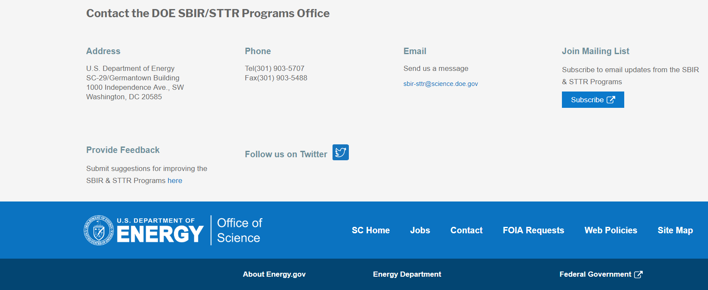
Funding Opportunity Announcement (FOA) Webinar
FY24 Phase I Release 1 FOA will be issued on August 7th
Join our Mailing List – this field is on every DOE SBIR/STTR web page
  Following the issuance of the FOA, look for an email with a link to the FOA
Webinar with Q&A for this FOA on August 11th
  Overview of the FY 2024 DOE SBIR/STTR Programs
    Following the issuance of the FOA, look for an email announcing this webinar

Slide 7
Reminder - Phase 0 Application Assistance Program
Free
to you!
Phase 0 application assistance program is available for first-time DOE SBIR/STTR applicants
Participants receive an individual coach who is an expert in our application process.
Program opens when Topics are released (Open now!)
Visit http://www.dawnbreaker.com/doephase0/ to determine your eligibility and apply to Phase 0

Slide 8
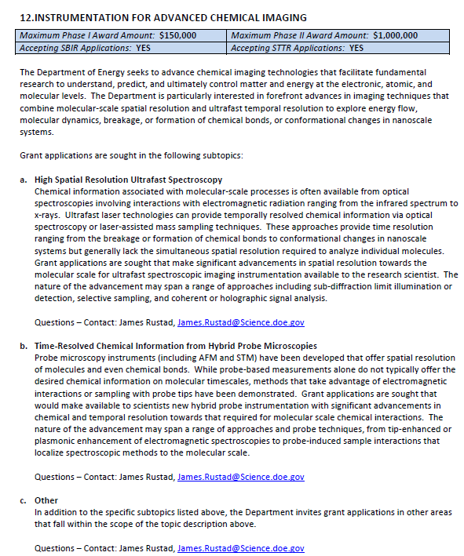
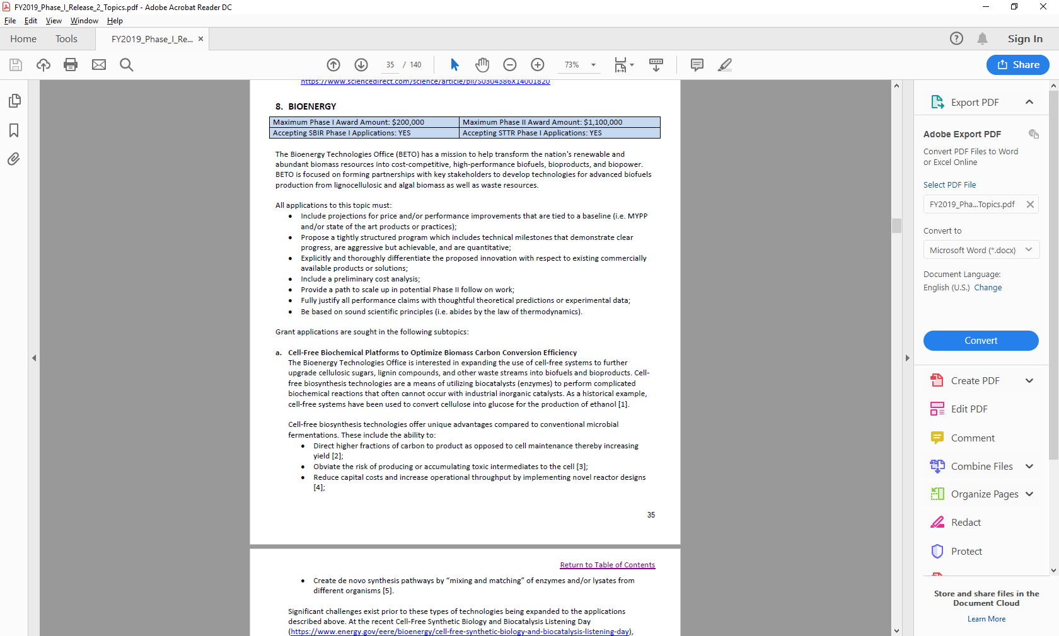
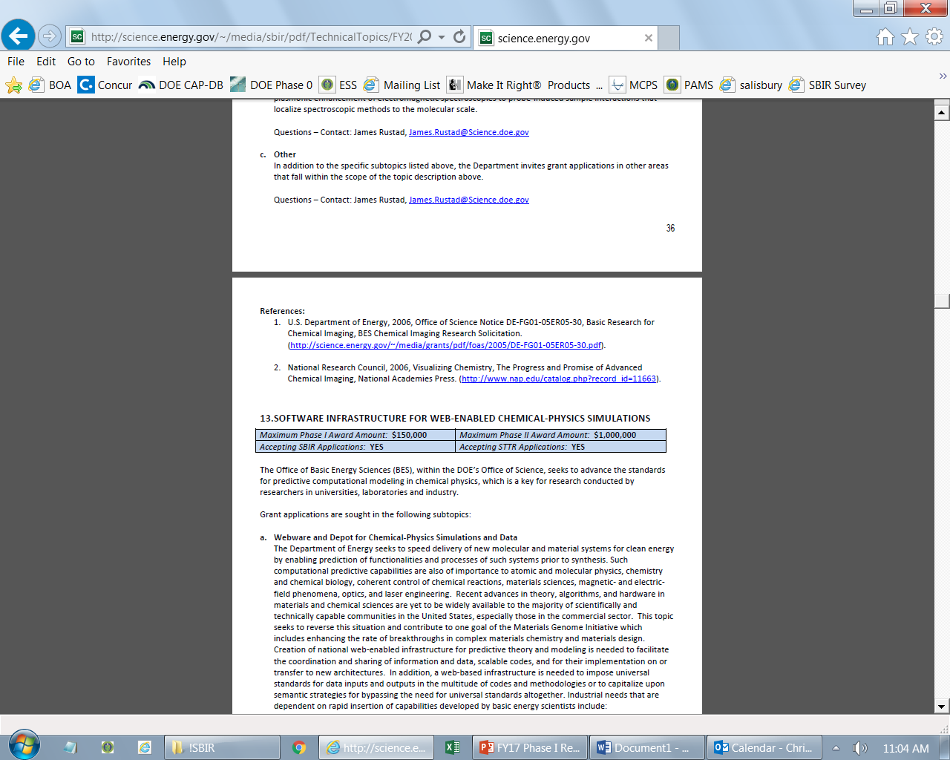
Example Topic
Topic & Subtopic
  You must specify the same topic and subtopic in your Letter of Intent and grant application
Topic Header
  Lists the maximum award amounts for Phase I & Phase II and the types of application accepted (SBIR and/or STTR)
Program Manager
  Each subtopic lists the responsible DOE program manager
“Other” Subtopic
References
Notes:
Here is an example topic from our current announcement. Note that every SBIR or STTR application must include the topic and subtopic to which you are applying. The general topic description describes the general field of technology that is of interest. The subtopics describe specific opportunities in which proposals are requested. Each topic at DOE will also have an “other” subtopic. Under this subtopic you can submit proposals that fall within the general topic description, but do not fit with any of the other subtopics. We have found that when we write the subtopics too narrow sometimes we miss good opportunities, and this “other” subtopic is a means collecting disruptive solutions.

Slide 9
Topic C57-16: URBAN MEASUREMENT TECHNOLOGY
Maximum Phase I Award Amount: $250,000 | Maximum Phase II Award Amount: $1,600,000
Accepting SBIR Phase I Applications: YES | Accepting STTR Phase I Applications: YES
a. Urban Atmospheric Characterization
b. Urban Visualization and Data Analysis Tools
c. Other
Questions: Subtopic a & c – Jeff Stehr, Jeff.Stehr@science.doe.gov or Sally McFarlane, Sally.McFarlane@science.doe.gov
Subtopic b & c – Justin Hnilo, justin.hnilo@science.doe.gov

Slide 10
Topic C57-17: COMPLEX DATA: ADVANCED DATA ANALYTIC TECHNOLOGIES FOR SYSTEMS BIOLOGY AND BIOENERGY
Maximum Phase I Award Amount: $250,000 | Maximum Phase II Award Amount: $1,600,000
Accepting SBIR Phase I Applications: YES | Accepting STTR Phase I Applications: YES
Complex Data: Advanced Data Analytic Technologies for Systems Biology and Bioenergy
Other
Questions: Ramana Madupu, Ramana.Madupu@science.doe.gov , or Resham Kulkarni Resham.Kulkarni@science.doe.gov

Slide 11
Topic C57-18: ENABLING TOOLS FOR MOLECULAR STRUCTURE OR MORPHOLOGICAL CHARACTERIZATION OF BIOLOGICAL AND BIOGEOCHEMICAL INTERACTIONS WITHIN OR AMONG MICROBES, PLANTS, MINERALS, SOILS
Maximum Phase I Award Amount: $250,000 | Maximum Phase II Award Amount: $1,600,000
Accepting SBIR Phase I Applications: YES | Accepting STTR Phase I Applications: YES
Tools or Instruments for Structural or Morphological Characterization of Biological Systems Ranging from Atomic to Multi-cellular Scales
Other
Questions: Amy Swain, Amy.Swain@science.doe.gov

Slide 12
Topic C57-19: BIOIMAGING TECHNOLOGIES FOR BIOLOGICAL SYSTEMS
Maximum Phase I Award Amount: $250,000 | Maximum Phase II Award Amount: $1,600,000
Accepting SBIR Phase I Applications: YES | Accepting STTR Phase I Applications: YES
Automated Bioimaging Devices for Structural and Functional Characterization of Plant and Microbial Communities
Quantum Enabled Bioimaging and Sensing Approaches for Bioenergy
Other
Questions: Paul Sammak, Paul.Sammak@science.doe.gov

Slide 13
Top C57-20: DELIVERY TECHNOLOGIES FOR GENETIC ENGINEERING BIOENERGY CROPS
Maximum Phase I Award Amount: $250,000 | Maximum Phase II Award Amount: $1,600,000
Accepting SBIR Phase I Applications: YES | Accepting STTR Phase I Applications: YES
Improved Delivery Technologies
Other
Questions: Kari Perez, Kari.Perez@science.doe.gov

Slide 14
Topic C57-21: FUSION MATERIALS
Maximum Phase I Award Amount: $200,000 | Maximum Phase II Award Amount: $1,100,000
Accepting SBIR Phase I Applications: YES | Accepting STTR Phase I Applications: YES
Advanced and Additive Manufacturing Technologies
Neutron Source Enabling Technologies and Components
Other
Questions: Guinevere Shaw, guinevere.shaw@science.doe.gov

Slide 15
Topic C57-22: SUPERCONDUCTING MAGNETS
Maximum Phase I Award Amount: $200,000 | Maximum Phase II Award Amount: $1,100,000
Accepting SBIR Phase I Applications: YES | Accepting STTR Phase I Applications: YES
QA/QC Tools
Innovative Structural and Stabilization Approaches
Radiation-Resistant Electrical Insulators
Diagnostics
Other
Questions: Guinevere Shaw, guinevere.shaw@science.doe.gov

Slide 16
Topic C57-23: LOW TEMPERATURE PLASMAS AND MICROELECTRONICS
Maximum Phase I Award Amount: $200,000 | Maximum Phase II Award Amount: $1,100,000
Accepting SBIR Phase I Applications: YES | Accepting STTR Phase I Applications: YES
LTP Science and Engineering for Microelectronics and Nanotechnology
Other
Questions: Nirmol Podder, Nirmol.Podder@science.doe.gov

Slide 17
Topic C57-24: INERTIAL FUSION ENERGY (IFE)
Maximum Phase I Award Amount: $200,000 | Maximum Phase II Award Amount: $1,100,000
Accepting SBIR Phase I Applications: YES | Accepting STTR Phase I Applications: YES
a. Targets for Laser Inertial Fusion Energy
b. Other
Questions: Kramer Akli, Kramer.akli@science.doe.gov

Slide 18
Topic C57-25: PLASMA ACTUATORS FOR FUSION POWER PLANTS
Maximum Phase I Award Amount: $200,000 | Maximum Phase II Award Amount: $1,100,000
Accepting SBIR Phase I Applications: YES | Accepting STTR Phase I Applications: YES
Heating and Current Drive
Plasma Momentum Injection
Other
Questions: Matthew Lanctot, matthew.lanctot@science.doe.gov

Slide 19
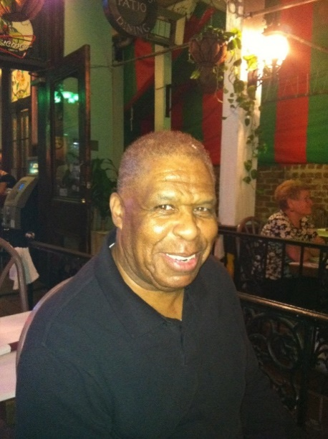
DOE SBIR/STTR Programs Office
Contact Information
SBIR/STTR Web: https://science.osti.gov/sbir
Email: sbir-sttr@science.doe.gov
Phone Assistance Hotline: 301-903-5707
DOE Phase 0 Assistance Program: https://doephase0.dawnbreaker.com/
DOE Application Assistance: https://science.osti.gov/SBIRLearning

