Slide 1
The DOE Webinar will begin shortly . . .
Why is there no sound?
  Once you logged into the webinar, you were provided two options to listen to this broadcast. The first option is through your computer speakers, the second option is via dialing the phone number provided to you upon login to the webinar. If you chose to listen through your computer speakers, you may need to turn your speaker volume on or up.
Will DOE provide access to the recorded webinar after the meeting?
  Yes, all those who registered will receive a link to the slides and to the recorded webinar soon after the meeting. It will also be available on the DOE SBIR/STTR web site.
Where can I find the Topics being discussed today?
  This link will take you to the Funding Opportunity Announcement (FOA) page that lists the FY 2024 Phase I Release 1 Topics: https://science.osti.gov/sbir/Funding-Opportunities
What if my question was not answered at today’s webinar?
  Please contact the point of contact that follows each subtopic in the document listed above for further clarification.
  If you have a question about the grant application process, please send us an email at: sbir-sttr@science.doe.gov.

Slide 2

DOE SBIR/STTR
Phase I Release 1 Topics Webinar
Topics associated with the
FY 2024 Phase I Release 1
Funding Opportunity Announcement
Topics 1-15
DOE SBIR/STTR Programs Office
July 18, 2022

Slide 3
TODAY’S AGENDA
Topics Introduction | DOE SBIR/STTR Programs Office
Topics 01 – 06 | Office of Advanced Scientific Computing Research
Topics 07 – 15 | Office of Basic Energy Sciences

Slide 4
FY 2024 Phase I Schedule
 | Release 1 | Release 2
Topics Issued | Monday, July 10, 2023 | Monday, November 6, 2023
Webinar(s) | Week of July 17, 2023 | Week of November 13, 2023
FOA Issued | Monday, August 7, 2023 | Monday, December 11, 2023
Webinar(s) | Friday, August 11, 2023 | Friday, December 15, 2023
Letters of Intent (LOI) Due | Monday, August 28, 2023 | Tuesday, January 2, 2024
Non-responsive LOI Feedback Provided | Monday, September 18, 2023 | Tuesday, January 23, 2024
Applications Due | Tuesday, October 10, 2023 | Tuesday, February 20, 2024
Award Notification | Tuesday, January 2, 2024 | Monday, May 13, 2024

Slide 5
Phase I Funding Opportunity Announcements
Participating DOE Programs (FY 2024)
Office of Advanced Scientific Computing Research
Office of Basic Energy Sciences
Office of Biological and Environmental Research
Office of Fusion Energy Sciences
Office of High Energy Physics
Office of Nuclear Physics
Phase I
Release 1
Phase I
Release 2
Office of Cyber Security, Energy Security, and Emergency Response
Office of Defense Nuclear Nonproliferation
Office of Electricity
Office of Energy Efficiency and Renewable Energy
Office of Fossil Energy and Carbon Management
Office of Nuclear Energy

Slide 6
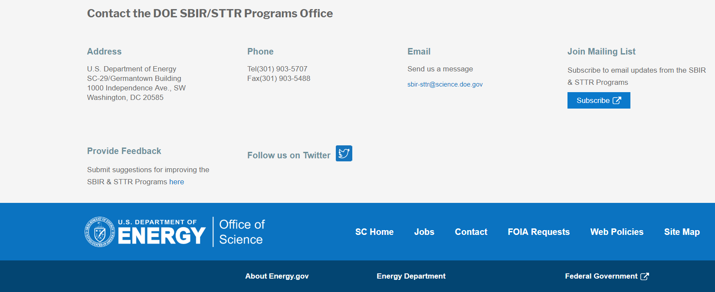
Funding Opportunity Announcement (FOA) Webinar
FY24 Phase I Release 1 FOA will be issued on August 7th
Join our Mailing List – this field is on every DOE SBIR/STTR web page
  Following the issuance of the FOA, look for an email with a link to the FOA
Webinar with Q&A for this FOA on August 11th
  Overview of the FY 2024 DOE SBIR/STTR Programs
    Following the issuance of the FOA, look for an email announcing this webinar

Slide 7
Reminder - Phase 0 Application Assistance Program
Free
to you!
Phase 0 application assistance program is available for first-time DOE SBIR/STTR applicants
Participants receive an individual coach who is an expert in our application process.
Program opens when Topics are released (Open now!)
Visit http://www.dawnbreaker.com/doephase0/ to determine your eligibility and apply to Phase 0

Slide 8
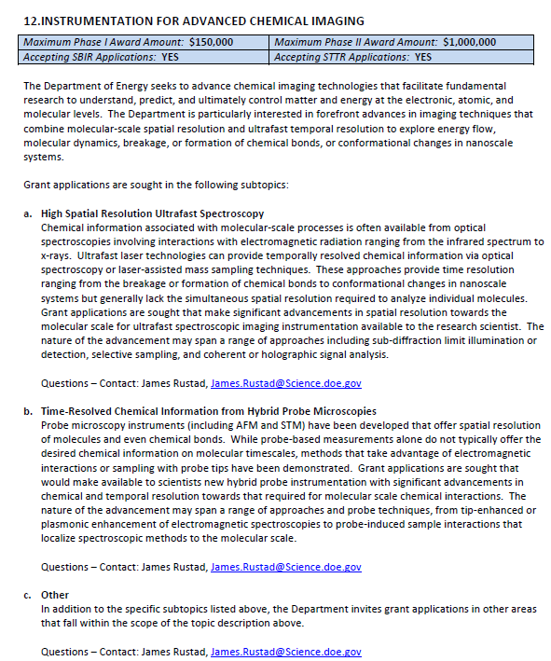
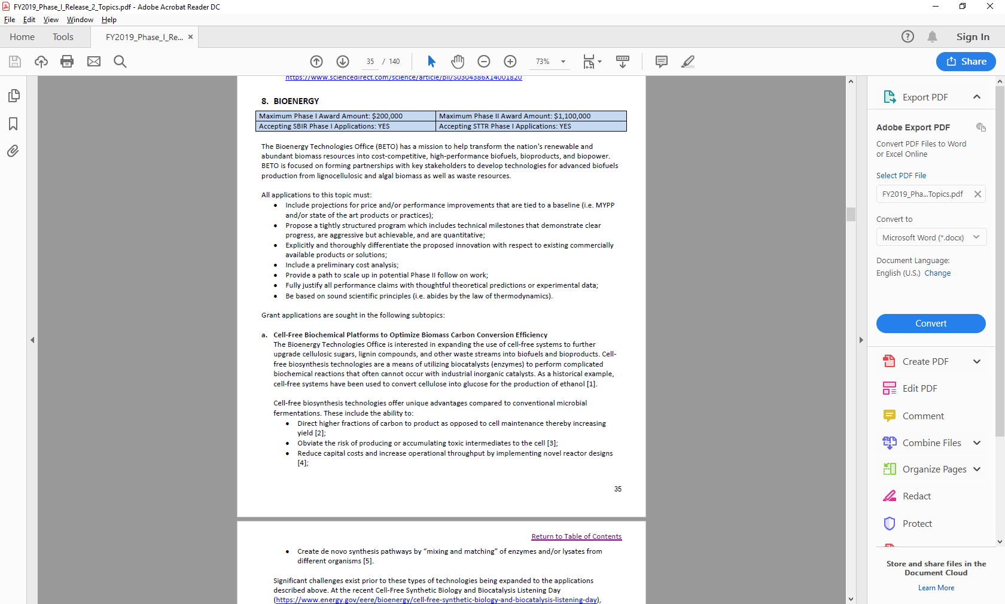
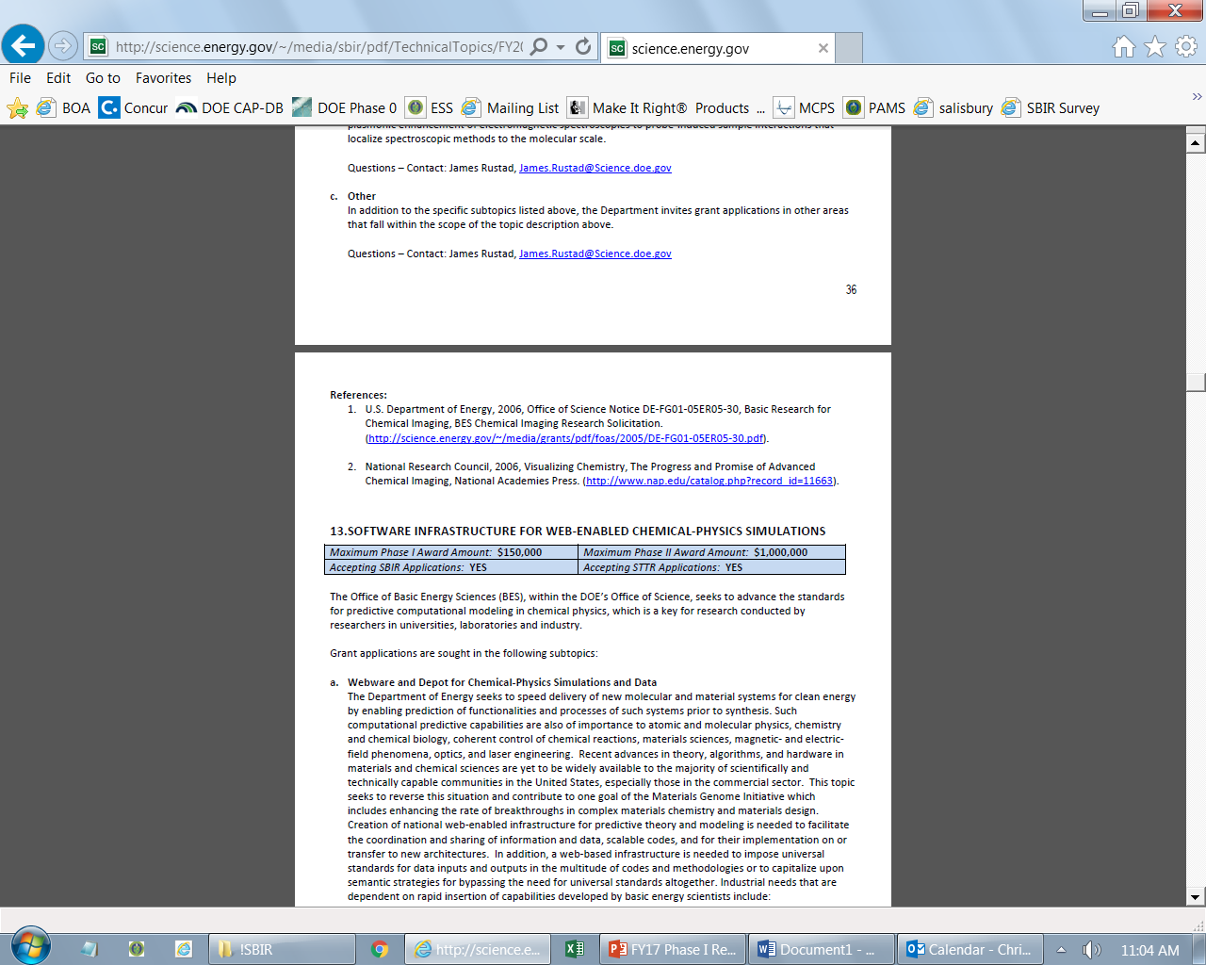
Example Topic
Topic & Subtopic
  You must specify the same topic and subtopic in your Letter of Intent and grant application
Topic Header
  Lists the maximum award amounts for Phase I & Phase II and the types of application accepted (SBIR and/or STTR)
Program Manager
  Each subtopic lists the responsible DOE program manager
“Other” Subtopic
References
Notes:
Here is an example topic from our current announcement. Note that every SBIR or STTR application must include the topic and subtopic to which you are applying. The general topic description describes the general field of technology that is of interest. The subtopics describe specific opportunities in which proposals are requested. Each topic at DOE will also have an “other” subtopic. Under this subtopic you can submit proposals that fall within the general topic description, but do not fit with any of the other subtopics. We have found that when we write the subtopics too narrow sometimes we miss good opportunities, and this “other” subtopic is a means collecting disruptive solutions.

Slide 9
Topic C57-01: ACCELERATING THE DEPLOYMENT OF ADVANCED SOFTWARE TECHNOLOGIES
Maximum Phase I Award Amount: $200,000 | Maximum Phase II Award Amount: $1,100,000
Accepting SBIR Phase I Applications: YES | Accepting STTR Phase I Applications: YES
Deployment of ASCR-Funded Software
Integration of ASCR-Funded Libraries
Other
Questions: Hal Finkel, Hal.Finkel@science.doe.gov and/or William Spotz, William.Spotz@science.doe.gov

Slide 10
Topic C57-02: HPC CYBERSECURITY
Maximum Phase I Award Amount: $200,000 | Maximum Phase II Award Amount: $1,100,000
Accepting SBIR Phase I Applications: YES | Accepting STTR Phase I Applications: YES
Strengthening Isolation between HPC Users
Other
Questions: Carol Hawk, carol.hawk@science.doe.gov

Slide 11
Topic C57-03: DIGITAL-TWIN CAPABILITIES FOR SCIENCE NETWORK INFRASTRUCTURES
Maximum Phase I Award Amount: $200,000 | Maximum Phase II Award Amount: $1,100,000
Accepting SBIR Phase I Applications: YES | Accepting STTR Phase I Applications: YES
Network Simulation Tools
Other
Questions: Kalyan Perumalla, kalyan.perumalla@science.doe.gov

Slide 12
Topic C57-04: TECHNOLOGY TO FACILITATE THE USE OF NEAR-TERM QUANTUM COMPUTING HARDWARE
Maximum Phase I Award Amount: $200,000 | Maximum Phase II Award Amount: $ 1,100,000
Accepting SBIR Phase I Applications: YES | Accepting STTR Phase I Applications: YES
Software for Calibration, Characterization, and Control of Quantum Processors
Questions: Claire Cramer, Claire.Cramer@science.doe.gov

Slide 13
Topic C57-05: ARTIFICIAL INTELLIGENCE TOOLS FOR CATALYZING INTERDISCIPLINARY SCIENCE
Maximum Phase I Award Amount: $ 200,000 | Maximum Phase II Award Amount: $ 1,100,000
Accepting SBIR Phase I Applications: YES | Accepting STTR Phase I Applications: YES
a. Interdisciplinary Training and Interfaces
Questions: Kalyan Perumalla, Kalyan.Perumalla@science.doe.gov Margaret Lentz, Margaret.Lentz@science.doe.gov Hal Finkel, Hal.Finkel@science.doe.gov

Slide 14
Topic C57-06: MIXED INTEGER SOLVER TECHNOLOGY FOR ACCELERATED COMPUTING SYSTEMS
Maximum Phase I Award Amount: $ 200,000 | Maximum Phase II Award Amount: $ 1,100,000
Accepting SBIR Phase I Applications: YES | Accepting STTR Phase I Applications: YES
a. Efficient Distributed Tree Management
b. Efficient Linear Program Relaxation Solution
c. Other
Questions: Kalyan Perumalla, Kalyan.Perumalla@science.doe.gov

Slide 15
Topic C57-07: COST-EFFECTIVE CRYOGENIC COOLING SYSTEMS FOR HIGH POWER X-RAY OPTICS
Maximum Phase I Award Amount: $ 200,000 | Maximum Phase II Award Amount: $1,100,000
Accepting SBIR Phase I Applications: YES | Accepting STTR Phase I Applications: YES
Development of Cost-Effective, Compact, Closed-Loop, Cryogenic Systems for Cooling of High-Power X-Ray Optics
Other
Questions: Eliane Lessner, Eliane.Lessner@science.doe.gov

Slide 16
Topic C57-08: THERMAL AND COLD NEUTRON BEAM TRANSPORT TECHNOLOGY FOR SCATTERING INSTRUMENTATION AT PULSED AND CONTINUOUS NEUTRON SOURCES
Maximum Phase I Award Amount: $ 200,000 | Maximum Phase II Award Amount: $ 1,100,000
Accepting SBIR Phase I Applications: YES | Accepting STTR Phase I Applications: YES
Large-Scale Fabrication of Super-Mirror Reflection Surfaces for Neutron Guides, Mirrors, Polarizers and Filters
Other
Questions: Mikhail Zhernenkov, Mikhail.Zhernenkov@science.doe.gov

Slide 17
Topic C57-09: SOFTWARE TOOLS AND DATA MOVEMENT SYSTEMS SOLUTIONS FOR HIGH BRIGHTNESS X-RAY SOURCES
Maximum Phase I Award Amount: $ 200,000 | Maximum Phase II Award Amount: $ 1,100,000
Accepting SBIR Phase I Applications: YES | Accepting STTR Phase I Applications: YES
Machine-Guided Visualization Tool to Explore and Coalesce Multi-Channel and Multi-Modal Nanoscale Imaging Data
Efficient High-Performance Data Transfer Over ESnet for Massive-Scale Data Analytics
Other
Questions: Eliane Lessner, Eliane.Lessner@science.doe.gov

Slide 18
Topic C57-10: SPIN-POLARIZED AND TIME-RESOLVED ELECTRON BEAM SOURCE FOR ELECTRON MICROSCOPY
Maximum Phase I Award Amount: $ 200,000 | Maximum Phase II Award Amount: $ 1,100,000
Accepting SBIR Phase I Applications: YES | Accepting STTR Phase I Applications: YES
Development of a Commercially Viable Spin-Polarized and Time-Resolved Electron Gun from a GaAs Emitter
Other
Questions: Claudia Cantoni, claudia.cantoni@science.doe.gov

Slide 19
Topic C57-11: ARTIFICIAL INTELLIGENCE/MACHINE LEARNING APPROACHES TO REVEAL STRUCTURE AND DYNAMICS OF FRACTURE SYSTEMS AND INDUCED SEISMICITY IN THE EARTH’S CRUST
Maximum Phase I Award Amount: $ 200,000 | Maximum Phase II Award Amount: $ 1,100,000
Accepting SBIR Phase I Applications: YES | Accepting STTR Phase I Applications: YES
Development of AI/ML Data-Driven Algorithms for Assessing the Potential of Induced Seismicity
Other
Questions: Raul Miranda, Raul.Miranda@science.doe.gov

Slide 20
Topic C57-12: RARE EARTH AND CRITICAL ELEMENTS RECOVERY VIA SELECTIVE MEMBRANES: AI/ML-GUIDED MEMBRANE DEVELOPMENT
Maximum Phase I Award Amount: $ 200,000 | Maximum Phase II Award Amount: $ 1,100,000
Accepting SBIR Phase I Applications: YES | Accepting STTR Phase I Applications: YES
AI/ML Framework for Hybrid Data/Physics Modelling and Design of RE/CE Separation Membranes
Other
Questions: Raul Miranda, Raul.Miranda@science.doe.gov

Slide 21
Topic C57-13: HIGH PERFORMANCE MATERIALS FOR NUCLEAR APPLICATION
Maximum Phase I Award Amount: $ 250,000 | Maximum Phase II Award Amount: $ 1,600,000
Accepting SBIR Phase I Applications: YES | Accepting STTR Phase I Applications: YES
Powder Metallurgy-Hot Isostatic Pressing of High Temperature Metallic Alloys
Salt Vapor Trap + Reversible Chlorine Gas Absorber Technology for Recovery and Recycle of Chlorine
Other
Questions: Subtopic a & c – Dirk Cairns-Gallimore, dirk.cairns-gallimore@nuclear.energy.gov
Subtopic b – James Willit, James.Willit@nuclear.energy.gov

Slide 22
Topic C57-14: ADVANCED SUBSURFACE ENERGY TECHNOLOGIES
Maximum Phase I Award Amount: $ 200,000 | Maximum Phase II Award Amount: $ 1,100,000
Accepting SBIR Phase I Applications: YES | Accepting STTR Phase I Applications: YES
a. Geothermal
Questions: William Vandermeer, william.vandermeer@ee.doe.gov

Slide 23
Topic C57-15: TECHNOLOGY TRANSFER OPPORTUNITIES: BASIC ENERGY SCIENCES
Maximum Phase I Award Amount: $ 250,000 | Maximum Phase II Award Amount: $ 1,600,000
Accepting SBIR Phase I Applications: YES | Accepting STTR Phase I Applications: YES
TTO: Advanced X-Ray Emission Spectrometer
TTO: Force-Neutral Adjustable Phase Undulator
Questions: Subtopic a – Dava Keavney, Dava.Keavney@science.doe.gov
Subtopic b – Eliane Lessner, Eliane.Lessner@science.doe.gov

Slide 24

DOE SBIR/STTR Programs Office
Contact Information
SBIR/STTR Web: https://science.osti.gov/sbir
Email: sbir-sttr@science.doe.gov
Phone Assistance Hotline: 301-903-5707
DOE Phase 0 Assistance Program: https://doephase0.dawnbreaker.com/
DOE Application Assistance: https://science.osti.gov/SBIRLearning

