Slide 1
The DOE Webinar will begin shortly . . .
Why is there no sound?
  Once you logged into the webinar, you were provided two options to listen to this broadcast. The first option is through your computer speakers, the second option is via dialing the phone number provided to you upon login to the webinar. If you chose to listen through your computer speakers, you may need to turn your speaker volume on or up.
Will DOE provide access to the recorded webinar after the meeting?
  Yes, all those who registered will receive a link to the slides and to the recorded webinar soon after the meeting. It will also be available on the DOE SBIR/STTR web site.
Where can I find the Topics being discussed today?
  This link will take you to the Funding Opportunity Announcement (FOA) page that lists the FY 2023 Phase I Release 2 Topics: https://science.osti.gov/sbir/Funding-Opportunities
What if my question was not answered at today’s webinar?
  Please contact the point of contact that follows each subtopic in the document listed above for further clarification.
  If you have a question about the grant application process, please send us an email at: sbir-sttr@science.doe.gov.

Slide 2

DOE SBIR/STTR
Phase I Release 2 Topics Webinar
Topics associated with the
FY 2023 Phase I Release 2
Funding Opportunity Announcement
Topics 29-41
DOE SBIR/STTR Programs Office
November 17, 2022

Slide 3
TODAY’S AGENDA
Topics Introduction | DOE SBIR/STTR Programs Office
Topics 29 – 32 | Office of Fusion Energy Sciences
Topics 33 – 39 | Office of High Energy Physics
Topics 40 – 41 | Office of Nuclear Energy

Slide 4
FY 2023 Phase I Schedule
 | Release 1 | Release 2
Topics Issued | Monday, July 11, 2022 | Monday, November 7, 2022
Webinar(s) | Week of July 18, 2022 | Week of November 14, 2022
FOA Issued | Monday, August 8, 2022 | Monday, December 12, 2022
Webinar(s) | Friday, August 12, 2022 | Friday, December 16, 2022
Letters of Intent (LOI) Due | Monday, August 29, 2022 | Tuesday, January 3, 2023
Non-responsive LOI Feedback Provided | Monday, September 19, 2022 | Tuesday, January 24, 2023
Applications Due | Tuesday, October 11, 2022 | Tuesday, February 21, 2023
Award Notification | Tuesday, January 3, 2023 | Monday, May 15, 2023

Slide 5

Phase I Funding Opportunity Announcements
Participating DOE Programs (FY 2023)
Office of Advanced Scientific Computing Research
Office of Basic Energy Sciences
Office of Biological and Environmental Research
Office of Nuclear Physics
Phase I
Release 1
Office of Cyber Security, Energy Security, and Emergency Response
Office of Defense Nuclear Nonproliferation
Office of Electricity
Office of Energy Efficiency and Renewable Energy
Office of Environmental Management
Office of Fossil Energy and Carbon Management
Office of Fusion Energy Sciences
Office of High Energy Physics
Office of Nuclear Energy
Phase I
Release 2

Slide 6
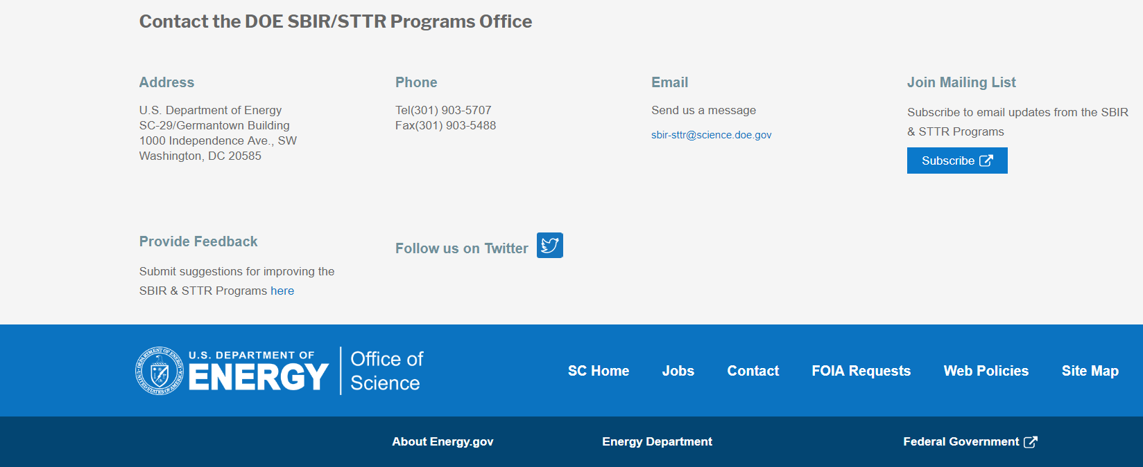
Funding Opportunity Announcement (FOA) Webinar
FY23 Phase I Release 2 FOA will be issued on December 12th
Join our Mailing List – this field is on every DOE SBIR/STTR web page
  Following the issuance of the FOA, look for an email with a link to the FOA
Webinar with Q&A for this FOA on December 16th
  Overview of the FY 2023 DOE SBIR/STTR Programs
    Following the issuance of the FOA, look for an email announcing this webinar

Slide 7
Reminder - Phase 0 Application Assistance Program
Free
to you!
Phase 0 application assistance program is available for first-time DOE SBIR/STTR applicants
Participants receive an individual coach who is an expert in our application process.
Program opens when Topics are released (Open now!)
Visit http://www.dawnbreaker.com/doephase0/ to determine your eligibility and apply to Phase 0

Slide 8
Topic Basics
Topics are created by DOE program managers and define important technology breakthroughs needed in R&D areas that support the DOE mission
Topics are organized by DOE Program Office, e.g., ASCR, BES, etc.
DOE program managers are listed with each subtopic
  Questions to DOE program managers are limited to clarification of the topic and subtopic (including references)
  Clarification is provided to help you determine whether your technology fits within the topic and subtopic
  You may communicate with these topic managers from the release of topics until the grant application due date
  The decision to apply is yours

Slide 9
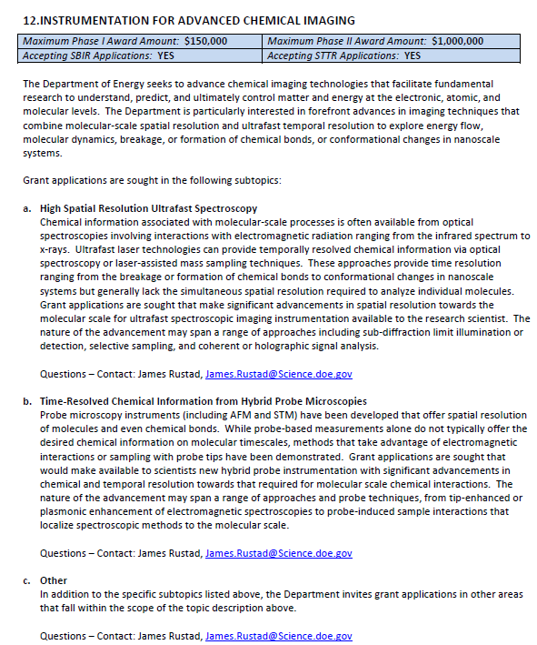
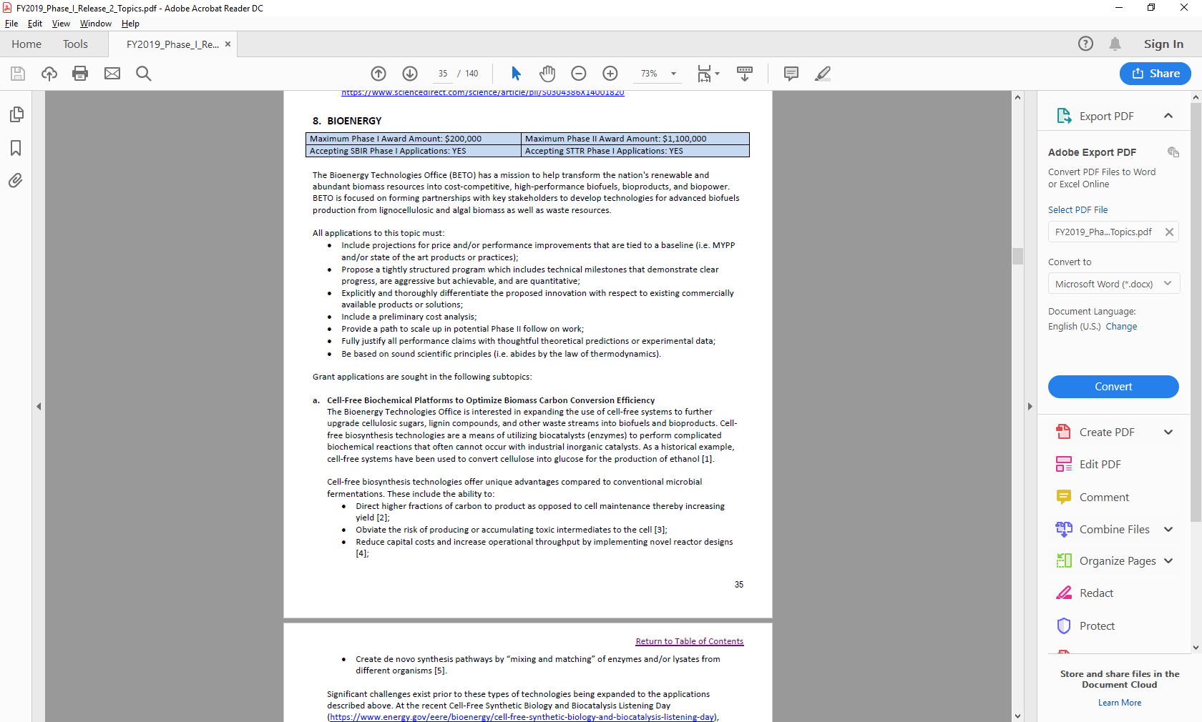
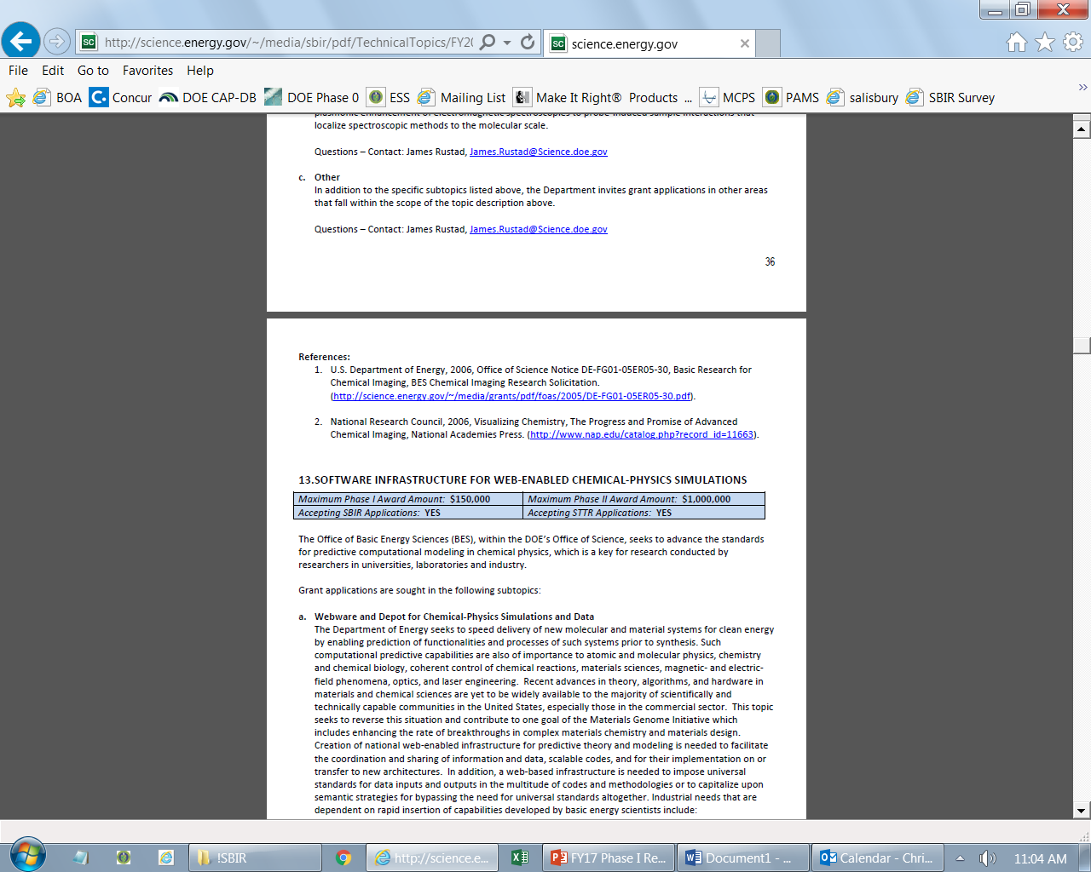
Example Topic
Topic & Subtopic
  You must specify the same topic and subtopic in your Letter of Intent and grant application
Topic Header
  Lists the maximum award amounts for Phase I & Phase II and the types of application accepted (SBIR and/or STTR)
Program Manager
  Each subtopic lists the responsible DOE program manager
“Other” Subtopic
References
Notes:
Here is an example topic from our current announcement. Note that every SBIR or STTR application must include the topic and subtopic to which you are applying. The general topic description describes the general field of technology that is of interest. The subtopics describe specific opportunities in which proposals are requested. Each topic at DOE will also have an “other” subtopic. Under this subtopic you can submit proposals that fall within the general topic description, but do not fit with any of the other subtopics. We have found that when we write the subtopics too narrow sometimes we miss good opportunities, and this “other” subtopic is a means collecting disruptive solutions.

Slide 10
Topic C56-29: ENABLING TECHNOLOGIES IN PLASMA HEATING, FUELING, AND DISTRUPTION MITIGATION
Maximum Phase I Award Amount: $200,000 | Maximum Phase II Award Amount: $1,100,000
Accepting SBIR Phase I Applications: YES | Accepting STTR Phase I Applications: YES
Accepting SBIR Fast-Track Applications: NO | Accepting STTR Fast-Track Applications: NO
Advanced Plasma Heating and Current Drive
Advanced Vacuum Pumping Systems
Fusion Engineering Component Modeling or Tool Development
Remote Maintenance
Other
Questions: Guinevere Shaw, guinevere.shaw@science.doe.gov

Slide 11
Topic C56-30: SUPERCONDUCTING MAGNETS
Maximum Phase I Award Amount: $200,000 | Maximum Phase II Award Amount: $1,100,000
Accepting SBIR Phase I Applications: YES | Accepting STTR Phase I Applications: YES
Accepting SBIR Fast-Track Applications: NO | Accepting STTR Fast-Track Applications: NO
Superconducting Magnetic Technology
Other
Questions: Guinevere Shaw, guinevere.shaw@science.doe.gov

Slide 12
Topic C56-31: LOW TEMPERATURE PLASMAS
Maximum Phase I Award Amount: $200,000 | Maximum Phase II Award Amount: $1,100,000
Accepting SBIR Phase I Applications: YES | Accepting STTR Phase I Applications: YES
Accepting SBIR Fast-Track Applications: NO | Accepting STTR Fast-Track Applications: NO
LTP Science and Technology for Biomedical Applications
Other
Questions: Nirmol Podder, Nirmol.Podder@science.doe.gov

Slide 13
Topic C56-32: INERTIAL FUSION ENERGY (IFE)
Maximum Phase I Award Amount: $200,000 | Maximum Phase II Award Amount: $1,100,000
Accepting SBIR Phase I Applications: YES | Accepting STTR Phase I Applications: YES
Accepting SBIR Fast-Track Applications: NO | Accepting STTR Fast-Track Applications: NO
High Damage Threshold Optics for Inertial Fusion Energy Laser Drivers
Other
Questions: Kramer Akli, kramer.akli@science.doe.gov

Slide 14
Topic C56-33: ADVANCED CONCEPTS AND TECHNOLOGY FOR PARTICLE ACCELERATORS
Maximum Phase I Award Amount: $200,000 | Maximum Phase II Award Amount: $1,100,000
Accepting SBIR Phase I Applications: YES | Accepting STTR Phase I Applications: YES
Accepting SBIR Fast-Track Applications: NO | Accepting STTR Fast-Track Applications: NO
Non-Destructive Electron Beam Position Monitors
Beam Control Systems for Future HEP Advanced Accelerator Facilities
High Fidelity Modeling of Advanced Accelerator Structures
Other
Questions: Derun Li, Derun.Li@science.doe.gov

Slide 15
Topic C56-34: RADIO FREQUENCY ACCELERATOR TECHNOLOGY
Maximum Phase I Award Amount: $200,000 | Maximum Phase II Award Amount: $1,100,000
Accepting SBIR Phase I Applications: YES | Accepting STTR Phase I Applications: YES
Accepting SBIR Fast-Track Applications: NO | Accepting STTR Fast-Track Applications: NO
Low-Cost Radio Frequency Power Sources for Accelerator Application
Automation of SRF Cavity String Assembly
New Superconducting RF Cavity Design
Other
Questions: Subtopic a – Eric Colby, Eric.Colby@science.doe.gov
Subtopics b, c, & d – Ken Marken, ken.marken@science.doe.gov

Slide 16
Topic C56-35: LASER TECHNOLOGY R&D FOR ACCELERATORS
Maximum Phase I Award Amount: $200,000 | Maximum Phase II Award Amount: $1,100,000
Accepting SBIR Phase I Applications: YES | Accepting STTR Phase I Applications: YES
Accepting SBIR Fast-Track Applications: NO | Accepting STTR Fast-Track Applications: NO
High Energy and Broadband Components for Fiber Lasers and Arrays
High Damage Threshold Large Area Spatial Light Modulators
Feedback Systems for Control of High Intensity Laser Mode and Delivery
Other
Questions: Eric Colby, eric.colby@science.doe.gov

Slide 17
Topic C56-36: HIGH FIELD SUPERCONDUCTING MAGNET TECHNOLOGY
Maximum Phase I Award Amount: $200,000 | Maximum Phase II Award Amount: $1,100,000
Accepting SBIR Phase I Applications: YES | Accepting STTR Phase I Applications: YES
Accepting SBIR Fast-Track Applications: NO | Accepting STTR Fast-Track Applications: NO
High-Field HTS Wire and Cable Technologies for Magnets
Cryogenic Power Electronics for Distributed Powering and Quench Protection of HTS and Hybrid Magnets
Other
Questions: Ken Marken, ken.marken@science.doe.gov

Slide 18
Topic C56-37: HIGH ENERGY PHYSICS ELECTRONICS
Maximum Phase I Award Amount: $200,000 | Maximum Phase II Award Amount: $1,100,000
Accepting SBIR Phase I Applications: YES | Accepting STTR Phase I Applications: YES
Accepting SBIR Fast-Track Applications: NO | Accepting STTR Fast-Track Applications: NO
Radiation-Hard Sensors and Engineered Substrates for Detectors at High Energy Colliders
High-Density Chip Interconnect Technology
Electronics Systems for Ultra-Low-Temperature Experiments
Other
Questions: Helmut Marsiske, helmut.marsiske@science.doe.gov

Slide 19
Topic C56-38:HIGH ENERGY PHYSICS DETECTORS AND INSTRUMENTATION
Maximum Phase I Award Amount: $200,000 | Maximum Phase II Award Amount: $1,100,000
Accepting SBIR Phase I Applications: YES | Accepting STTR Phase I Applications: YES
Accepting SBIR Fast-Track Applications: NO | Accepting STTR Fast-Track Applications: NO
Low-Cost, High-Performance (V)UV/Visible/Near-IR Photon Detection
Scintillating Detector Materials and Wavelength Shifters
Low Radioactivity Integration Solutions for Cryogenic Detectors
Other
Questions: Helmut Marsiske, helmut.marsiske@science.doe.gov

Slide 20
Topic C56-39: ARTIFICIAL INTELLIGENCE/MACHINE LEARNING FOR ACCELERATORS
Maximum Phase I Award Amount: $200,000 | Maximum Phase II Award Amount: $1,100,000
Accepting SBIR Phase I Applications: YES | Accepting STTR Phase I Applications: YES
Accepting SBIR Fast-Track Applications: NO | Accepting STTR Fast-Track Applications: NO
Machine Learning, Diagnostics, Controls and Digital Twins for Particle Accelerators
Adaptive Online Machine Learning for Dynamic Beam Diagnostics
Other
Questions: Jeremy Love, Jeremy.Love@science.doe.gov

Slide 21
Topic C56-40: ADVANCED TECHNOLOGIES FOR NUCLEAR ENERGY
Maximum Phase I Award Amount: $200,000 | Maximum Phase II Award Amount: $1,100,000
Accepting SBIR Phase I Applications: YES | Accepting STTR Phase I Applications: YES
Accepting SBIR Fast-Track Applications: NO | Accepting STTR Fast-Track Applications: NO
Advanced Modeling and Simulation
Component Development to Support Liquid Metal Reactors – Electromagnetic Pumps
Roller Bearings for High Temperature Sodium Applications
Rapid, Inexpensive Molten Salt Property Measurement
National Reactor Innovation Center (NRIC)
Advanced Methods and Manufacturing Technologies (AMMT) Program
Nuclear Science User Facilities (NSUF) Program
Questions: Subtopic a – David Henderson, David.Henderson@nuclear.energy.gov
Subtopic b & c – Kat Abbott, Kaatrin.Abbott@nuclear.energy.gov
Subtopic d – Brian K. Robinson, Brian.Robinson@nuclear.energy.gov
Subtopic e – Janelle Eddins, Janelle.Eddins@nuclear.energy.gov
Subtopic f – Dirk Cairns-Gallimore, Dirk.Cairns-Gallimore@nuclear.energy.gov
Subtopic g – Christopher Barr, christopher.barr@nuclear.energy.gov

Slide 22
Topic C56-40: ADVANCED TECHNOLOGIES FOR NUCLEAR ENERGY
CONTINUED
Maximum Phase I Award Amount: $200,000 | Maximum Phase II Award Amount: $1,100,000
Accepting SBIR Phase I Applications: YES | Accepting STTR Phase I Applications: YES
Accepting SBIR Fast-Track Applications: NO | Accepting STTR Fast-Track Applications: NO
Cybersecurity Technologies for Protection of Nuclear Critical Systems
Envisioning Distributed Nuclear Generation and Reactor Siting Considerations for Integrated Energy Systems
Small Modular Reactor Capabilities, Components, and Systems
Microreactor Applications, Unattended Operations, and Cost-Reduction Technologies
Advanced and Small Reactor Physical Security Cost Reduction
Materials Protection Accounting and Control for Domestic Fuel Cycles
Advanced and Small Reactor Material Control and Accounting Modernization
Questions: Subtopic h – Rebecca Onuschak, rebecca.onuschak@nuclear.energy.gov
Subtopic i – Jason Marcinkoski, Jason.Marcinkoski@nuclear.energy.gov
Subtopic j – Melissa Bates, Melissa.Bates@nuclear.energy.gov
Subtopic k – Diani Li, Diana.Li@nuclear.energy.gov
Subtopic l & n – Savannah Fitzwater, savannah.fitzwater@nuclear.energy.gov
Subtopic m – Tansel Selekler, tansel.selekler@nuclear.energy.gov

Slide 23
Topic C56-40: ADVANCED TECHNOLOGIES FOR NUCLEAR ENERGY
CONTINUED
Maximum Phase I Award Amount: $200,000 | Maximum Phase II Award Amount: $1,100,000
Accepting SBIR Phase I Applications: YES | Accepting STTR Phase I Applications: YES
Accepting SBIR Fast-Track Applications: NO | Accepting STTR Fast-Track Applications: NO
Risk Informed Licensing
Software Development for Digital I&C System Risk Assessment and Design Optimization
Plant Modernization
Light Water Reactor Central Alarm Station Simulator Based Human Factors Studies
Develop or Improve Small Scale Mechanical Testing Techniques to Provide Size-independent Material Properties of Alloys in a Nuclear Power Plant Environment
Cost of Construction and Installation of Advanced Reactor Technologies for Industrial Purposes
Process Models and Economics for Nuclear Power-Integrated Industrial Applications
Advanced Technologies for the Fabrication, Characterization of Nuclear Reactor Fuel
Advanced Sensors and Instrumentation (Crosscutting Research)
Other
Questions: Subtopics o, p, q – William Walsh, william.walsh@nuclear.energy.gov
Subtopic r – Savannah Fitzwater, savannah.fitzwater@nuclear.energy.gov
Subtopic s – Sue Lesica, Sue.Lesica@nuclear.energy.gov
Subtopics t & u – Jason Marcinkoski, Jason.Marcinkoski@nuclear.energy.gov
Subtopic v – Frank Goldner, Frank.Goldner@nuclear.energy.gov
Subtopic w – Daniel Nichols, daniel.nichols@nuclear.energy.gov
Subtopic x – JoAnne Hanners, joanne.hanners@nuclear.energy.gov

Slide 24
Topic C56-41: ADVANCED TECHNOLOGIES FOR NUCLEAR WASTE
Maximum Phase I Award Amount: $200,000 | Maximum Phase II Award Amount: $1,100,000
Accepting SBIR Phase I Applications: YES | Accepting STTR Phase I Applications: YES
Accepting SBIR Fast-Track Applications: NO | Accepting STTR Fast-Track Applications: NO
Disposal Research
Storage & Transportation R&D
Salt Vapor Trap + Reversible Chlorine Gas Absorber Technology for Recovery and Recycle of Chlorine
High Durability, Low-Cost Sorbents and Waste Form for Iodine Capture and Immobilization
Crucible Materials for Phosphate Waste Glass Melts
Optimize the Kr/Xe Capture Process to Reduce Cost for the Overall Process
Questions: Subtopic a – Prasad Nair, Prasad.Nair@nuclear.energy.gov
Subtopic b – John Orchard, John.Orchard@nuclear.energy.gov
Subtopic c – James Wilit, james.willit@nuclear.energy.gov
Subtopic d, e, f – Kimberly Gray, Kimberly.Gray@nuclear.energy.gov

Slide 25
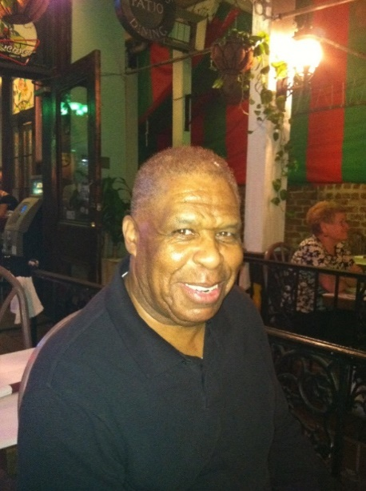
DOE SBIR/STTR Programs Office
Contact Information
SBIR/STTR Web: https://science.osti.gov/sbir
Email: sbir-sttr@science.doe.gov
Phone Assistance Hotline: 301-903-5707
DOE Phase 0 Assistance Program: http://www.dawnbreaker.com/doephase0/
DOE Application Assistance: https://doetutorials.dawnbreaker.com/

