Slide 1
The DOE Webinar will begin shortly . . .
Why is there no sound?
  Once you logged into the webinar, you were provided two options to listen to this broadcast. The first option is through your computer speakers, the second option is via dialing the phone number provided to you upon login to the webinar. If you chose to listen through your computer speakers, you may need to turn your speaker volume on or up.
Will DOE provide access to the recorded webinar after the meeting?
  Yes, all those who registered will receive a link to the slides and to the recorded webinar soon after the meeting. It will also be available on the DOE SBIR/STTR web site.
Where can I find the Topics being discussed today?
  This link will take you to the Funding Opportunity Announcement (FOA) page that lists the FY 2023 Phase I Release 2 Topics: https://science.osti.gov/sbir/Funding-Opportunities
What if my question was not answered at today’s webinar?
  Please contact the point of contact that follows each subtopic in the document listed above for further clarification.
  If you have a question about the grant application process, please send us an email at: sbir-sttr@science.doe.gov.

Slide 2

DOE SBIR/STTR
Phase I Release 2 Topics Webinar
Topics associated with the
FY 2023 Phase I Release 2
Funding Opportunity Announcement
Topics 1-9 & 22-28
DOE SBIR/STTR Programs Office
November 15, 2022

Slide 3
TODAY’S AGENDA
Topics Introduction | DOE SBIR/STTR Programs Office
Topic 1 | Office of Cyber Security, Energy Security, and Emergency Response
Topics 2 – 7 | Office of Defense Nuclear Nonproliferation
Topics 8 – 9 | Office of Electricity
Topics 22 – 24 | Office of Environmental Management
Topics 25 – 28 | Office of Fossil Energy and Carbon Management

Slide 4
FY 2023 Phase I Schedule
 | Release 1 | Release 2
Topics Issued | Monday, July 11, 2022 | Monday, November 7, 2022
Webinar(s) | Week of July 18, 2022 | Week of November 14, 2022
FOA Issued | Monday, August 8, 2022 | Monday, December 12, 2022
Webinar(s) | Friday, August 12, 2022 | Friday, December 16, 2022
Letters of Intent (LOI) Due | Monday, August 29, 2022 | Tuesday, January 3, 2023
Non-responsive LOI Feedback Provided | Monday, September 19, 2022 | Tuesday, January 24, 2023
Applications Due | Tuesday, October 11, 2022 | Tuesday, February 21, 2023
Award Notification | Tuesday, January 3, 2023 | Monday, May 15, 2023

Slide 5

Phase I Funding Opportunity Announcements
Participating DOE Programs (FY 2023)
Office of Advanced Scientific Computing Research
Office of Basic Energy Sciences
Office of Biological and Environmental Research
Office of Nuclear Physics
Phase I
Release 1
Office of Cyber Security, Energy Security, and Emergency Response
Office of Defense Nuclear Nonproliferation
Office of Electricity
Office of Energy Efficiency and Renewable Energy
Office of Environmental Management
Office of Fossil Energy and Carbon Management
Office of Fusion Energy Sciences
Office of High Energy Physics
Office of Nuclear Energy
Phase I
Release 2

Slide 6
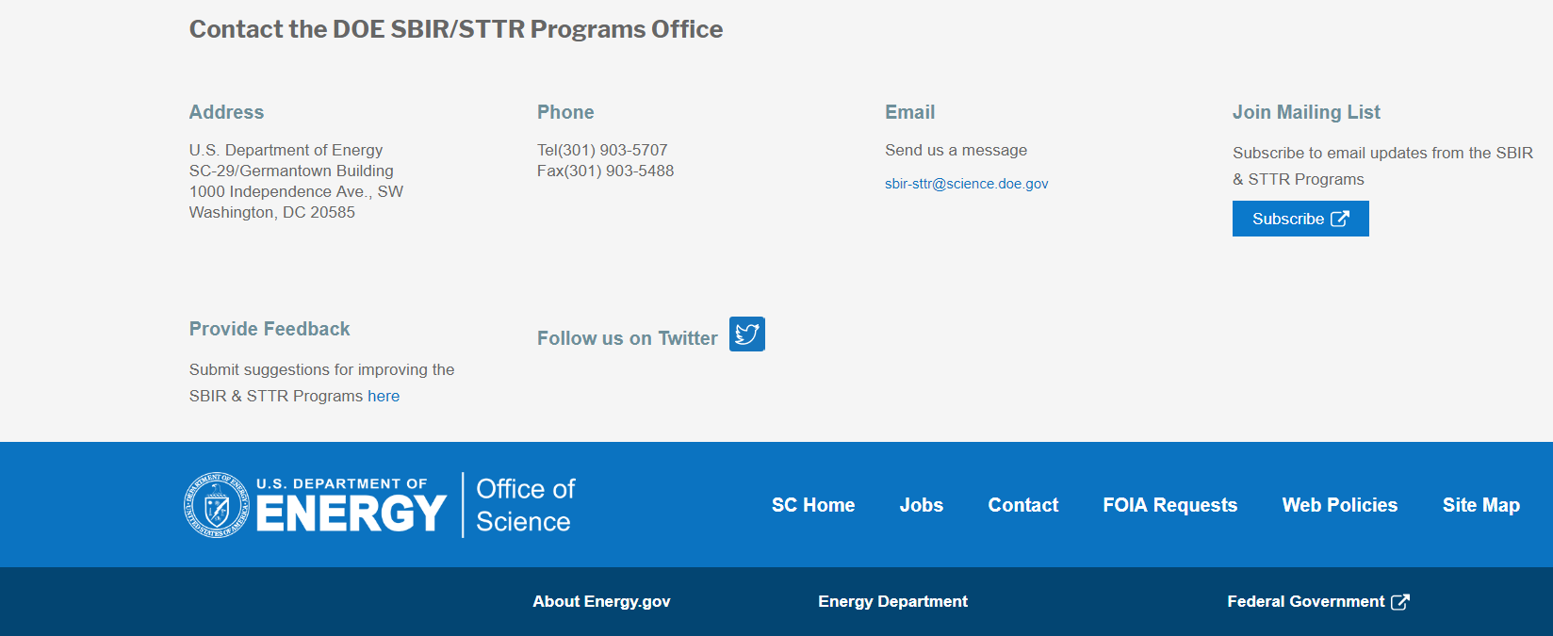
Funding Opportunity Announcement (FOA) Webinar
FY23 Phase I Release 2 FOA will be issued on December 12th
Join our Mailing List – this field is on every DOE SBIR/STTR web page
  Following the issuance of the FOA, look for an email with a link to the FOA
Webinar with Q&A for this FOA on December 16th
  Overview of the FY 2023 DOE SBIR/STTR Programs
    Following the issuance of the FOA, look for an email announcing this webinar

Slide 7
Reminder - Phase 0 Application Assistance Program
Free
to you!
Phase 0 application assistance program is available for first-time DOE SBIR/STTR applicants
Participants receive an individual coach who is an expert in our application process.
Program opens when Topics are released (Open now!)
Visit http://www.dawnbreaker.com/doephase0/ to determine your eligibility and apply to Phase 0

Slide 8
Topic Basics
Topics are created by DOE program managers and define important technology breakthroughs needed in R&D areas that support the DOE mission
Topics are organized by DOE Program Office, e.g., ASCR, BES, etc.
DOE program managers are listed with each subtopic
  Questions to DOE program managers are limited to clarification of the topic and subtopic (including references)
  Clarification is provided to help you determine whether your technology fits within the topic and subtopic
  You may communicate with these topic managers from the release of topics until the grant application due date
  The decision to apply is yours

Slide 9
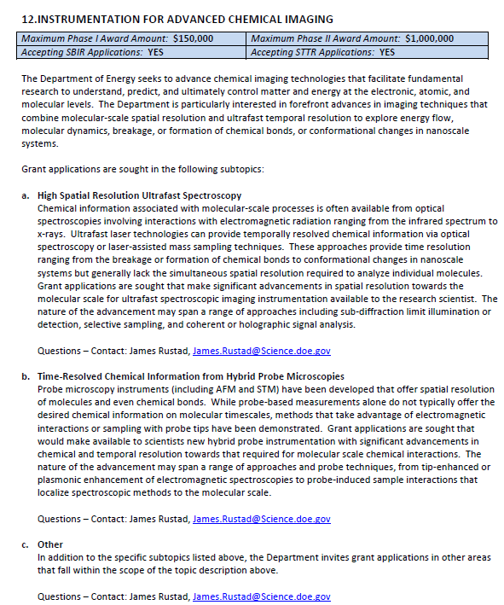
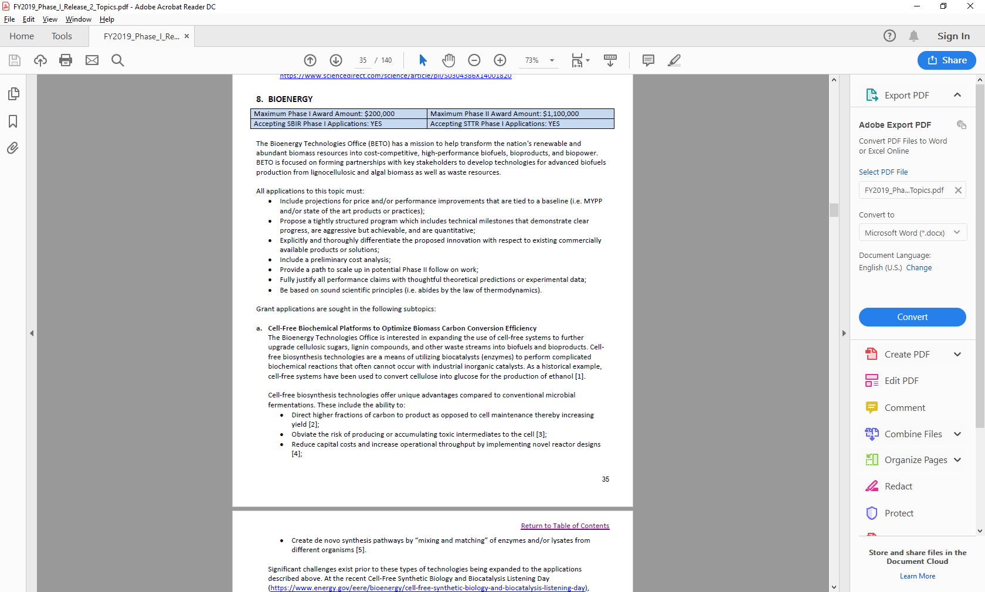
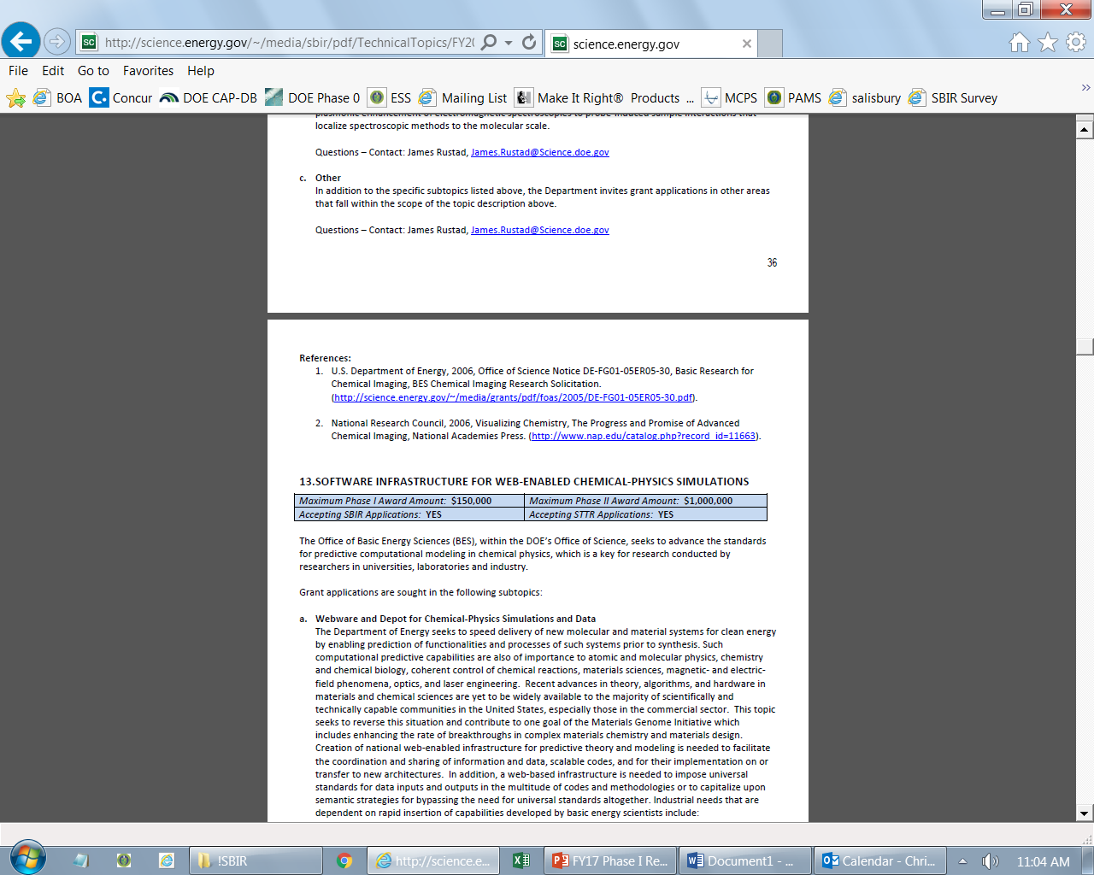
Example Topic
Topic & Subtopic
  You must specify the same topic and subtopic in your Letter of Intent and grant application
Topic Header
  Lists the maximum award amounts for Phase I & Phase II and the types of application accepted (SBIR and/or STTR)
Program Manager
  Each subtopic lists the responsible DOE program manager
“Other” Subtopic
References
Notes:
Here is an example topic from our current announcement. Note that every SBIR or STTR application must include the topic and subtopic to which you are applying. The general topic description describes the general field of technology that is of interest. The subtopics describe specific opportunities in which proposals are requested. Each topic at DOE will also have an “other” subtopic. Under this subtopic you can submit proposals that fall within the general topic description, but do not fit with any of the other subtopics. We have found that when we write the subtopics too narrow sometimes we miss good opportunities, and this “other” subtopic is a means collecting disruptive solutions.

Slide 10
Topic C56-01: ENERGY SYSTEMS CYBERSECURITY
Maximum Phase I Award Amount: $200,000 | Maximum Phase II Award Amount: $1,100,000
Accepting SBIR Phase I Applications: YES | Accepting STTR Phase I Applications: NO
Accepting SBIR Fast-Track Applications: NO | Accepting STTR Fast-Track Applications: NO
Distributed Energy Resource (DER) Cyber Protection
Other
Questions: Joseph Dygert, Joseph.dygert@netl.doe.gov

Slide 11
Topic C56-02: ALTERNATIVE RADIOLOGICAL SOURCE TECHNOLOGIES
Maximum Phase I Award Amount: $200,000 | Maximum Phase II Award Amount: $1,100,000
Accepting SBIR Phase I Applications: YES | Accepting STTR Phase I Applications: NO
Accepting SBIR Fast-Track Applications: NO | Accepting STTR Fast-Track Applications: NO
Novel Non-Radioisotopic Technology for Portable Calibration Sources
Improved Vacuum X-Ray Tube Design for Radiological Source Replacement
Other
Questions: Hank Zhu, hank.zhu@nnsa.doe.gov

Slide 12
Topic C56-03: RADIATION DETECTION MATERIALS
Maximum Phase I Award Amount: $200,000 | Maximum Phase II Award Amount: $1,100,000
Accepting SBIR Phase I Applications: YES | Accepting STTR Phase I Applications: NO
Accepting SBIR Fast-Track Applications: NO | Accepting STTR Fast-Track Applications: NO
High-Yield Growth of High-Performance Radiation Detection Semiconductor Materials
Other
Questions: Hank Zhu, hank.zhu@nnsa.doe.gov

Slide 13
Topic C56-04: SEPARATION AND DETECTION TECHNOLOGIES ESPECIALLY FOR RARE EARTH ELEMENTS AND LITHIUM
Maximum Phase I Award Amount: $200,000 | Maximum Phase II Award Amount: $1,100,000
Accepting SBIR Phase I Applications: YES | Accepting STTR Phase I Applications: NO
Accepting SBIR Fast-Track Applications: NO | Accepting STTR Fast-Track Applications: NO
High-Purity Separations of Rare Earth Elements from Bulk Material
Environmental Monitoring of Lithium
Other
Questions: Richard Gostic, Richard.Gostic@nnsa.doe.gov

Slide 14
Topic C56-05: ADVANCED DATA ANALYTICS FOR MULTIPLE MICROSCOPIES
Maximum Phase I Award Amount: $200,000 | Maximum Phase II Award Amount: $1,100,000
Accepting SBIR Phase I Applications: YES | Accepting STTR Phase I Applications: NO
Accepting SBIR Fast-Track Applications: NO | Accepting STTR Fast-Track Applications: NO
Graphical Analyses for Material Characterization
Other
Questions: Richard Gostic, Richard.Gostic@nnsa.doe.gov

Slide 15
Topic C56-06:TECHNOLOGY FOR SEISMIC MONITORING SYSTEMS
Maximum Phase I Award Amount: $200,000 | Maximum Phase II Award Amount: $1,100,000
Accepting SBIR Phase I Applications: YES | Accepting STTR Phase I Applications: NO
Accepting SBIR Fast-Track Applications: NO | Accepting STTR Fast-Track Applications: NO
Hardware/Software Applications for Distributed Acoustic Sensing (DAS) Data Acquisition and Processing
Other
Questions: John Lazarz, John.Lazarz@nnsa.doe.gov

Slide 16
Topic C56-07: TECHNOLOGY FOR FUTURE RADIONUCLIDE MONITORING SYSTEMS
Maximum Phase I Award Amount: $200,000 | Maximum Phase II Award Amount: $1,100,000
Accepting SBIR Phase I Applications: YES | Accepting STTR Phase I Applications: NO
Accepting SBIR Fast-Track Applications: NO | Accepting STTR Fast-Track Applications: NO
Electrostatic Precipitation System for Local-Distance Radionuclide Monitoring
Other
Questions: Brian Paeth, Brian.Paeth@nnsa.doe.gov

Slide 17
Topic C56-08: ADVANCED GRID TECHNOLOGIES
Maximum Phase I Award Amount: $200,000 | Maximum Phase II Award Amount: $1,100,000
Accepting SBIR Phase I Applications: YES | Accepting STTR Phase I Applications: NO
Accepting SBIR Fast-Track Applications: NO | Accepting STTR Fast-Track Applications: NO
Advanced Materials for Power Electronic Components in Medium and High Voltage Grid Applications
Grid-Enhancing Technologies to Reduce Electricity Delivery Losses and Improve T&D Systems Energy Efficiency and Utilization
Questions: Subtopic a – Andre Pereira, andre.pereira@hq.doe.gov
Subtopic b – Fernando Palma, fernando.palma@hq.doe.gov

Slide 18
Topic C56-09: ADVANCED POWER CONVERSION SYSTEM FOR GRID-TIED ENERGY STORAGE & ENERGY STORAGE DEPLOYMENT
Maximum Phase I Award Amount: $200,000 | Maximum Phase II Award Amount: $1,100,000
Accepting SBIR Phase I Applications: YES | Accepting STTR Phase I Applications: NO
Accepting SBIR Fast-Track Applications: NO | Accepting STTR Fast-Track Applications: NO
High Density Cell-Level Battery Power Converters for Next Generation Grid-Tied Energy Storage Systems
Innovations to Accelerate Energy Storage Deployment
Questions: Subtopic a – Imre Gyuk, imre.gyuk@hq.doe.gov
Subtopic b – Vinod Siberry, vinod.siberry@hq.doe.gov

Slide 19
Topic C56-22: IN-SITU CHARACTERIZATION METHODS
Maximum Phase I Award Amount: $200,000 | Maximum Phase II Award Amount: $1,100,000
Accepting SBIR Phase I Applications: YES | Accepting STTR Phase I Applications: NO
Accepting SBIR Fast-Track Applications: NO | Accepting STTR Fast-Track Applications: NO
a. Remote Characterization of HLW Tank Waste, Effluents from HLW Treatment, and Other Miscellaneous Slurry, Solid and Liquid Waste During Retrieval, Pretreatment, and Immobilization Processes
b. Development of New Technologies to Advance Autonomous Monitoring of Soil and Groundwater Contamination at Sites Undergoing Both Active and Passive Remediation
c. Deep Aquifer Characterization
d. Analytical Logistics
e. Other
Questions: Latrincy Bates, Latrincy.Bates@em.doe.gov

Slide 20
Topic C56-23: IMPROVED TREATMENT METHODS FOR LLW AND HLW
Maximum Phase I Award Amount: $200,000 | Maximum Phase II Award Amount: $1,100,000
Accepting SBIR Phase I Applications: YES | Accepting STTR Phase I Applications: NO
Accepting SBIR Fast-Track Applications: NO | Accepting STTR Fast-Track Applications: NO
Waste Retrieval
Separation of Contaminants from Waste Streams
Waste Immobilization
Other
Questions: Latrincy Bates, Latrincy.Bates@em.doe.gov

Slide 21
Topic C56-024: IMPROVEMENTS FOR DECONTAMINATION OF EQUIPMENT/STRUCTURES
Maximum Phase I Award Amount: $200,000 | Maximum Phase II Award Amount: $1,100,000
Accepting SBIR Phase I Applications: YES | Accepting STTR Phase I Applications: NO
Accepting SBIR Fast-Track Applications: NO | Accepting STTR Fast-Track Applications: NO
Characterization
Decontamination Methods
Fixatives
Other
Questions: Latrincy Bates, Latrincy.Bates@em.doe.gov

Slide 22
Topic C56-25: CARBON CAPTURE, CONVERSION, AND STORAGE
Maximum Phase I Award Amount: $250,000 | Maximum Phase II Award Amount: $1,600,000
Accepting SBIR Phase I Applications: YES | Accepting STTR Phase I Applications: YES
Accepting SBIR Fast-Track Applications: NO | Accepting STTR Fast-Track Applications: NO
Novel Reactive Capture Approaches that Convert Industrially Produced CO2 to Useful Products On-Site
Combined Direct Air Capture and Conversion of Carbon Dioxide to Chemical Products
Mineralization of Produced Water Cations Using Anthropogenic CO₂
Development of Novel Sensors or System Components for Subsurface Electromagnetic (EM) Monitoring Applications
"Turn-key" System for High Resolution, Long Term AZMI Pressure Monitoring
Other
Questions: Subtopic a – Andrew O’Palko, andrew.opalko@netl.doe.gov
Subtopic b – Sai Gollakota sai.gollakota@netl.doe.gov
Subtopics c & f – Isaac (Andy) Aurelio isaac.aurelio@netl.doe.gov
Subtopics d & e – James Gardiner james.gardiner@netl.doe.gov

Slide 23
Topic C56-026: HYDROGEN TECHNOLOGIES
Maximum Phase I Award Amount: $250,000 | Maximum Phase II Award Amount: $1,600,000
Accepting SBIR Phase I Applications: YES | Accepting STTR Phase I Applications: YES
Accepting SBIR Fast-Track Applications: NO | Accepting STTR Fast-Track Applications: NO
Smart Manufacture of Ceramic Matrix Composite (CMC) Substrates
Advanced Thermal Barrier Coatings (TBC) and Environmental Barrier Coatings (EBC) for Ceramic Matrix Composites (CMC)
Advanced Manufacturing Concepts for Hydrogen Transportation and Storage
Feedstock Dechlorination Technologies of Mixed-Plastics and MSW for Downstream Gasifier Use to Produce Clean Hydrogen
Contaminant Filter for Clean Hydrogen Production and Separation from Coal Waste, Biomass, MSW and Plastics
Other
Questions: Subtopic a – Andrew Downs, andrew.downs@netl.doe.gov
Subtopic b & f – Adam Payne adam.payne@netl.doe.gov
Subtopic c – Stephen Henry stephen.henry@netl.doe.gov
Subtopic d – Evelyn Lopez evelyn.lopez@netl.doe.gov
Subtopic e – Sarah Michalik sarah.michalik@netl.doe.gov

Slide 24
Topic C56-027: METHANE MITIGATION
Maximum Phase I Award Amount: $250,000 | Maximum Phase II Award Amount: $1,600,000
Accepting SBIR Phase I Applications: YES | Accepting STTR Phase I Applications: YES
Accepting SBIR Fast-Track Applications: NO | Accepting STTR Fast-Track Applications: NO
Mitigation of Emissions of Methane and Other Gases Through the Monitoring and Maintaining Combustion and Destruction Efficiency in Gas Flares
Other
Questions: Stephen Henry stephen.henry@netl.doe.gov

Slide 25
Topic C56-028: ADVANCED REMEDIATION
Maximum Phase I Award Amount: $250,000 | Maximum Phase II Award Amount: $1,600,000
Accepting SBIR Phase I Applications: YES | Accepting STTR Phase I Applications: YES
Accepting SBIR Fast-Track Applications: NO | Accepting STTR Fast-Track Applications: NO
Produced Water Management
Other
Questions:Stephen Henry stephen.henry@netl.doe.gov

Slide 26

DOE SBIR/STTR Programs Office
Contact Information
SBIR/STTR Web: https://science.osti.gov/sbir
Email: sbir-sttr@science.doe.gov
Phone Assistance Hotline: 301-903-5707
DOE Phase 0 Assistance Program: http://www.dawnbreaker.com/doephase0/
DOE Application Assistance: https://doetutorials.dawnbreaker.com/

