Slide 1
The DOE Webinar will begin shortly . . .
Why is there no sound?
  Once you logged into the webinar, you were provided two options to listen to this broadcast. The first option is through your computer speakers, the second option is via dialing the phone number provided to you upon login to the webinar. If you chose to listen through your computer speakers, you may need to turn your speaker volume on or up.
Will DOE provide access to the recorded webinar after the meeting?
  Yes, all those who registered will receive a link to the slides and to the recorded webinar soon after the meeting. It will also be available on the DOE SBIR/STTR web site.
Where can I find the Topics being discussed today?
  This link will take you to the Funding Opportunity Announcement (FOA) page that lists the FY 2021 Phase I Release 2 Topics: https://science.osti.gov/sbir/Funding-Opportunities
What if my question was not answered at today’s webinar?
  Please contact the point of contact that follows each subtopic in the document listed above for further clarification.
  If you have a question about the grant application process, please send us an email at: sbir-sttr@science.doe.gov.

Slide 2

DOE SBIR/STTR
Phase I Release 1 Topics Webinar
Topics associated with the
FY 2021 Phase I Release 2
Funding Opportunity Announcement
Topics 28-40
DOE SBIR/STTR Programs Office
November 18, 2020

Slide 3
TODAY’S AGENDA
Topics Introduction | DOE SBIR/STTR Programs Office
Topics 28-31 | Office of Fusion Energy Sciences
Topics 32-38 | Office of High Energy Physics
Topics 39-40 | Office of Nuclear Energy

Slide 4
FY 2021 Phase I Schedule
 | Release 1 | Release 2
Topics Issued | Monday, July 13, 2020 | Monday, November 9, 2020
Webinar(s) | Week of July 20, 2020 | Week of November 16, 2020
FOA Issued | Monday, August 10, 2020 | Monday, December 14, 2020
Webinar(s) | Monday, August 17, 2020 | Friday, December 18, 2020
Letters of Intent (LOI) Due | Monday, August 31, 2020 | Monday, 4 January, 2021
Non-responsive LOI Feedback Provided | Monday, September 21, 2020 | Monday, January 25, 2021
Applications Due | Tuesday, October 13, 2020 | Monday, February 22, 2021
Award Notification | Monday, January 4, 2021 | Monday, May 17, 2021

Slide 5

Phase I Funding Opportunity Announcements
Participating DOE Programs (FY 2021)
Office of Advanced Scientific Computing Research
Office of Basic Energy Sciences
Office of Biological and Environmental Research
Office of Nuclear Physics
Office of Science
Phase I
Release 1
Office of Cybersecurity, Energy Security, and Emergency Response
Office of Defense Nuclear Nonproliferation
Office of Electricity
Office of Energy Efficiency and Renewable Energy
Office of Environmental Management
Office of Fossil Energy
Office of Fusion Energy Sciences
Office of High Energy Physics
Office of Nuclear Energy
Phase I
Release 2

Slide 6
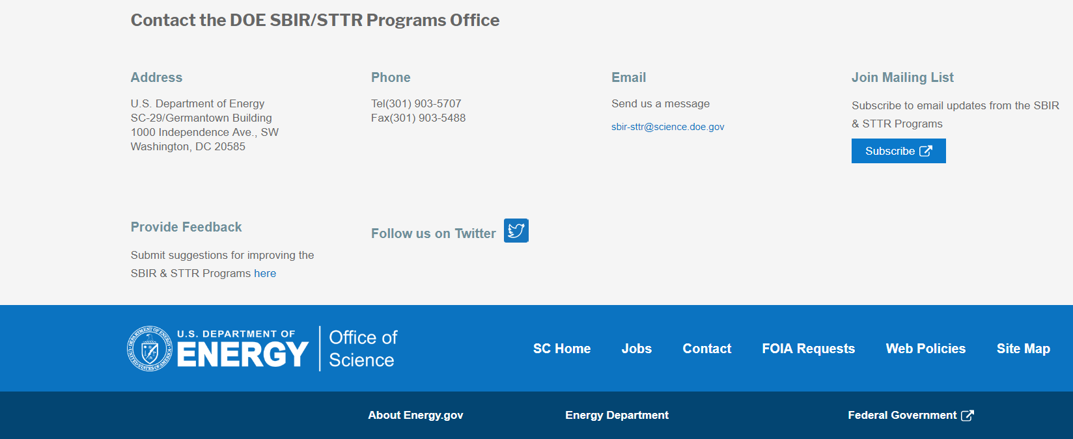
Funding Opportunity Announcement (FOA) Webinar
FY21 Phase I Release 2 FOA will be issued on December 14th
Join our Mailing List – this field is on every DOE SBIR/STTR web page
  Following the issuance of the FOA, look for an email with a link to the FOA
Webinar with Q&A for this FOA on December 18th
  Overview of the FY 2021 DOE SBIR/STTR Programs
    Following the issuance of the FOA, look for an email announcing this webinar

Slide 7
Topic Basics
Topics are created by DOE program managers and define important technology breakthroughs needed in R&D areas that support the DOE mission
Topics are organized by DOE Program Office, e.g., EERE, BES, etc.
DOE program managers are listed with each subtopic
  Questions to DOE program managers are limited to clarification of the topic and subtopic (including references)
  Clarification is provided to help you determine whether your technology fits within the topic and subtopic
  You may communicate with these topic managers from the release of topics until the grant application due date
  The decision to apply is yours

Slide 8
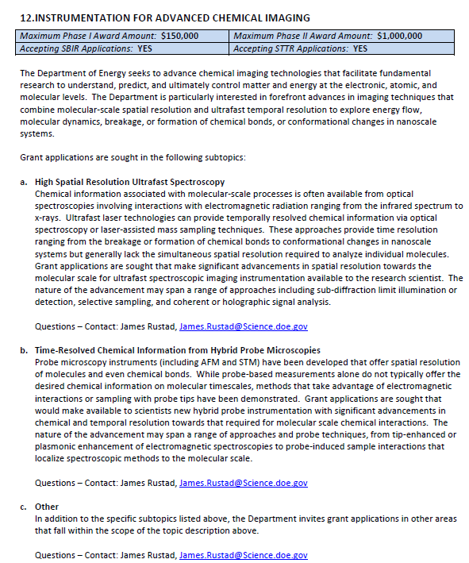
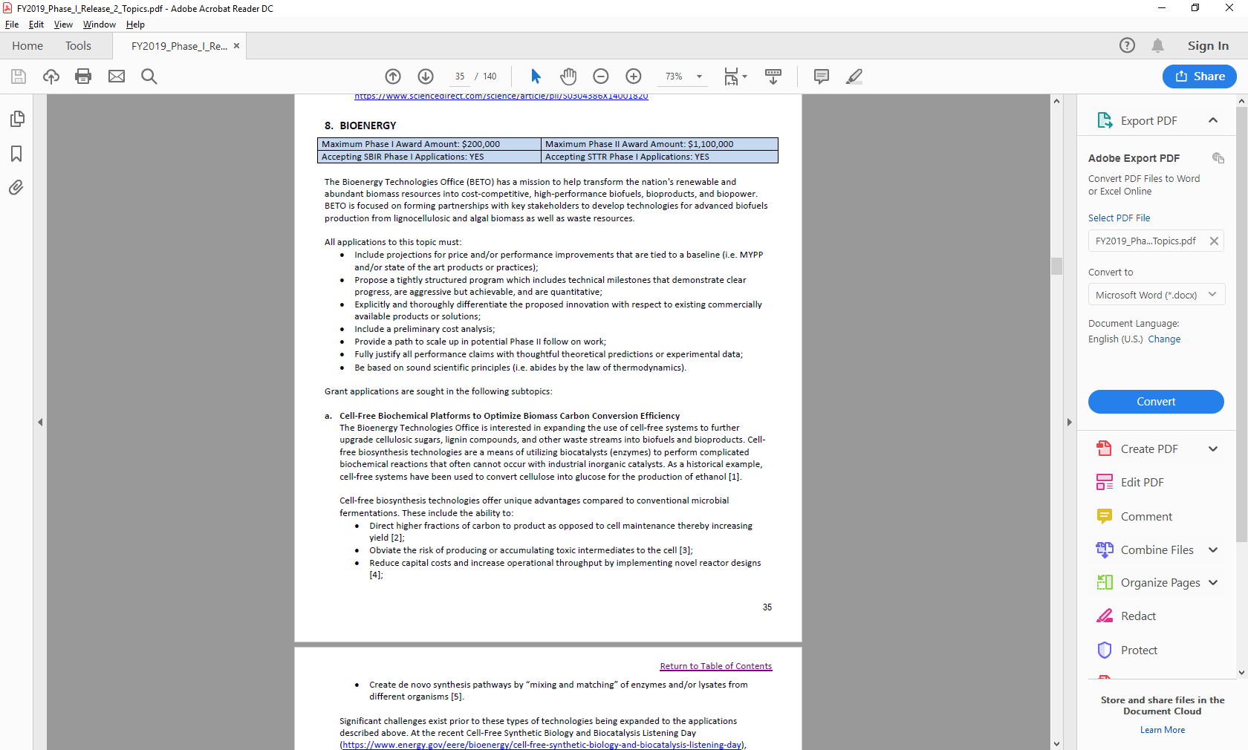
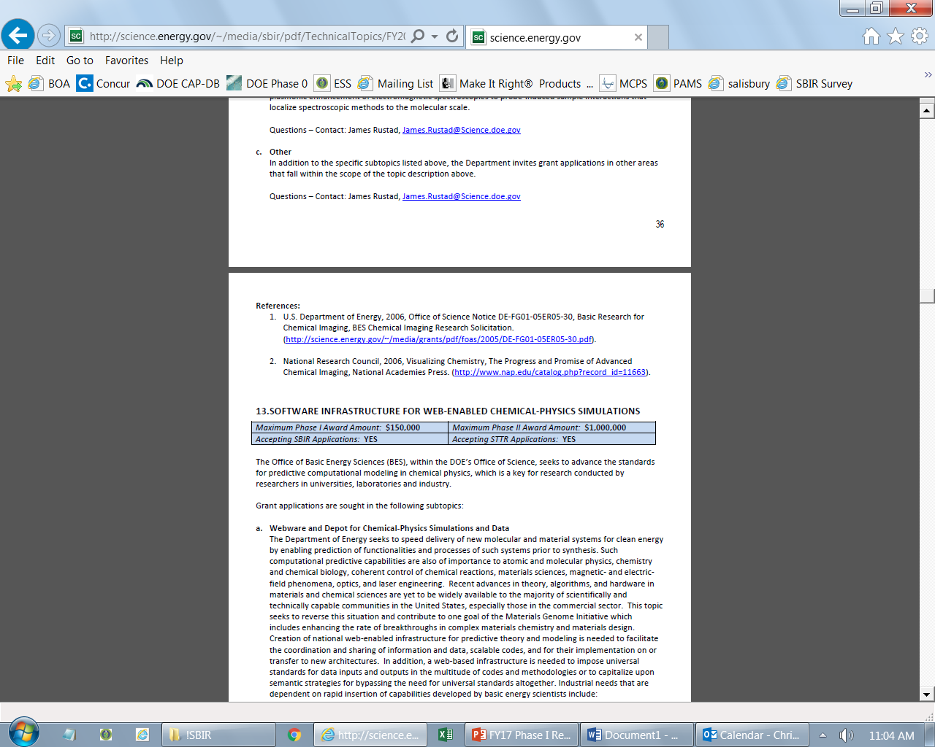
Example Topic
Topic & Subtopic
  You must specify the same topic and subtopic in your Letter of Intent and grant application
Topic Header
  Lists the maximum award amounts for Phase I & Phase II and the types of application accepted (SBIR and/or STTR)
Program Manager
  Each subtopic lists the responsible DOE program manager
“Other” Subtopic
References
Notes:
Here is an example topic from our current announcement. Note that every SBIR or STTR application must include the topic and subtopic to which you are applying. The general topic description describes the general field of technology that is of interest. The subtopics describe specific opportunities in which proposals are requested. Each topic at DOE will also have an “other” subtopic. Under this subtopic you can submit proposals that fall within the general topic description, but do not fit with any of the other subtopics. We have found that when we write the subtopics too narrow sometimes we miss good opportunities, and this “other” subtopic is a means collecting disruptive solutions.

Slide 9
Topic 28: FUSION MATERIALS
Maximum Phase I Award Amount: $200,000 | Maximum Phase II Award Amount: $1,100,000
Accepting SBIR Phase I Applications: YES | Accepting STTR Phase I Applications: YES
Development of Plasma Facing Component Materials
Development of Reduced Activation Ferritic Martensitic (RAFM) Steels Technologies
Development of Advanced Oxide Dispersion Strengthened (ODS) Ferritic Steels and Technologies
Development of Functional Materials for Use in Fusion Reactors
Other
Questions: Daniel Clark, daniel.clark@science.doe.gov

Slide 10
Topic 29: SUPERCONDUCTING MAGNETS
Maximum Phase I Award Amount: $200,000 | Maximum Phase II Award Amount: $1,100,000
Accepting SBIR Phase I Applications: YES | Accepting STTR Phase I Applications: YES
Superconducting Magnetic Technology
Other
Questions: Guinevere Shaw, guinevere.shaw@science.doe.gov

Slide 11
Topic 30: HIGH ENERGY DENSITY LABORATORY PLASMAS
Maximum Phase I Award Amount: $200,000 | Maximum Phase II Award Amount: $1,100,000
Accepting SBIR Phase I Applications: YES | Accepting STTR Phase I Applications: YES
High-intensity Short-pulse Laser Technologies
Ultra-fast Detectors for HED Applications
Other
Questions: Kramer Akli, Kramer.akli@science.doe.gov

Slide 12
Topic 31: LOW TEMPERATURE PLASMAS AND MICROELECTRONICS
Maximum Phase I Award Amount: $200,000 | Maximum Phase II Award Amount: $1,100,000
Accepting SBIR Phase I Applications: YES | Accepting STTR Phase I Applications: YES
LTP Science and Engineering for Microelectronics and Nanotechnology
LTP Science and Technology for Biomedicine
Other Emerging LTP Technologies
Questions: Nirmol Podder, Nirmol.Podder@science.doe.gov

Slide 13
Topic 32: ADVANCED CONCEPTS AND TECHNOLOGY FOR PARTICLE ACCELERATORS
Maximum Phase I Award Amount: $200,000 | Maximum Phase II Award Amount: $1,100,000
Accepting SBIR Phase I Applications: YES | Accepting STTR Phase I Applications: YES
Machine Learning, Diagnostics, Controls and Modeling
Adaptive Online Machine Learning for Dynamic Beam Diagnostics
Structure Wakefield Acceleration (SWFA)
Targetry: Radiation Resistant Strain/Vibration Instrumentation Development
Other
Questions: John Boger, john.boger@science.doe.gov

Slide 14
Topic 33: RADIO FREQUENCY ACCELERATOR TECHNOLOGY
Maximum Phase I Award Amount: $200,000 | Maximum Phase II Award Amount: $1,100,000
Accepting SBIR Phase I Applications: YES | Accepting STTR Phase I Applications: YES
Low Cost Radio Frequency Power Sources for Accelerator Application
Automation of SRF Cavity String Assembly
Advanced Conduction Cooling for SRF Systems
Other
Questions: Subtopic a – Eric Colby, Eric.Colby@science.doe.gov
Subtopic b, c & d – Ken Marken, ken.marken@science.doe.gov

Slide 15
Topic 34: LASER TECHNOLOGY R&D FOR ACCELERATORS
Maximum Phase I Award Amount: $200,000 | Maximum Phase II Award Amount: $1,100,000
Accepting SBIR Phase I Applications: YES | Accepting STTR Phase I Applications: YES
High Energy and Broadband Components for Fiber Lasers and Arrays
Aperture-Scalable High Performance Diffraction Gratings
Advanced Quality Control Instruments and Services for Ultrafast Laser Optics
Fast Feedback Systems for Lasers to Increase Stability and Control
Large Format Faraday Isolators for High Power Ultrafast Laser Systems
Other
Questions: Eric Colby, eric.colby@science.doe.gov

Slide 16
Topic 35: SUPERCONDUCTOR TECHNOLOGIES FOR PARTICLE ACCELERATORS
Maximum Phase I Award Amount: $200,000 | Maximum Phase II Award Amount: $1,100,000
Accepting SBIR Phase I Applications: YES | Accepting STTR Phase I Applications: YES
a. High-Field Superconducting Wire and Cable Technologies for Magnets
b. Superconducting Magnet Technology
c. Persistent Current Mode HTS Magnets
d. Other
Questions: Ken Marken, ken.marken@science.doe.gov

Slide 17
Topic 36: HIGH ENERGY PHYSICS ELECTRONICS
Maximum Phase I Award Amount: $200,000 | Maximum Phase II Award Amount: $1,100,000
Accepting SBIR Phase I Applications: YES | Accepting STTR Phase I Applications: YES
Radiation Hard CMOS Sensors and Engineered Substrates for Detectors at High Energy Colliders
Single Electron Transistors for Exotic Force and Particle Searches
High Density Chip Interconnect Technology
Radiation-Hard High-Bandwidth Data Transmission for Detectors at High Energy Colliders
Electronics and Frequency Multiplexed DAQ Systems for Low-Temperature Experiments
High-Channel Count Electronic Tools for Picosecond (ps) Timing
Other
Questions: Helmut Marsiske, helmut.marsiske@science.doe.gov

Slide 18
Topic 37: HIGH ENERGY PHYSICS DETECTORS AND INSTRUMENTATION
Maximum Phase I Award Amount: $200,000 | Maximum Phase II Award Amount: $1,100,000
Accepting SBIR Phase I Applications: YES | Accepting STTR Phase I Applications: YES
a. Low-Cost, High-Performance Visible/(V)UV/Near-IR Photon Detection
b. Scintillating Detector Materials and Wavelength Shifters
c. Cost-Effective, Large-Area, High-Performance Dichroic Filters
d. Advanced Composite Materials
e. Additive Manufacturing
f. Other
Questions: Helmut Marsiske, helmut.marsiske@science.doe.gov

Slide 19
Topic 38: QUANTUM INFORMATION SCIENCE (QIS) SUPPORTING TECHNOLOGIES
Maximum Phase I Award Amount: $200,000 | Maximum Phase II Award Amount: $1,100,000
Accepting SBIR Phase I Applications: YES | Accepting STTR Phase I Applications: YES
Development of Low-Temperature Technologies for QIS Systems
High Efficiency Photodetectors and Homodyne Detectors
Technology for Co-existence of Traditional Data and Quantum Information Over Long Distances
Other
Questions: John Boger, john.boger@science.doe.gov

Slide 20
Topic 39: ADVANCED TECHNOLOGIES FOR NUCLEAR ENERGY
Maximum Phase I Award Amount: $200,000 | Maximum Phase II Award Amount: $1,100,000
Accepting SBIR Phase I Applications: YES | Accepting STTR Phase I Applications: YES
Wireless Technology for Nuclear Instrumentation and Control Systems (Crosscutting Research)
Advanced Technologies for the Fabrication, Characterization of Nuclear Reactor Fuel
Materials Protection Accounting and Control for Domestic Fuel Cycles
Advanced Modeling and Simulation
Materials Research
Flexible Plant Operation & Generation
Enhancement of LOGOS and SR2ML
Plant Modernization
Questions: Subtopic a – Melissa Bates, melissa.bates@nuclear.energy.gov
Subtopic b – Frank Goldner, Frank.Goldner@nuclear.energy.gov
Subtopic c – Michael Reim, michael.reim@nuclear.energy.gov
Subtopic d – David Henderson, David.Henderson@nuclear.energy.gov
Subtopic e - h – Alison Hahn, Alison.Hahn@nuclear.energy.gov

Slide 21
Topic 39: ADVANCED TECHNOLOGIES FOR NUCLEAR ENERGY
Maximum Phase I Award Amount: $200,000 | Maximum Phase II Award Amount: $1,100,000
Accepting SBIR Phase I Applications: YES | Accepting STTR Phase I Applications: YES
Component Development to Support Molten Salt Reactors
Advanced Methods for Manufacturing
Nuclear Science User Facilities
Transformational Challenge Reactor
Cybersecurity Technologies for Protection of Nuclear Safety, Security, or Emergency Preparedness Systems
Integrated Energy Systems
Questions: Subtopic i – Brian K. Robinson, Brian.Robinson@nuclear.energy.gov
Subtopic j – Dirk Cairns-Gallimore, dirk.cairns-gallimore@nuclear.energy.gov
Subtopic k – Tansel Selekler, Tansel.Selekler@nuclear.energy.gov
Subtopic l – Dirk Cairns-Gallimore, dirk.cairns-gallimore@nuclear.energy.gov
Subtopic m & n – Rebecca Onuschak, rebecca.onuschak@nuclear.energy.gov

Slide 22
Topic 39: ADVANCED TECHNOLOGIES FOR NUCLEAR ENERGY
Maximum Phase I Award Amount: $200,000 | Maximum Phase II Award Amount: $1,100,000
Accepting SBIR Phase I Applications: YES | Accepting STTR Phase I Applications: YES
Small Modular Reactor Capabilities, Components, and Systems
Microreactor Applications, Unattended Operations, and Cost-Reduction Technologies
Development of Online Monitoring Technologies for Molten Salt Reactors
Advanced and Small Reactor Physical Security Cost Reduction
Other
Questions: Subtopic o – Rebecca Onuschak, Rebecca.Onuschak@nuclear.energy.gov
Subtopic p – Thomas Sowinski, Thomas.Sowinski@nuclear.energy.gov
Subtopic q – Christina Leggett, Christina.Leggett@nuclear.energy.gov
Subtopic r & s – Won Yoon, Won.Yoon@nuclear.energy.gov

Slide 23
Topic 40: ADVANCED TECHNOLOGIES FOR NUCLEAR WASTE
Maximum Phase I Award Amount: $200,000 | Maximum Phase II Award Amount: $1,100,000
Accepting SBIR Phase I Applications: YES | Accepting STTR Phase I Applications: YES
Spent Fuel and Waste Science and Technology, Disposal R&D
Spent Fuel and Waste Science and Technology, Storage & Transportation R&D
Spent Fuel and Waste Science and Technology, Other R&D
Other
Questions: Subtopics a, c &d – Prasad Nair, Prasad.Nair@nuclear.energy.gov
Subtopic b – John Orchard, John.Orchard@doe.gov

Slide 24

DOE SBIR/STTR Programs Office
Contact Information
SBIR/STTR Web: https://science.osti.gov/sbir
Email: sbir-sttr@science.doe.gov
Phone Assistance Hotline: 301-903-5707
DOE Phase 0 Assistance Program: http://www.dawnbreaker.com/doephase0/
DOE Application Assistance: https://science.osti.gov/SBIRLearning

