Slide 1
The DOE Webinar will begin shortly . . .
Why is there no sound?
  Once you logged into the webinar, you were provided two options to listen to this broadcast. The first option is through your computer speakers, the second option is via dialing the phone number provided to you upon login to the webinar. If you chose to listen through your computer speakers, you may need to turn your speaker volume on or up.
Will DOE provide access to the recorded webinar after the meeting?
  Yes, all those who registered will receive a link to the slides and to the recorded webinar soon after the meeting. It will also be available on the DOE SBIR/STTR web site.
Where can I find the Topics being discussed today?
  This link will take you to the Funding Opportunity Announcement (FOA) page that lists the FY 2022 Phase I Release 2 Topics: https://science.osti.gov/sbir/Funding-Opportunities
What if my question was not answered at today’s webinar?
  Please contact the point of contact that follows each subtopic in the document listed above for further clarification.
  If you have a question about the grant application process, please send us an email at: sbir-sttr@science.doe.gov.

Slide 2

DOE SBIR/STTR
Phase I Release 2 Topics Webinar
Topics associated with the
FY 2022 Phase I Release 2
Funding Opportunity Announcement
Topics 1-6 & 21-23
DOE SBIR/STTR Programs Office
November 16, 2021

Slide 3
TODAY’S AGENDA
Topics Introduction | DOE SBIR/STTR Programs Office
Topic 1 | Office of Cyber Security, Energy Security, and Emergency Response (CESER)
Topics 2 – 4 | Office of Defense Nuclear Nonproliferation (NNSA)
Topics 5 – 6 | Office of Electricity (OE)
Topics 21–23 | Office of Fossil Energy and Carbon Management (FECM)

Slide 4
FY 2022 Phase I Schedule
 | Release 1 | Release 2
Topics Issued | Monday, July 12, 2021 | Monday, November 8, 2021
Webinar(s) | Week of July 19, 2021 | Week of November 15, 2021
FOA Issued | Monday, August 9, 2021 | Monday, December 13, 2021
Webinar(s) | Friday, August 13, 2021 | Friday, December 17, 2021
Letters of Intent (LOI) Due | Monday, August 30, 2021 | Monday, 3 January, 2022
Non-responsive LOI Feedback Provided | Monday, September 20, 2021 | Monday, January 24, 2022
Applications Due | Tuesday, October 12, 2021 | Tuesday, February 22, 2022
Award Notification | Monday, January 3, 2022 | Monday, May 16, 2022

Slide 5

Phase I Funding Opportunity Announcements
Participating DOE Programs (FY 2022)
Office of Advanced Scientific Computing Research
Office of Basic Energy Sciences
Office of Biological and Environmental Research
Office of Nuclear Physics
Phase I
Release 1
Office of Cybersecurity, Energy Security, and Emergency Response
Office of Defense Nuclear Nonproliferation
Office of Electricity
Office of Energy Efficiency and Renewable Energy
Office of Fossil Energy and Carbon Management
Office of Fusion Energy Sciences
Office of High Energy Physics
Office of Nuclear Energy
Phase I
Release 2

Slide 6
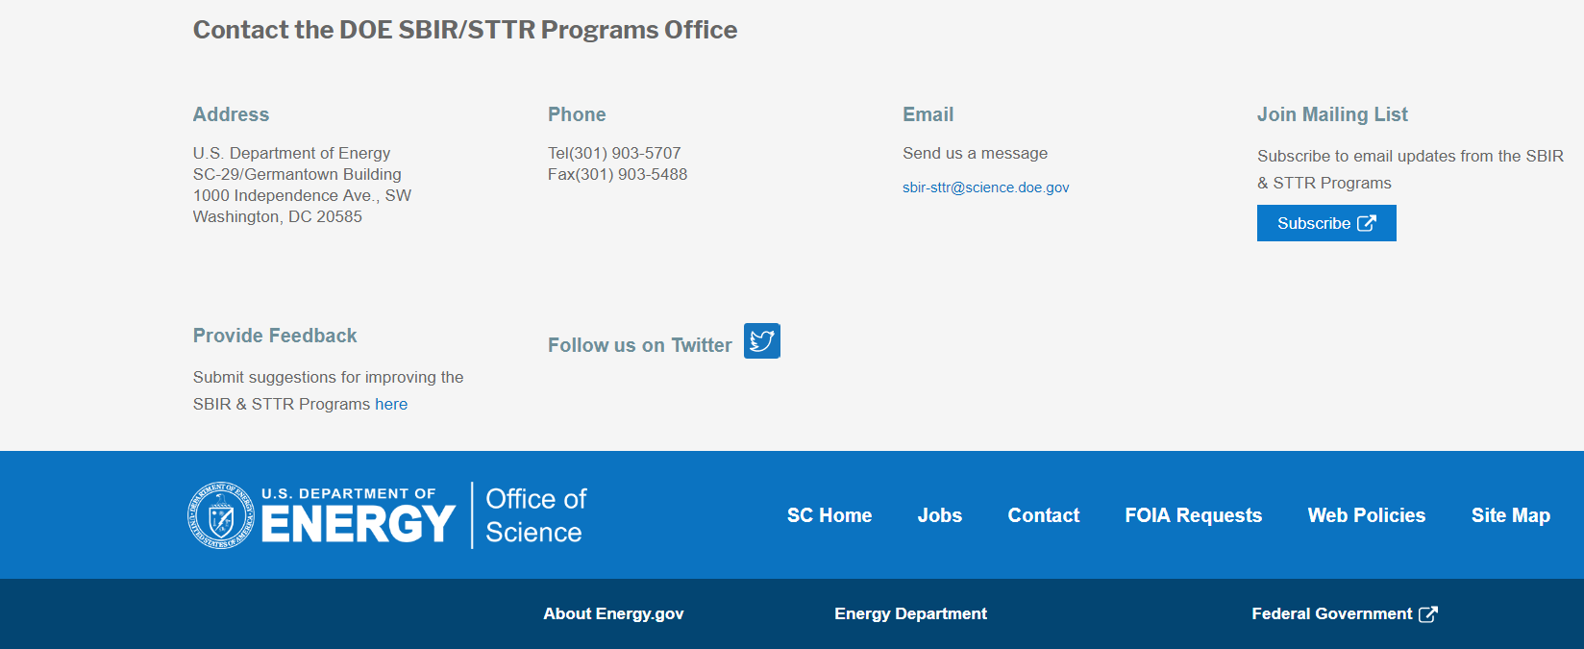
Funding Opportunity Announcement (FOA) Webinar
FY22 Phase I Release 2 FOA will be issued on December 13th
Join our Mailing List – this field is on every DOE SBIR/STTR web page
  Following the issuance of the FOA, look for an email with a link to the FOA
Webinar with Q&A for this FOA on December 17th
  Overview of the FY 2022 DOE SBIR/STTR Programs
    Following the issuance of the FOA, look for an email announcing this webinar

Slide 7
Topic Basics
Topics are created by DOE program managers and define important technology breakthroughs needed in R&D areas that support the DOE mission
Topics are organized by DOE Program Office, e.g., ASCR, BES, etc.
DOE program managers are listed with each subtopic
  Questions to DOE program managers are limited to clarification of the topic and subtopic (including references)
  Clarification is provided to help you determine whether your technology fits within the topic and subtopic
  You may communicate with these topic managers from the release of topics until the grant application due date
  The decision to apply is yours

Slide 8
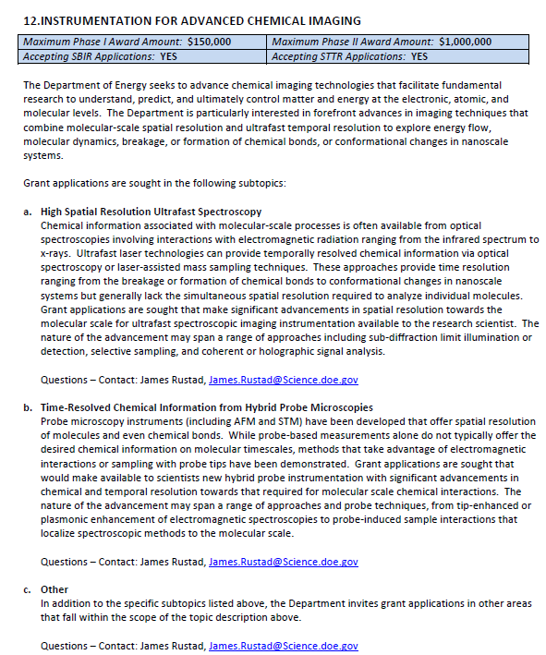
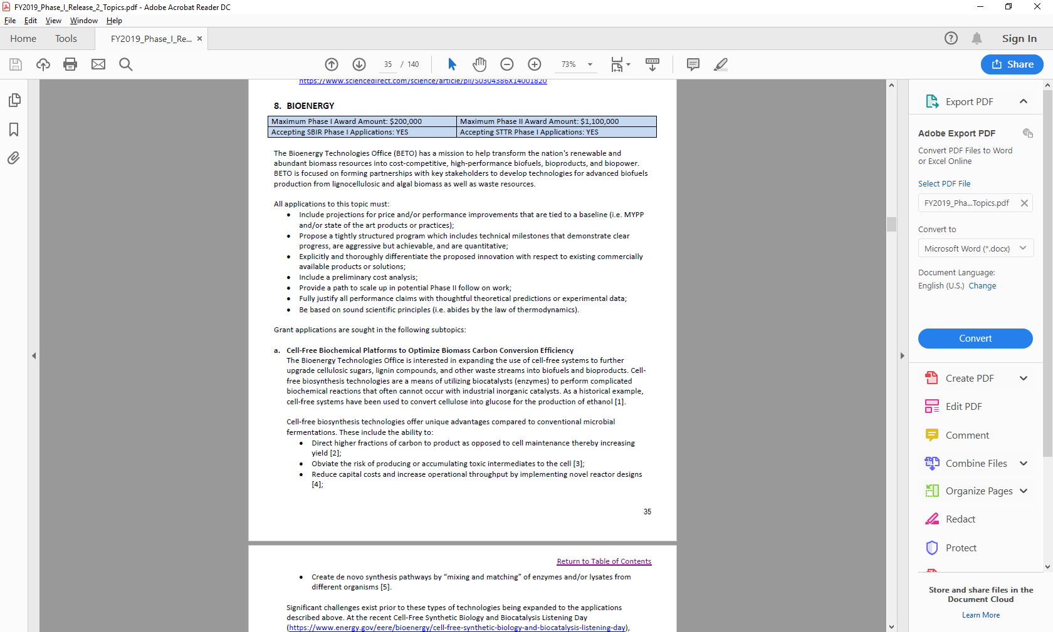
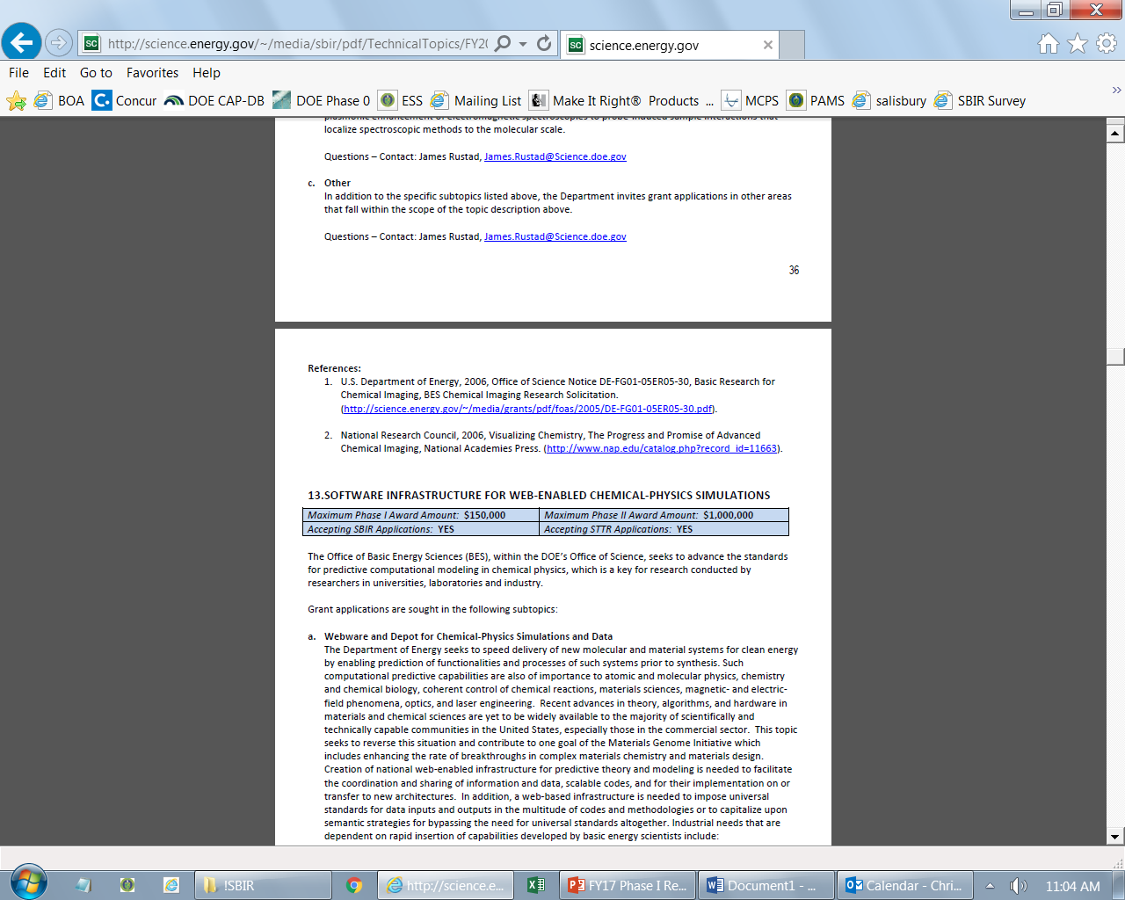
Example Topic
Topic & Subtopic
  You must specify the same topic and subtopic in your Letter of Intent and grant application
Topic Header
  Lists the maximum award amounts for Phase I & Phase II and the types of application accepted (SBIR and/or STTR)
Program Manager
  Each subtopic lists the responsible DOE program manager
“Other” Subtopic
References
Notes:
Here is an example topic from our current announcement. Note that every SBIR or STTR application must include the topic and subtopic to which you are applying. The general topic description describes the general field of technology that is of interest. The subtopics describe specific opportunities in which proposals are requested. Each topic at DOE will also have an “other” subtopic. Under this subtopic you can submit proposals that fall within the general topic description, but do not fit with any of the other subtopics. We have found that when we write the subtopics too narrow sometimes we miss good opportunities, and this “other” subtopic is a means collecting disruptive solutions.

Slide 9
Topic 01: ENERGY SYSTEMS CYBERSECURITY
Maximum Phase I Award Amount: $200,000 | Maximum Phase II Award Amount: $1,100,000
Accepting SBIR Phase I Applications: YES | Accepting STTR Phase I Applications: NO
a. Actionable Cyber Intelligence
Questions: Walter Yamben, Walter.Yamben@netl.doe.gov

Slide 10
Topic 02: ALTERNATIVE RADIOLOGICAL SOURCE TECHNOLOGIES
Maximum Phase I Award Amount: $200,000 | Maximum Phase II Award Amount: $1,100,000
Accepting SBIR Phase I Applications: YES | Accepting STTR Phase I Applications: NO
Novel Non-Radioisotopic Technology for Industrial Radiography
Novel Non-Radioisotopic Technology for Well Logging
Other
Questions: Hank Zhu, hongguo.zhu@nnsa.doe.gov

Slide 11
Topic 03: RADIATION DETECTION MATERIALS
Maximum Phase I Award Amount: $200,000 | Maximum Phase II Award Amount: $1,100,000
Accepting SBIR Phase I Applications: YES | Accepting STTR Phase I Applications: NO
Large Size, Low-Cost Scintillation Materials for Gamma-Ray Spectroscopy in Portal Monitors
Other
Questions: Hank Zhu, hongguo.zhu@nnsa.doe.gov

Slide 12
Topic 04: ADDITIVE MANUFACTURING TECHNIQUES FOR SPACE APPLICATIONS
Maximum Phase I Award Amount: $200,000 | Maximum Phase II Award Amount: $1,100,000
Accepting SBIR Phase I Applications: YES | Accepting STTR Phase I Applications: NO
Shielding of Electronic Circuits from Space Radiation via Additive Manufacturing
Space Qualified Printed Circuit Boards Produced Via Additive Manufacturing
Other
Questions: Major Adam Rich, adam.rich@nnsa.doe.gov

Slide 13
Topic 05: ADVANCED GRID TECHNOLOGIES
Maximum Phase I Award Amount: $200,000 | Maximum Phase II Award Amount: $1,100,000
Accepting SBIR Phase I Applications: YES | Accepting STTR Phase I Applications: NO
Advanced Protective Relaying Technologies and Tools
Methods for Predicting Performance of Power Electronics Technologies
Questions: Subtopic a – David Howard, david.howard@hq.doe.gov
Questions: Subtopic b – Vinod Siberry, vinod.siberry@hq.doe.gov

Slide 14
Topic 06: ADVANCED ENERGY STORAGE AND POWER CONVERSION SYSTEM FOR ENERGY EQUITY
Maximum Phase I Award Amount: $200,000 | Maximum Phase II Award Amount: $1,100,000
Accepting SBIR Phase I Applications: YES | Accepting STTR Phase I Applications: NO
Adaptable, Deployable, and Robust Power Conversion System for Energy Storage Used by Disadvantaged Off-grid Communities
Questions: Imre Gyuk, imre.gyuk@hq.doe.gov

Slide 15
Topic 21: INNOVATIVE ENERGY SYSTEMS
Maximum Phase I Award Amount: $250,000 | Maximum Phase II Award Amount: $1,600,000
Accepting SBIR Phase I Applications: YES | Accepting STTR Phase I Applications: YES
Advanced Sensors and Instrumentation for Online Measurement of Hydrogen and Natural Gas Fuels for Gas Turbines
Ammonia Reforming for Gas Turbine Applications
Hydrogen Burners for Industrial Application
Processing Methods to Manufacture High-Quality, Low-Cost Silicon Carbide (SiC) Fibers
Improved Lifing Models for CMC
Questions: Subtopics a & c – Richard Dalton, richard.dalton@netl.doe.gov
Questions: Subtopic b – Matt Adams, matthew.f.adams@netl.doe.gov
Questions: Subtopics d & e – Adam Payne, adam.payne@netl.doe.gov

Slide 16
Topic 21: INNOVATIVE ENERGY SYSTEMS (CONTINUED)
Maximum Phase I Award Amount: $250,000 | Maximum Phase II Award Amount: $1,600,000
Accepting SBIR Phase I Applications: YES | Accepting STTR Phase I Applications: NO
Component Technology Advancement in Coal Waste and Biomass Gasification Systems
High Performance Hydrogen Electrodes in Solid Oxide Electrolysis Cells using Atomic Layer Deposition (ALD) Technique
Other
Questions: Subtopics f & h – Evelyn Lopez, evelyn.lopez@netl.doe.gov
Questions: Subtopic g – Patcharin Burke, Patcharin.Burke@netl.doe.gov

Slide 17
Topic 22: CARBON CAPTURE AND REMOVAL
Maximum Phase I Award Amount: $250,000 | Maximum Phase II Award Amount: $1,600,000
Accepting SBIR Phase I Applications: YES | Accepting STTR Phase I Applications: YES
Novel Carbon Capture Technologies Employing Waste Heat in Regeneration of Materials Used in Direct Air Capture
Highly Efficient Materials and Processes to Support Disruptive Carbon Capture Technologies for Natural Gas Combined Cycle Power Plants
Novel Technologies for Mitigation of Process CO2 Emissions in the Cement/Steel Sector
Highly Efficient Carbon Capture Technologies for Production of Hydrogen from Natural Gas
Quantification of Ancillary Environmental Benefits of Transformational Carbon Capture Technologies
Other
Questions: Subtopic a – Dustin Brown, dustin.brown@netl.doe.gov
Questions: Subtopic b – Nicole Klingensmith, nicole.shamitko-klingensmith@netl.doe.gov
Questions: Subtopic c – Mariah Richardson, mariah.richardson@netl.doe.gov
Questions: Subtopics d & e – Elliot Roth, elliot.roth@netl.doe.gov
Questions: Subtopic f – Zachary Roberts, zachary.roberts@netl.doe.gov

Slide 18
Topic 23: CARBON MANAGEMENT
Maximum Phase I Award Amount: $250,000 | Maximum Phase II Award Amount: $1,600,000
Accepting SBIR Phase I Applications: YES | Accepting STTR Phase I Applications: YES
Production of Carbon-Metal Composites Incorporating Coal-Derived Materials
Conversion of CO2 into Plastics
Technology Innovations for Efficient and Effective Passive Seismic Monitoring During Carbon Storage Site Characterization
Other
Questions: Subtopic a – Brett Hakey, brett.hakey@netl.doe.gov
Questions: Subtopics b & d – Naomi O’Neil, naomi.oneil@netl.doe.gov
Questions: Subtopic c – Natalie Iannacchione, natalie.iannacchione@netl.doe.gov

Slide 19
DOE SBIR/STTR Programs Office
Contact Information
Join our mailing list: https://science.osti.gov/sbir
Follow us on twitter: @DOESBIR
Follow us on LinkedIn: U.S. Department of Energy (DOE) SBIR/STTR Programs | LinkedIn
Phase 0 Application Assistance: https://doephase0.dawnbreaker.com/
Email: sbir-sttr@science.doe.gov
Phone: (301) 903-5707

